Slide 1
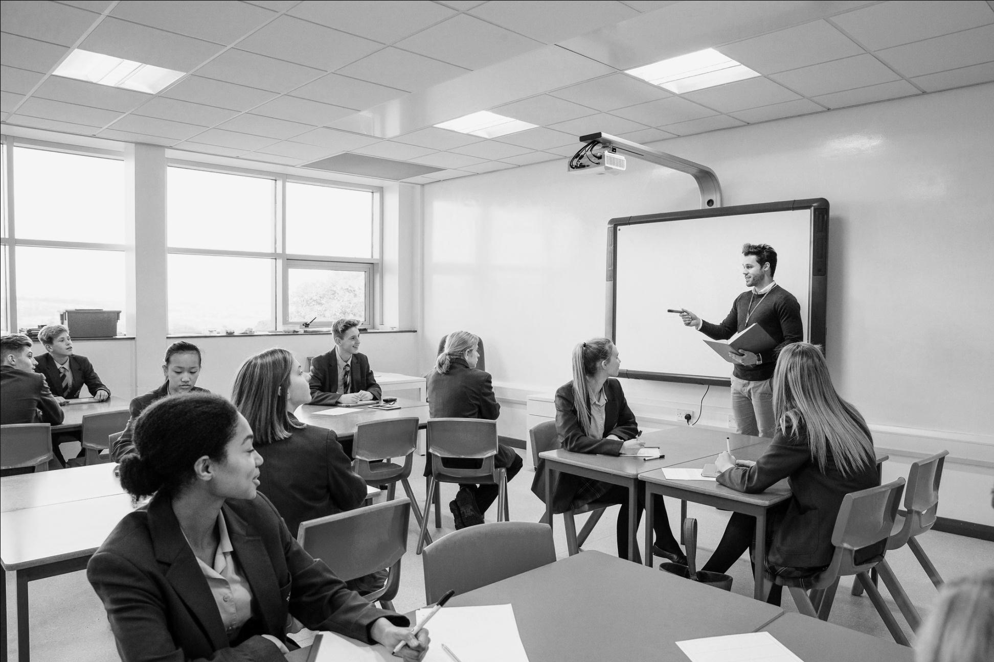
GOOD POWERPOINT
AND ACADEMIC PRESENTATION

Slide 2
Agenda
Presentation and Academic Presentation
Types of academic presentation
A Good Powerpoint
How to have a good academic presentation
Preparation for academic presentation

Slide 3

A presentation is an activity that includes people with the purpose of making a point, educating, or sharing information.
It may additionally have supporting visual tools such as slides, projection, flip charts, or whiteboard.

Slide 4

Academic presentation simply differs from a common presentation because it includes research, so you need to cite a reference. In academic presentation, you need to prove that what you are explaining is relevant, correct, and valid.

Slide 5
Types of Academic Presentation
Academic Presentation in Class
Conference Presentation
Job Presentation
etc

Slide 6
How to have a Good Powerpoint
Presentation slides should convey ideas, not details
Presentation is not similar to reading the paper
The purpose of presentation is to present the points of material with visually attractive way
Do not need to write a complete sentence
Use large fonts
Use color to emphasize main points
Tables and graphs must be simple and understandable

Slide 7
How to Deliver
Make an eye contact not only with one person
Speak loudly enough that the person in the back row can hear your voice
Use the laser pointer (if you need it to make it clearer)
Natural but professional, not like a news anchor
Energetic, but not over-bearing and communicative
Practice

Slide 8
Handling Questions
Repeat each questions so the audience remember what you have been asked
Be respectful eventhough the question is out of the scope. Give the best response.
Finish your answer by asking the person whether or not you have answered the question sufficiently for them.
e.g: does my explanation answer your question enough?

Slide 9
Mini Quiz
What do you now about power point?
What do you think a power point is for?
How do you think about a good power point?
Mention how a good power point can be used the best.
Search an information about making a good power point. Mention at least three points in the next online meeting.

Slide 10
Homework
Choose 1 problem which happened in our campus (A,B,or C) and think about possible solutions.
Make a powerpoint. Upload it in AULA.

