Slide 1

PERSUASIVE SPEECH
PERSUASIVE SPEECH
YUNI SARI AMALIA, Ph.D

Slide 2
What is Persuasive Speech?
Persuasive speech is a specific type of speech that is delivered with a purpose. The speaker communicates with an audience to accomplish specific goals, to ensure the audience accepts his or her point of view.
A type of communication that intends to bring about a change in others.
The speaker has a goal of convincing the audience to accept his or her point of view.

Slide 3
Persuasive vs. Informative Speech
Informative (or informational) and persuasive speaking are related, but distinct, types of speeches. The difference between the two lies in the speaker’s end goal and what the speaker wants the audience to leave with.

Slide 4
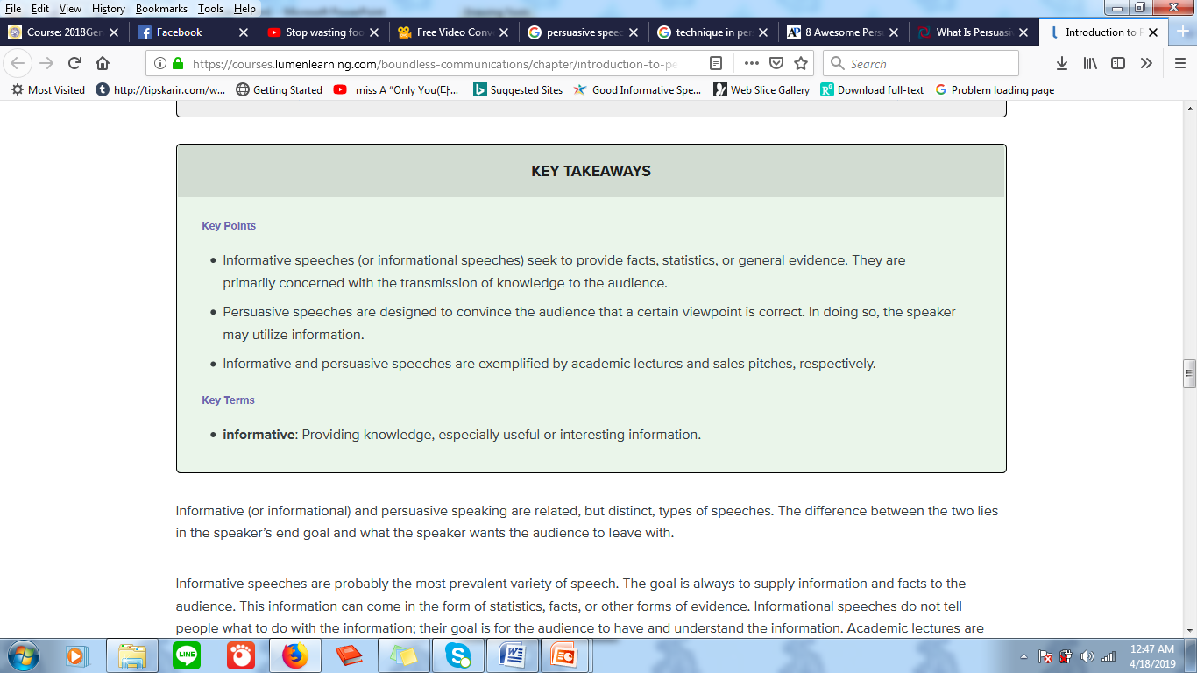
Source: https://courses.lumenlearning.com/boundless-communications/chapter/introduction-to-persuasive- speaking/

Slide 5
Purposes of Persuasive Speech
1. To urge a choice among options.
2. Persuaders act as advocates for a cause or point of view.
3. To use supporting materials as evidence that justified advice.
4. Persuaded listeners become agents of change.
5. Asks for audience commitment to a cause
6. Establishes character and commitment of speaker through leadership
7. Makes appeals to feelings
8. Makes us confront our obligation to believe and act in socially and morally responsive ways.

Slide 6
Method of Persuasive Speech
Aristotle believed there were three forms of proof:
Credibility : showing people that the speaker knows exactly what he or she wishes to communicate.
Emotional Appeal : a major component of persuasive speech, followed by the most eloquent speakers.
Logical Appeal : provide evidence and reasons to support the appeal.
Other supportive factors : The body language, voice of the speaker, confidence levels, knowledge, the environment and others

Slide 7
Types of Evidence to use in
Persuasive Speeches:
Facts, figures, statistics
Use examples from “real life”
Narratives—make your audience witness to a living drama
Use Expert Testimony/Witnesses
  When you quote others, you are associating yourself with them, so be careful whom you choose!
  Reluctant witnesses are those who testify against their apparent self-interest and so are often more powerful (such as Democratic critics of a Democratic president).

Slide 8
Constructing an Argument
Create an Awareness of the problem/issue
Create an understanding of the issue/problem
Offer a solution/plan/action that would address the issue or solve the problem
Enactment

Slide 9
Example of Recent Issues
Bullying
Hate Speech
Election Day/Post-Election
Health
Environment
Religion Issue
Etc
*topics are already decided for each of students by using lottery.

Slide 10

Video Link

Slide 11
Video Link
Stop Wasting Food
https://www.youtube.com/watch?v=dIIhbjY4s8A
Persuasive Speech
https://www.youtube.com/watch?v=jnfoFN7TBhw&t=111s

Slide 12
References
https://persuasivespeechideas.org/what-is-persuasive-speech-importance-of-persuasion-in-business-and-life/
https://courses.lumenlearning.com/boundless-communications/chapter/introduction-to-persuasive-speaking/
https://www.wsfcs.k12.nc.us/cms/lib/.../Centricity/.../The%20Persuasive%20Speech.pptx/

Slide 13
Assignment 1(Class Assignment)
Choose a topic about a recent issue.
Create one minute persuasive speech.
Present it in this online meeting.
Lecturer will choose the student randomly.

Slide 14
Assignment 2 (For next week)
Choose one of topics
Make a draft of a persuasive speech
  - topic
  - opening, body, closing
  - give some proves to support your arguments
Make a persuasive speech presentation/video (3-7 mins)
Upload it in AULA

