Slide 1





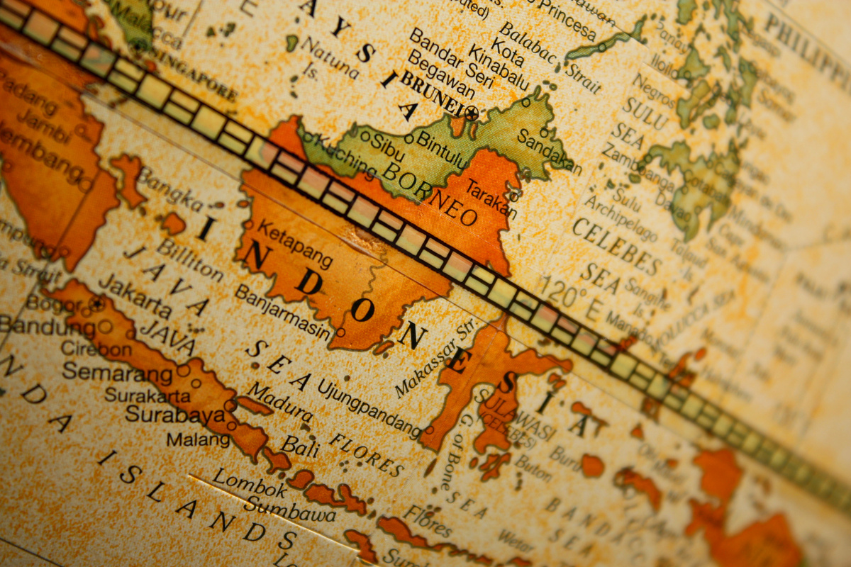









UNIT 1
Indonesia as an
Archipelagic
Country

Slide 2
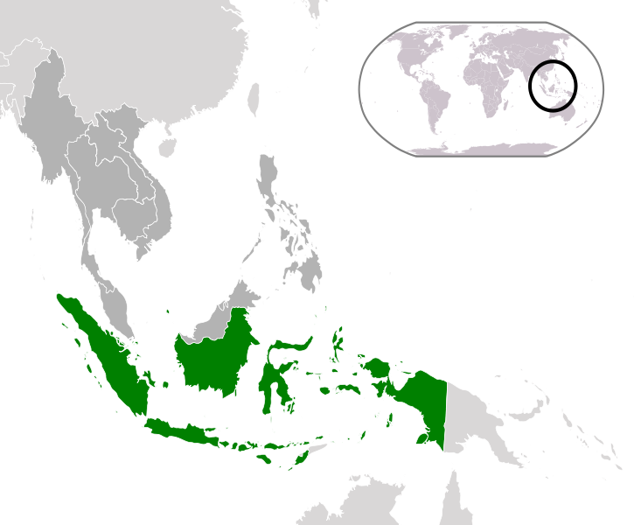





As the largest archipelagic country in
the world, Indonesia consists of a big
number of islands. The data released
by the Indonesian Ministry of Maritime
and Fishery, which was based from
the latest report in 2020, mentions
that there are 16.771 islands in the
area. Out of these number, five
islands are considered to be the
biggest and major ones. These are
Java, Sumatra, Kalimantan, Sulawesi,
and Papua.

Slide 3


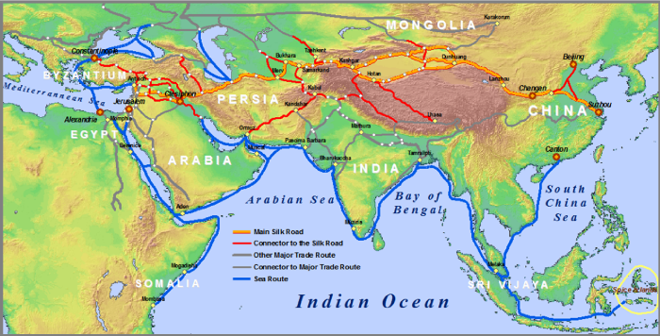

Indonesia is located between the Indian and Pacific Oceans in
Southeast Asia, linking mainland Asia with the Pacific world. This
strategic location enables it to be the melting pot of highly varied
ethnicities from all around the world.
Jalur Sutra, source: Geostrategic

Slide 4
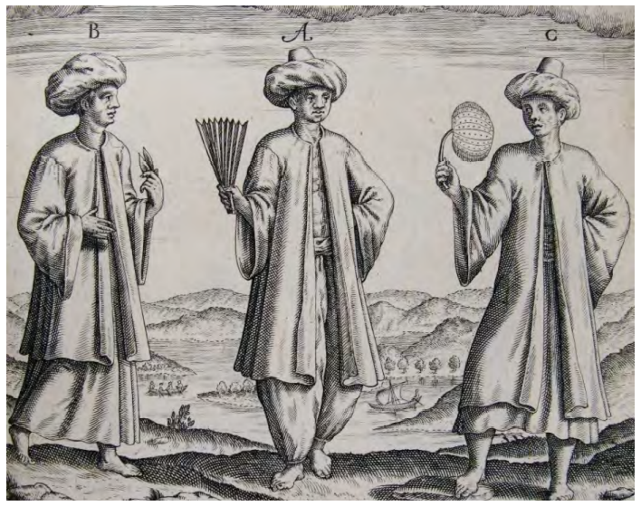
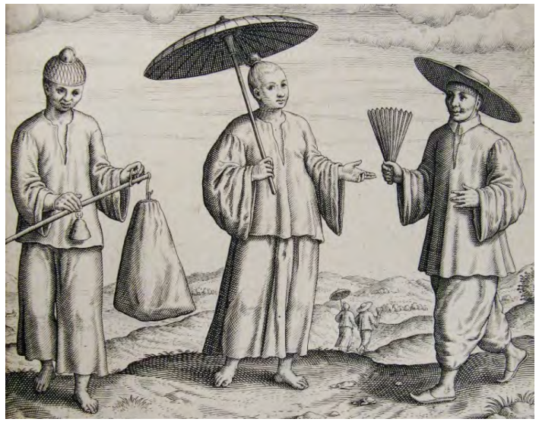

In their genetic study on Indonesia, Meryanne K. Tumonggor and her
colleagues found that Indonesia hosts a wide range of linguistic, ethnic, and
genetic diversity. Their study on the genetic composition of Indonesians
identifies that there have been historic contacts from Chinese, Indians, Arabs
and Europeans taking place during the period of 50.000 years in the site
that is now known as Indonesia.
(Rouffaer dan Ijzerman, 1915 (Deerste Boek):120-121)

Slide 5


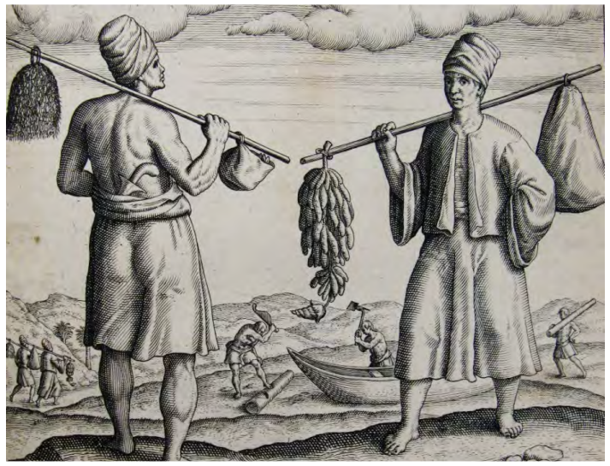
For hundred years before the period of Dutch
colonization and the formalization of nation state,
sea had been playing an important role in the life of
people in the archipelago. Coastal areas or pesisir,
were considered to be the centres, not the
peripheries. Anything related to sea had been the
central basis of people’s life. An example can be
taken from the sea cultures of Bugis people (South
Sulawesi), who had been well known for their sea
navigation skill. Parimartha noted that some of
Bugis’ astonishing skill include the detailed
tabulation of monsoon patterns, as well as the
rhythms of the winds and local seas. The tabulations
were useful for the livelihoods of Bugis people, as
they became the basis of deciding when it was safe
to sail to catch fish, meet their business partners in
other parts of the globe, and other activities that
affected their wellbeing.

Slide 6
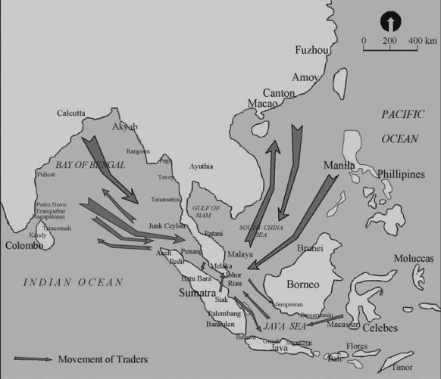
Geographical identities of the
archipelago in the past were
often defined by the connection
with water. The hulu/hilir
distinctions, for example, have
been noted in pre-colonial
Sumatra, Sulawesi and
Kalimantan. These
geographical markers were
often translated into upland
and lowland respectively. They
were also part of a pattern that
was common in the neighboring
areas, such as the Philippines
and the Malay Peninsula.

Slide 7
Many sources have
documented that the vast
array of water and sea has
made people easily
connected by sea. Rather
than being a separator, sea
was seen more as a
connector. The cultures
related to motion and
migration have become
closely connected to people
living in the muara or hilir.
The tradition of merantau or
non-permanent migration
(Kato 1982) has been
developed in the hulu area in
Sumatra so that they are
encouraged to find better
living in the hilir.

Slide 8



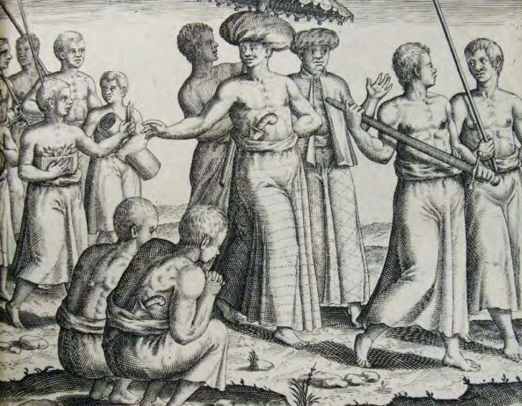
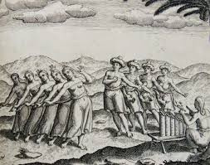

The openness and
cosmopolitanism of pre-colonial
Indonesia, which was supported
by sea trade, are illustrated in
the images made by Theodorus
de Bry and his two sons in their
works Icones Indiae Orientalis in
1601. This work illustrates the life
in India and the East Indies (the
name of the archipelago that is
now known as Indonesia), and is
considered to be one of early
works about East Indies in Europe.

Slide 9
As Farish Noor noted in his
article written in 2014, images
about Banten (a coastal city in
West Java) port in the 16th
century display the pluralism and
cosmopolitanism of the East
Indies. These images show how
ethnically varied the traders
were during the business
activities. The Arabs, Persians,
Turks, Chinese, Burmese, and
Malays were captured in the
images, mingling well and
showing harmonious relationship.

Slide 10
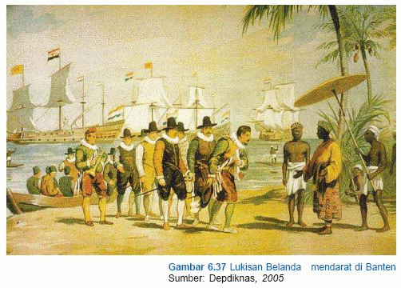

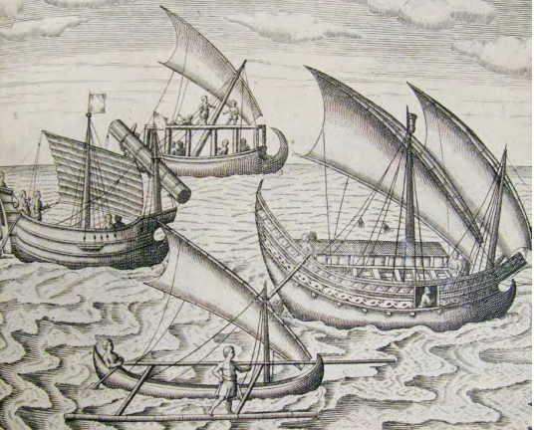

Blusse (2013) in his study
also shows the maritime
power of the archipelago in
Southeast Asia before the
arrival of Europeans. During
that time, major and minor
ports thrived and the region
was the centre of a
complex network of trading
routes, bringing goods from
the interior rivers and
connecting these with the
sea ports that linked across
the region and beyond.
Port of Banten

Slide 11
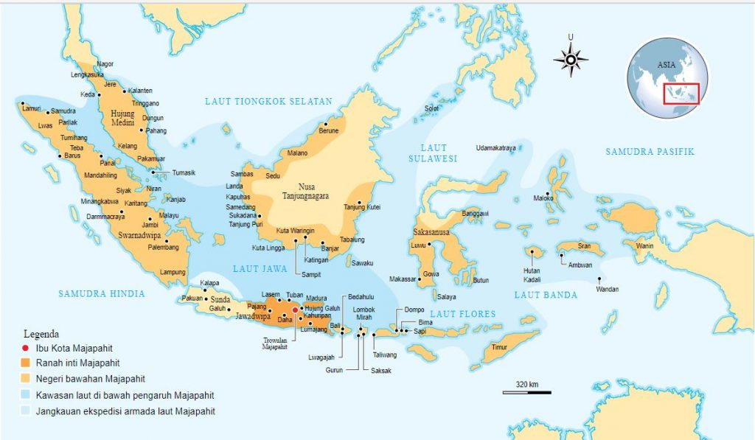


The Glory of Majapahit and Sriwijaya
The importance of sea for
Indonesia can be seen in the
motto Jalasveva Jayamahe (Our
Glory is at the Seas). This is
Indonesian Navy’s motto, which
was originally created during the
Majapahit era to ignite the spirit
of Majapahit soldiers in the
fights against the enemy on the
waters. It is also manifest in the
motto “Nenek moyangku seorang
pelaut” (my ancestors were
seafarers). Two great kingdoms
in the archipelago, namely
Majapahit and Sriwijaya, are
well-known as dominant rulers in
Southeast Asia during 13th–16th
century and 7th to 13th century
respectively.

Slide 12
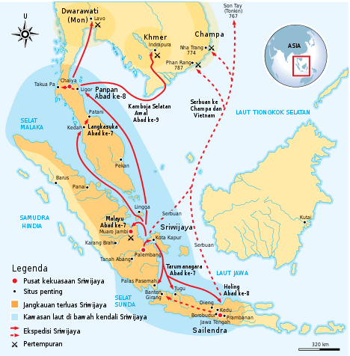
The Glory of Majapahit and Sriwijaya
The importance of sea for
Indonesia can be seen in the
motto Jalasveva Jayamahe (Our
Glory is at the Seas). This is
Indonesian Navy’s motto, which
was originally created during the
Majapahit era to ignite the spirit
of Majapahit soldiers in the
fights against the enemy on the
waters. It is also manifest in the
motto “Nenek moyangku seorang
pelaut” (my ancestors were
seafarers). Two great kingdoms
in the archipelago, namely
Majapahit and Sriwijaya, are
well-known as dominant rulers in
Southeast Asia during 13th–16th
century and 7th to 13th century
respectively.

Slide 13

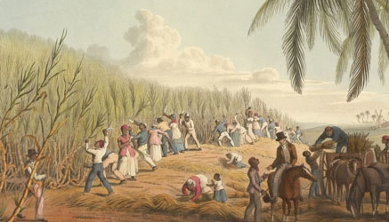


Unfortunately, Indonesians’ way of life and
the national development tend to be
based on land cultures, instead of maritime
or sea-based cultures. This land paradigm
to some extent has been influenced by
European colonialism. The application of
Cultuur Stelsel (Forced Cultivation System/
tanam paksa) in the nineteenth century
reflects this land-based policy.
Source: Dokumentasi PTPN

Slide 14
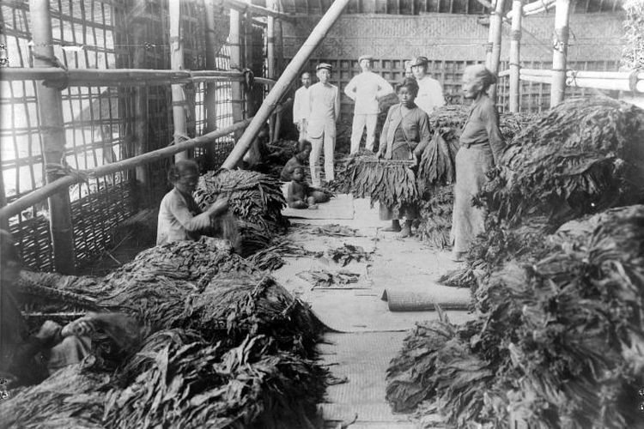
Under the application of this colonial
policy, the natives were forced to plant
specific crops that were exported and
gave financial benefits to the colonial
government. This land-based economic
activities forced the natives to shift their
maritime cultures to agricultural ones. Thus,
the maritime spirit (jiwa bahari) which had
become the pride of the Indonesians for
hundreds of years was eliminated.
Source: TropenMuseum

Slide 15
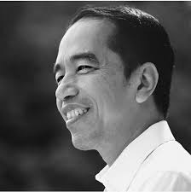
Under Jokowi’s presidency, there have been attempts to
revitalize Indonesia’s past maritime glory. It is visible in the
president’s first-term rule. This vision was called the World
Maritime Axis (Poros Maritim Dunia). This was stated in the
President’s Regulation number 16 2017.
The Indonesian Maritime Regulation states that PMD aims
to make Indonesia as an advanced, independent, and
strong country. By declaring as a maritime state, Indonesia
has to be able to make the best use of its maritime
potentials in the fields of economy, security, and defense.

Slide 16

Blusse, Leonard.2013. “Port Cities of Southeast Asia: 1400-1800”, in : Peter Clark (ed.). The Oxford Handbook of Cities in World History, pp. 346-363. Oxford: Oxford University Press.
References
Kato, T. Matriliny and Migration: Evolving Minangkabau Traditions in Indonesia, Ithaca: Cornell University Press 1982.

