Slide 1
COMBINING SOURCES
(Synthesis)
Read Meeting 9 of your Learning Materials
English Department
Faculty of Humanities
AIRLANGGA UNIVERSITY

Slide 2
What is Synthesis?
Most academic/scientific writings require the writer to read more than one book or article. The differences between the ideas of different authors may be the focus of the writing. The way a writer combines sources in particular manners in his/her writing is called synthesis.

Slide 3
Synthesis vs. Summary
In a summary, you share the key points from an individual source and then move on and summarize another source.
In synthesis, you need to combine the information from those multiple sources and add your own analysis of the literature.
This means that each of yourparagraphs will include multiple sources and citations, as well as your own ideas and voice.

Slide 4
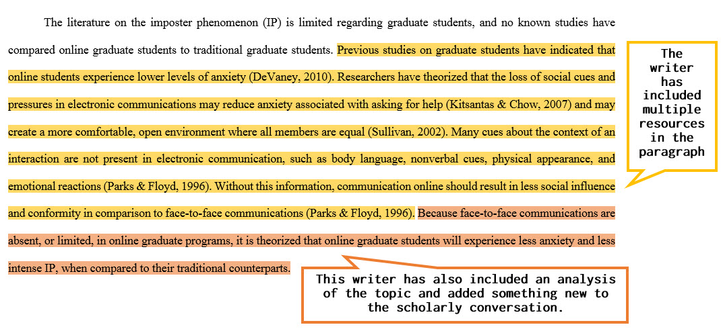
Example of Synthesis
(read Meeting 9 of your Learning Materials for more examples)

Slide 5
What Do You Synthesize?
The key to a good synthesis is to be organized as you’re researching and reading sources on your topic.
One way to organize your research is to use a synthesis matrix.

Slide 6
SYNTHESIS MATRIX
  It is a table/chart that can be used to organize research.
  In the chart, you can record your sources and main ideas on the topic.
When completed, it provides a visual representation of your research and help you to see how sources are connected.

Slide 7
How to Create a Matrix?
A matrix should be able to help you to answer the following questions:
Do any authors disagree with another author?
Does one author extend the research of another author?
Are the authors all in agreement?
Does any author raise new questions or ideas about the topic?

Slide 8
How to Create a Matrix?: Create a Table
 | Theme #1 | Theme #2 | Theme #3
Source #1
Source #2
Source #3

Slide 9
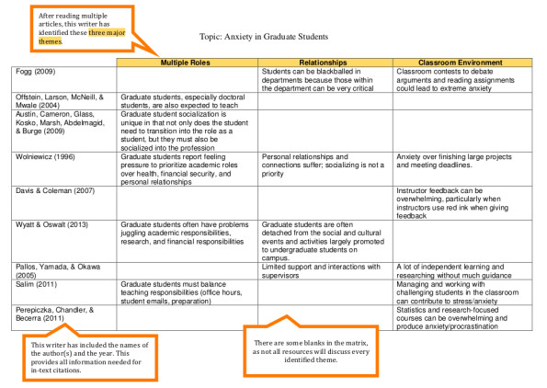
How to Create a Matrix?: SAMPLE

Slide 10
THANK YOU
Most of the information in this presentation is taken from https://writingcenter.ashford.edu/synthesis

