Slide 1
Culture, Communication and Representation

Slide 2
COMMUNICATION
PROCESS
Sender
Text
Receiver / Audience
Representation

Slide 3
THE SIGNIFICANCE OF COMMUNICATION RELATED TO CULTURE AND REPRESENTATION
Communication is a process how one individual (or a word, object, sign, gesture or similar) conveys meaning to another individual -> significantly involving representation through objects or actions.
Through language and communication we define and shape our social and cultural world by making meaning of our world, and convey these meanings to others

Slide 4
The Organization of Meaning

Slide 5
The Medium is the Message
(Marshal McLuhan)
Meaning based on content
Meaning based on context, form, or the medium through which it is delivered

Slide 6
First developed as sounds made to accompany facial expression and gestures (Newsom, 2007 and Goffman, 1959) => a social performance similar to acting on a stage as ‘impression management’ (Goffman, 1959)
Spoken
First developed as symbolic, usually artistic, representations (such as cave paintings and later hieroglyphics) (Newsom, 2007) => often be shaped by the ideologies or discourses of both the writer and the conventions associated with that type of document/publication
Written
Often give the impression of being neutral (after all, many would argue that ‘seeing is believing’), but just as prone to, and shaped by, ideologies and discourses as written or spoken texts
Visual

Slide 7
Ferdinand de Saussure Charles Peirce
(Swiss) (America)
Semiology Semeiotics
Semiotics
(The discipline studying signs which can represent the world – Umberto Eco)

Slide 8
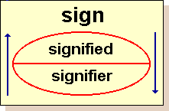
Sign / Dyadic model
SIGNIFIED - the idea being represented
SIGNIFIER - the word doing the representing
The sign is the whole that results from the association of the signifier with the signified

Slide 9
=the signifier
STOP!!!
=the signified

Slide 10




However, signfiers can have multiple signifieds. Take the color
red for example:
APPLE
FIRE
RED
Love
Blood

Slide 11
LANGUAGE IS …
➤ a patterned system (langue), which are relatively stable
➤ an actual speech (parole) that are much more fluid and dynamic
SIGNIFICATION -> RELATION OF SIGNS GENERATING MEANING
➤ Syntagmatically – the linear or sequential relations between signs
➤ Paradigmatically – the ‘vertical’ relations
SEMIOTICS (Ferdinand De Saussure) is structuralism -> developed effectively into poststructuralist by Roland Barthes

Slide 12
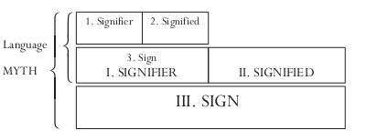
Roland Barthes’s Semiotics

Slide 13
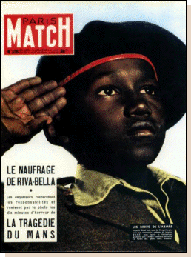

Slide 14
Myth
colonialism
militariness
Signifier + signified =
Young negro, in uniform, saluting,
With eyes uplifted, fixed
on the tricolor
sign (full)—denotation
([Black solider saluting
a French flag])
Patriotism/submission
primary signification:
Secondary signification
Sign (empty)/ Form
+ content = sign
--connotation: France as a
Great empire, loved by all her “sons.”

Slide 15
Structuralism and the Order of Meaning
Noam Chomsky => binary oppositions (conscious)
Lévi- Strauss => binary oppositions (not conscious) => deep structure – examining cultural forms as the result of the human mind being brought to bear on particular environments
Lévi-Strauss says that individuals have an innate biological capacity, what he calls a ‘bio-grammar’, which they use to ‘decode’ or interpret codes of cultural information
Lévi-Strauss says that everyone makes sense of the world at two distinct levels, namely deep structure where the binary oppositions operate and the surface level of contemporaneous activity where knowledge of a cultural code allows sorting and classifying to operate and meaning to emerge.

Slide 16
Hermeneutics and Interpretation
Hermeneutics argues that it is impossible to divorce the meaning of a text from the cultural context of its interpreter => but based on his / her certain prior understandings or foreunderstandings from their own culture.
‘Hermeneutic circle’ maintains that interpretation is not a simple one-way transmission of ideas from text to reader but it is rather an interactive process in which the reader’s fore-understandings are required for any further understanding of the text to be possible (Gadamer, 1975)
Karl Mannheim argues that a cultural act or text contains three levels of meaning: objective, expressive and documentary.

Slide 17
Goffman (1974) highlights how our social experiences are interpreted and understood through ‘frames’ of reference. Frames are basically cognitive tools that we subconsciously construct to help us make sense of a social situation.
Goffman also discusses at length the use of frame narratives. Narratives refer to the structured meanings within a story, which have a sense of sequence and causality strongly influenced by ideologies

Slide 18
Pierre Bourdieu (1984) also contributes to our understanding of social interactions and the meanings of communication through his discussion of ‘fields’ and ‘habitus’.
Fields for Bourdieu are the constituent parts of a society or ‘social space’ which will have its own habitus.
Bourdieu’s understanding of habitus is that this is embodied.
For both Bourdieu and Goffman meanings are shaped by existing frames of reference that social actors possess. However, these frames do not simply ‘appear’ ready-formed within individual heads, but rather it is important to recognise the role of ideology and the political economy in shaping these.

Slide 19
Jenkins (1992: 74) writes that habitus is Latin to mean ‘a habitual or typical condition, state or appearance, particularly of the body’ manifested in three ways:
Habitus only exists ‘inside the heads of actors’ – for instance, ways of behaving and modes of practice are learnt and internalised by social actors
Habitus only exists through the practice and actions of social actors – their ways of talking, moving, acting and behaviour.
Habitus is associated with the ‘practical taxonomies’ actors use to make sense of the world are all rooted in the body

Slide 20
Political Economy, Ideology, and Meaning
Political economy means that power and inequality are associated with the allocation of resources and the formation of wealth
What are the connections between ownership and control of the media and cultural transmission? What is the role of the economic infrastructure in the dissemination of ideas?
Antonio Gramsci divided up ideologies into three categories:
Common-sense => ideas and values as part of everyday life taken for granted - but either contradictory or very superficial. Ex. ‘Boys are better at football than girls’
Particular philosophy => the thought of a particular group of people in society who put forward a reasonably coherent set of ideas, such as traditional intellectuals (priests) and intellectuals from (trade unionists or political activists.
A dominant or hegemonic ideology=> one that has a leading role in society.

Slide 21
Poststructuralism and the Patterns of Meaning
Instead of binary oppositions, it suggests that there are much more complicated and ever-changing systems of meaning that need to be understood in their particular contexts => the meanings that things have are not fixed – they are fluid and changing
The solidity of the relationships that the political economy approach argues exist between economic relationships and cultural meanings => the relationships are both contingent and contextual
Poststructuralism highlights how meanings are not always intended, and that texts are polysemic (open to multiple readings)
Any text contains ‘multiple voices’ => ‘intertextuality’ (the relation of a given text to other texts) by Julia Kristeva’s (p. 149)

Slide 22
Postmodernism and Semiotics
Lyotard, the ‘founding fathers’ of postmodern social theory, rejects Marxism’s idea that society is based around technologies of production.
Lyotard suggests that social life revolves around language and discourse => changing nature of narrative in social life.
Lyotard suggests that in pre-industrial times, myths and stories had a religious quality and assisted in the reproduction of the social order => in the Enlightenment myths emphasised on progress and reason, knowledge and technology. In postmodern era, knowledge becomes more widespread and accessible, hence, there is a decline in belief of one truth or one knowledge.

Slide 23
Postmodernism and Semiotics
Derrida (1978) => the relationship between the signifier and the sign is now completely arbitrary and lacks any connection at all => Signs become free floating, without any link or relationship to an underlying reality.
Jean Baudrillard following Derrida, also sees signs as becoming free-floating, disconnected from reality => simulacra (an ‘image’ or representation of a person or thing, which lacks the substance or qualities of the original) = > leading to hyperreality (the blurring of distinctions between the real in the unreal and which the prefix ‘hyper’ signifies more real than real whereby the real is produced according to a model’)

Slide 24
Language, Representation, Power, and Inequality

Slide 25
Representation
Raymond Williams points to two meanings of ‘representation’, namely as ‘a symbol or image, or the process of presenting to the eye or the mind’
Representation vs Realism
Ang (1985) in her discussion of viewers’ reactions to the American soap Dallas shows, these representations may convey ideas and feelings that viewers feel to be subjectively real or important.

Slide 26
Language and Power
Cultural politics introduces the dimension of inequalities in power and authority in cultural forms and the contested nature of cultural practice => related with language use reflecting class, race or gender.
Language has become increasingly politicized and implicated in social struggles.
Benedict Anderson (1991) drew attention to the role of print languages in enabling the rise and spread of nationalism.
Street (1993) argues that the use of the word ‘one’ as in ‘one knows’ implies status

Slide 27
Language and Class
Basil Bernstein (1924–2000) => lower-class members of English society spoke a language that was restricted in comparison with the elaborated code of the middle classes
Bernstein’s depiction of the relationship between language and class is reminiscent of the Sapir–Whorf hypothesis => as lower- and middle-class groups occupying different ‘thought worlds’.
The privileging of one form of language against others is a political and not a linguistic act.

Slide 28
Language, Race, and Ethnicity
Labov (1972b) => the use of non-standard English by black youths, even their Black English Vernacular or BEV was different from that of middle-class speech forms
Speakers and writers of non-standard language may suffer the fate of others claiming to speak for them or of their own accounts of their situation being declared untrue or unworthy of attention
For example, writings from former colonial countries written in the metropolitan language have been declared not to be literature – due to (a) local variants of the metropolitan language are not legitimate for the writing of literature; (b) writing about colonial or postcolonial society from the experiences of native peoples is not a legitimate
Edward Said (1993) => cultural imperialism => how writers from metropolitan countries have, through their language, created an image of ‘other societies’ that is a product of language.

Slide 29
Language and Gender
Robin Lakoff (1975) => women’s speech is weaker than men’s, less decisive and functionally less useful.
Labov (1966) => women were more deferential and less assertive than men in language use. He even found that lower middle class women used fewer stigmatised forms than men of the same social class.
Men use competitive, aggressive speech while women’s speech is cooperative (Tannen 1990)
MALE TALK | FEMALE TALK
Hierarchies | Network
Independence | Intimacy
Information | Sharing
Superiority | Inferiority
Powerful | Powerless

Slide 30
Mass Communication and Representation

Slide 31
Mass Media Representations of Race and Ethnicity
Binary Opposition of White and Non-White in Indiana Jones Film (O’Shaughnessy 1999: 237)
Van Dijk (1991) => racism in the printed press (2700 news articles), primarily run and produced by white people conveying through this, dominant (often racist) ideological attitudes.
White | Non White
Civilized | Primitive
Sophisticated | Savage
Rational | Irrational
Scientific | Magical
Good | Evil

Slide 32
Mass Media Representations of Gender
Tuchman (1981) => ‘symbolic annihilation of women’ in popular culture – that is to say, either an absence, marginalisation or stereotyping of women in many aspects of popular culture, such as the mass media.
Though women take more active and prominent roles within the mass media – for example, journalists, television presenters and movie or digital game action heroes, such as Lara Croft (in both games and films) – women continue to be largely portrayed in the mass media as sexual objects, and/or fulfilling their traditional roles as wives, mothers and partners.
Tuchman (1981) suggests that the mass media reflects society, not as it really is, but rather how it would like to see itself.

Slide 33
Mass Media Representations of Celebrity
Three main and interrelated historical processes of being celebrity (Rojek, 2001):
The democratisation of society – which has increased our freedom of choice and allowed ‘ordinary’ people to rise to the status of celebrity.
The decline in organised religion – where in a Culture, communication and representation secular society celebrity culture replaces religious icons and role models.
The commodification of everyday life – where almost everything in life becomes commodified and purchasable, such as magazines which sell us insights into how to dress like celebrities, or celebrities themselves who sell us clothing ranges, perfumes or underwear bearing their names
‘Fame’ was once based upon success or achievement, contemporary celebrity is primarily a media creation or a ‘cultural fabrication’ (Rojek, 2001).
Three ‘types’ of celebrity (Rojek, 2001):
Ascribed celebrity – which is celebrity status that typically follows bloodline and biological dissent.
Achieved celebrity – derives from the (perceived) accomplishments of an individual in open competition.
Attributed celebrity – result of the representation of an individual as noteworthy or exceptional by cultural producers (such as the mass media), regardless of an individual’s actual talent or skill.
‘Celetoids’ => individuals who command media attention for only a very short period of time (Rojek, 2001)

Slide 34
Audiences
Audience members were frequently cast as ‘passive dopes’ (Theodor Adorno)
Audiences are not passive, but can actively ‘decode’ and engage with texts (Stuart Hall) into
the ‘dominant-hegemonic’
the ‘negotiated’
the‘oppositional’
Spectacle/Performance Paradigm => within an increasingly spectacular and performative society individuals become part of a ‘diffused audience’ => mass media as a resource of social performances, rendering us (and others) both performances, and audiences to others’ performances in our everyday lives.

Slide 35
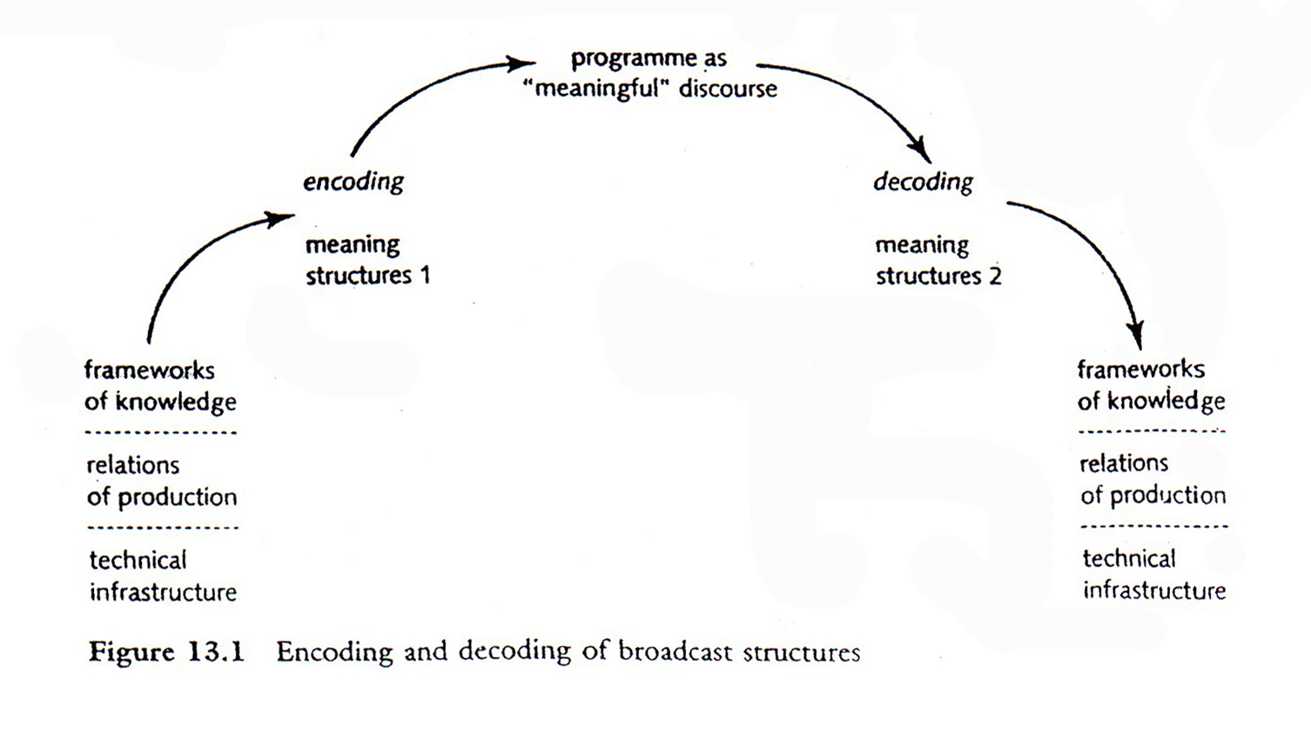
Encoding and Decoding Process

Slide 36
Conclusion

Slide 37
Communication => an extremely complex process => How the meanings attached to signs (such as words) are arbitrary, and hence language and meaning is not a straightforward and simple association.
The association between a sign and its meaning is a structured one (de Saussure, Chomsky and Lévi-Strauss), but hermeneutics, poststructuralism, and postmodernism, emphasise the more subjective and/or fluid nature of meanings in contemporary society.
There are also complexities involved in processes of representation => the power relations structuring gender, race and ethnicity and social class.
Mass media ‘messages’ need not always be accepted or encountered in the way they were intended, and that audiences have the ability to ‘decode’ and reinterpret ‘texts’.

