Slide 1

Multilingualism

Slide 2
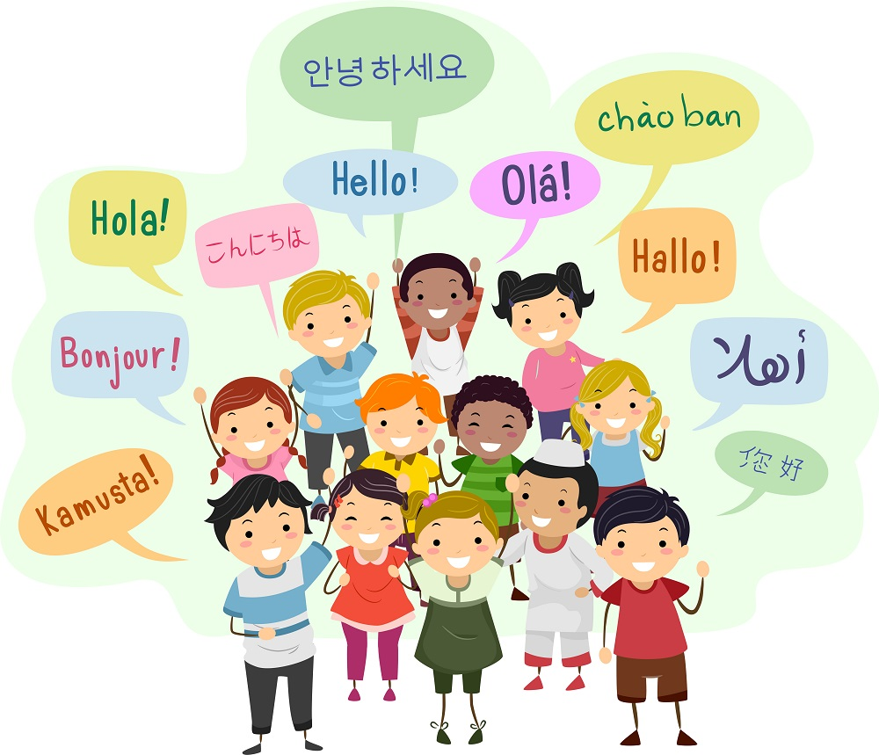

Slide 3
Monolingualism
knowing or being able to use only one language
Bilingualism
a phenomenon of speaking and understanding two languages
Multilingualism
the use of more than two languages, either used by an individual speaker or by a community of speakers
the act of using polyglotism, or using multiple languages
The people who can master more than two languages are called polyglot. In Greek, poly means ‘many’ and glot means ‘language’.

Slide 4
Li (2008)
“anyone who can communicate in more than one language, be it active (through speaking and writing) or passive (through listening and reading” (p. 4)
European Commission (2007)
“the ability of societies, institutions, groups and individuals to engage, on a regular basis, with more than one language in their day-to-day lives” (p. 6)

Slide 5
LANGUAGE ACQUISITION in multilingualism
Important differences in the experience of acquiring and using laguages
An individual can acquire the different languages by being exposed to second or additional languages later in life.
An individual can acquire the different languages simultaeusly by being expsed to two or more languages frm birth

Slide 6
Aronin and singleton (2008) compared the features of historical and contemporary multilingualism and reported some distinctions which can be clustered into three main areas:
Geographical
In comparison with the past, multilingualism is not limited to geographically close languages or to specific border areas or trade routes. It is a more global phenomenon spread over different parts of the world.
Social
Multilingualism is no longer associated with specific social strata, professions, or rituals. It is increasingly spread across different social classes, professions, and sociocultural activities.
Medium
In the past, multilingual communication was often limited to writing, and mail was slow. In the 21st century, because of the Internet, multilingual communication is multimodal and instantaneous.

Slide 7
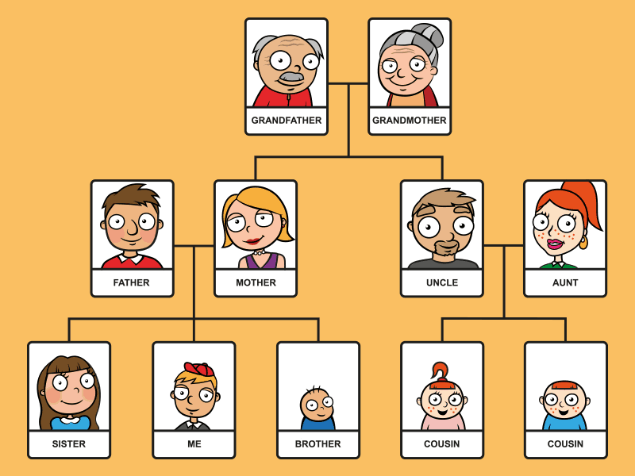

Slide 8
Types of multilingualism
Additive
a learning of second language which does not interfere with first language
For example: English speakers in the University often learn Javanese to upgrade their business skills.
Subtractive
a learning of second language which replaces the first language
For example: Successive US immigrant generations eventually become monolingual speakers.

Slide 9
THE BENEFITS of multilingualism
Enhance your communication skills
The more languages you know, the easier it is to talk to people, which consequently improves your communication skills.
Increase career opportunities
Speaking multiple languages has numerous employment benefits. Being multilingual means there are more job opportunities depending on the languages you speak.
Improve memory
People who speak multiple languages have better attention which has a positive impact on the memory skills of the people.

Slide 10
Multilingualism is a complex phenomenon that can be studied from different perspectives in disciplines such as linguistics, psycholinguistics, sociolinguistics, and education. (Cenoz, 2013: 4-5)

Slide 11
Research Themes in The Study of Multilingualism
Cognitive Outcomes of Multilingualism
Relationship Between Language and Thought in Multilinguals
Multilingual Language Processing
The Multilingual Brain
Cross-Linguistic Interaction
Multilingual Individuals
Multilingualism as a Social Construct
Multilingual Identities
Multilingual Practices

Slide 12
References
Cenos, J. 2013. Defining Multilingualism. Annual Review of Applied Linguistics, 33: 3–18.
Dewaele, J. 2015. Bilingualism and Multilingualism. The International Encyclopedia of Language and Social Interaction, First Edition.

Slide 13


