Slide 1

FORENSIC LINGUISTICS

Slide 2





Slide 3
What is Forensic Linguistics?
The application of linguistic knowledge to legal questions and issues (legal forum).
The interface between language, crime and law.
(Olsson, 2008)
Coulthard & Johnson (2010) argued that the linguist as expert in the legal process make an important contribution to the presentation of evidence.

Slide 4
What is Forensic Linguistics?
An expert’s opinion is called on where linguistic knowledge can assist the judge and jury in a particular case.
It is capable to provide expert evidence on language for police investigations or court hearings.
The forensic linguist examines courtrooms, particularly criminal ones, by analyzing talk from lawyers and witnesses.

Slide 5
The Border of Forensic Linguistics
DANIELEWICZ-BETZ (2012)
Phonetics;
Phonology;
Morphology;
Syntax;
Semantics;
Discourse analysis;
Pragmatics;
Psycholinguistics;
Neurolinguistics;
Sociolinguistics;
Dialectology;
Computational linguistics;
Corpus linguistics.

Slide 6
A Brief History of Forensic Linguistics
Forensic Linguistics is a relatively new discipline to the arena Fingerprint identification and shoeprint analysis are much older.
Early application of Forensic Linguistics in the United States related to the status of trademarks as words or phrases in the language.
McDonald – the attachment of the ‘Me’ prefix to unprotected words had been originated.
It was then popularizes and legitimized during the Unabomber case in the 70s in the United States.
In Australia, linguists began meeting in the 1980s to talk about application of Linguistics and Sociolinguistics to the legal process, in particular difficulties faced by Aboriginal suspects when being questioned by the police.

Slide 7
Forensic Linguistics Work field
Expert Witnesses
Prof. Dr. Bambang Kaswanti Purwo is one of the 16 expert witnesses in Basuki Tjahaja Purnama (Ahok) in 2017.
He is professor in Atma Jaya University, Jakarta.
Prof. Dr. Bambang is looking at how Ahok’s statement on his speech in Pramuka Island correlating with Al-Maidah 51 and blasphemy.

Slide 8
Forensic Linguistics Work field
FBI
According to FBI official YouTube channel, with Forensic Linguistics you could become Language Analyst.
Language analyst uses their linguistics knowledge to work with a team to defend the country against foreign counterintelligence threats, cases of corruption, espionage, cybercrime and other unlawful offenses.

Slide 9
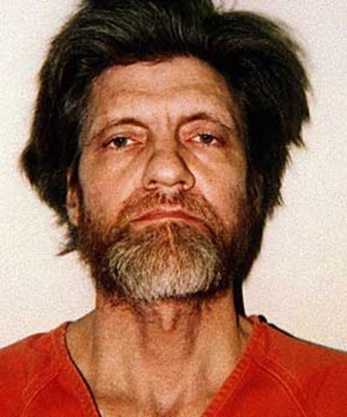
UNABOMER(1978-1996)
Found because of Linguistics
Real Name Ted Kaczynski;
Born May 22, 1942;
Accepted in Harvard on the age of 16;
1967 Work as teaching assistant for mathematic at University of California;

Slide 10
UNABOMER(1978-1996)
Found because of Linguistics
May 25, 1978 done the first bombing directed to Buckley Crist a professor of materials engineering at Northwestern University;
The other 13 bombs sent in irregular timing but has a pattern which are university student, university lecturer/professor, and Important person in airport;
Total fatalities are 3.

Slide 11
UNABOMER(1978-1996)
Found because of Linguistics
Got identified as male due to the word “chick” in his mail inside one of the bomb;
His arrest in 1995 makes Forensic Linguistics popular.

