Slide 1
LANGUAGE AND DIALECT

Slide 2
Language or dialect
Language:
Used to refer either to single linguistic norm or to a group of related norms
Used to mean both the super ordinate category and the standard variety
Dialect:
Used to refer to one of the norms
Used both for local varieties of English
Non standard and sub-ordinate to languages
Vernacular: refer to the language a person grows up with and uses in everyday life in ordinary, commonplace, social interaction.

Slide 3
1.
Mutual Intelligibity
Determining the language and dialect

Slide 4
Mutual intelligibity:
IF SPEAKERS CAN UNDERSTAND EACH OTHER, THEY ARE SPEAKING DIALECTS OF THE SAME LANGUAGE; IF THEY CANNOT, THEY ARE SPEAKING DIFFERENT LANGUAGES

Slide 5
The Problems
dialect continuum
distinct languages that are mutually intelligible
there are sometimes unintelligible
dialects which are identified by their speakers as being the same language
mutual intelligibility is not an objectively determined fact (Salzman et al. 2012, 170)

Slide 6
Power and Solidariy
The role of social identity

Slide 7
The various relationships among languages and dialects discussed above can be used to show how the concepts of power and solidarity help us understand what is happening.
Power
Power requires some kind of asymmetrical relationship between entities: one has more of something that is important, for example, status, money, influence, and so on, than the other or others
Solidarity
Solidarity, on the other hand, is a feeling of equality that people have with one another.

Slide 8
Standardization
Standardization refers to the process by which a language has been codified in some way. That process usually involves the development of such things as grammars, spelling books, and dictionaries, and possibly a literature

Slide 9
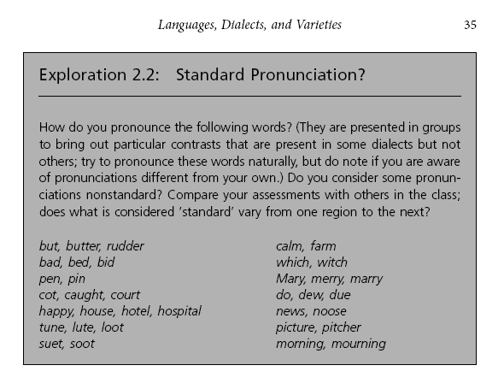

Slide 10
The standardization process
The standardization process itself performs a variety of functions (Mathiot and Garvin 1975).
It unifies individuals and groups within a larger community while at the same time separating the community that results from other communities.
Therefore, it can be employed to reflect and symbolize some kind of identity: regional, social, ethnic, or religious.
A standardized variety can also be used to give prestige to speakers, marking off those who employ it from those who do not, that is, those who continue to speak a nonstandard variety.

Slide 11
The standard and language change
The standardization process is necessarily an ongoing one for living languages.
The standardization process is also obviously one that attempts either to reduce or to eliminate diversity and variety.
However, it would appear that such diversity and variety are ‘natural’ to all languages, assuring them of their vitality and enabling them to change. To that extent, standardization imposes a strain on languages or, if not on the languages themselves, on those who take on the task of standardization.

Slide 12
Standard English?
It is not at all easy for us to define
Standard English because of a failure to
agree about the norm or norms that
should apply.

Slide 13
Trudgill (1995, 5–6) defines Standard English as the variety:
Usually used in print
Normally taught in schools
Learned by non-native speakers
Spoken by educated people
Used in news broadcasts

Slide 14
Standard English is constantly changing and developing. Trudgill also points out that the standard is not the same as formal language, as the standard can also be used colloquially
written Standard English is codified to the extent that the grammar and vocabulary of written varieties of English are much the same everywhere in the world: variation among local standards is really quite minor, so that the Singapore, South African, and Irish standard varieties are really very little different from one another so far as grammar and vocabulary are concerned.

Slide 15
Regional dialect
There may even be very distinctive local colorings in the language which you notice as you move from one location to another. Such distinctive varieties are usually called regional dialects of the language.

Slide 16
Dialect Continua
This use of the term dialect
to differentiate among
Regional varieties can be
confounded by what is
called a dialect continuum,
in which there is gradual
change of the language.
In such a distribution, which dialects can be classified together under one language, and how many such languages are there?

Slide 17
Dialect Geography
When a language is recognized as being spoken in different varieties, the issue becomes one of deciding how many varieties and how to classify each variety.
Dialect geography is the term used to describe attempts made to map the distributions of various linguistic features so as to show their geographical provenance.

