Slide 1

What is Pragmatics?

Slide 2

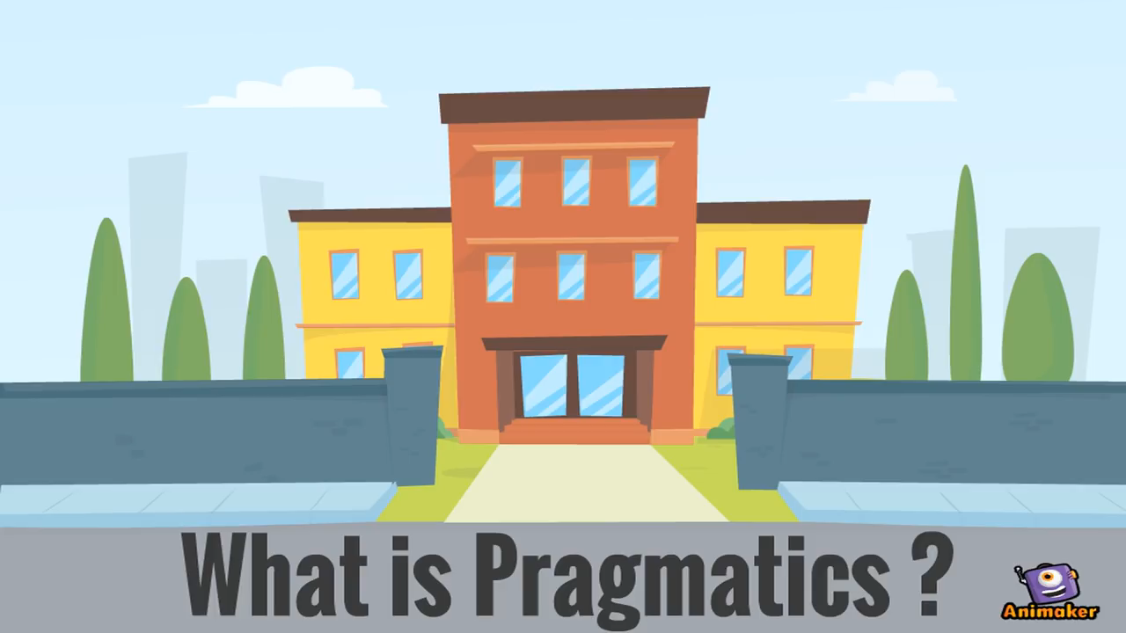
Enjoy the video!

Slide 3

Definitions
The study of speaker meaning.
The study of contextual meaning.
The study of how more gets communicated than is said.
The study of the expression of relative distance.
(Yule, 1996:3)

Slide 4
Dimension 1
Kharis is talking to Kavin,
Kharis : “Do you have some food?”
The listener thinks that…

Slide 5
Dimension 2
At PIPS UNAIR,
Audy : “Have you tried AULA?”
Niko : “I don’t where it is.”
At the canteen,
Audy : “Do you have some money?”
Niko : “I haven’t got any lunch yet.”

Slide 6
Dimension 3
Akbar is talking to Lia,
Akbar : “I heard that there is a good movie in the cinema premiere
today.”
The listener thinks that…

Slide 7
Dimension 4
Dhyan and Ika is having a conversation,
Ika : “Yeaaayyy, it’s happening!”
Dhyan : (Looking at Ika’s phone, sees
some pictures and Dhyan
understand what Ika said)

Slide 8
Activity 1
Work in pairs.
Find an example of each dimension covered by Pragmatics!
Share the answers with other groups.
Take notes!

Slide 9
Activity 2
Work in pairs.
Write all the example you have on a piece of paper!
(one paper-one example)
Pragmatics Race: Classify the example to each dimension!

Slide 10
Reference
Yule, George. 1996. Pragmatics. Oxford:
Oxford University Press.

Slide 11
Thank you

