Slide 1
Integrated Surveillance

Slide 2
Workplaces
“Workplace is an important setting for health protection, health promotion and disease prevention programs” (CDC, 2016)
Potential place of Injuries & Disease
Right place to start preventions

Slide 3
Occupational Hazard & Risk
HAZARD
Something that has the potential to cause harm to people, property, or the environment
RISK
The chance or probability of that hazard causing harm or damage to people, property, or environment
Physical
Biological
Chemical
Ergonomic
psychosocial

Slide 4
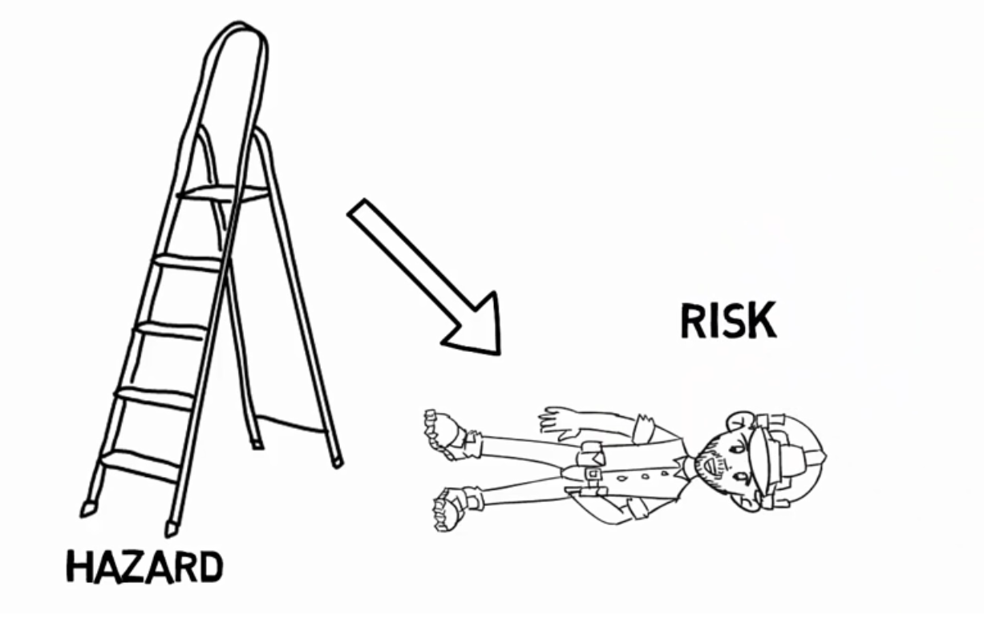
Example

Slide 5
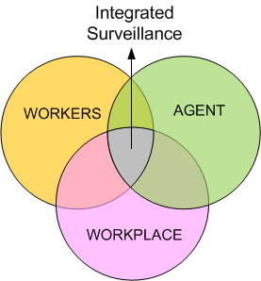

Slide 6
Case Example
A worker at plantation area often deals with pesticide (hazard). When the hazard (pesticide) is inhaled by the worker and he feels dizzy and falls down, then it’s an injury. But when it happens daily and the environment (high temperature) makes the pores bigger and the amount of pesticide entering the body higher, then it may result in a disease.

