Slide 1
Surveillance

Slide 2
Surveillance
Surveillance is the ongoing collection, analysis, and integration of outcome specific data for use in planning

Slide 3
Usefullness of the surveillance data and surveillance system
As early warning system
Detect outbreaks of diseases in a timely manner
Inform appropriate and effective public health response
Determine the distribution and spread of disease
Illustrate the epidemiology of new disease
Provide data to evaluate control measures

Slide 4
Usefullness of the surveillance data and surveillance system
Estimate disease burden
Identify risk group
Determine incidence trends over time
Measures outcomes and impact of preventive and public health intervention
Evaluate the overall control intervention

Slide 5
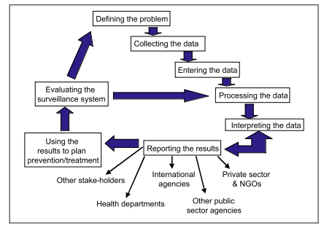
Step in surveillance system

Slide 6
1. Defining the problem
Problem definitions determine the structure and content of surveillance system
It tells what is to be place under surveillance and what kind informations is to be collected.

Slide 7
2. Collecting data
WHO and National health Authority should
Standardize case definitions to be used in the emergency context
Standardize and finalize reporting forms
Specify the information flow and define responsibilities each level of reporting
Train officer dan surveillance officer
Ensure the involvement of all health-care providers at outpatient levels and inpatient levels, wheter they be part of national health systems

Slide 8
3.Enter Data
Once your raw data have been sourced and collected together, you will need to decide how
best to collate and process it. In some cases, these two steps may go together

Slide 9
4. Interpreting Data
Raw statistics are usually not enough; more often than not, there is a need for further analysis and interpretation of raw data in order to draw out the most important features and to present information in such a way so as to make it easy to understand.

Slide 10
Reporting
Once data have been collated and analysed, the results of surveillance need to be presented and disseminated. This is usually done in the form of written reports, geared to your target audience(s). Often one report will suit all intended readers.

