Slide 1
Occupational Hazard and Risk

Slide 2
Hazard and Risk in workplace
Hazard is something that has the potensiaal to cause harm to people, property or the environment
Risk is the chance or probability of that hazard causing harm or damage to people, property, or environment
To Undertand the defferent well, please watch the video provide in the section

Slide 3
Hazard
Existing or Potential Condition That Alone or Interacting With Other Factors Can Cause Harm
A Spill on the Floor
Broken Equipment
Notes:
Unsafe Conditions – examples
Poor housekeeping , Blocked walkways, Improper or damaged PPE
Machine guards removed, Exposed electrical wires Slippery floors,
Physical Factors – noise, vibration, illumination, temperature extremes
Chemical Factors – exposures that may impair a worker’s skill, reactions,
Judgment Ergonomic Factors –workstation design, habits,

Slide 4
Hazard caused of Unsafe Condition
examples
Poor housekeeping , Blocked walkways, Improper or damaged PPE
Machine guards removed, Exposed electrical wires Slippery floors,
Physical Factors – noise, vibration, illumination, temperature extremes
Chemical Factors – exposures that may impair a worker’s skill, reactions,
Judgment Ergonomic Factors –workstation design, habits,

Slide 5
WORKPLACE HAZARDS
Safety Hazards
working conditions where harm to the workers is of an immediate and violent nature
result in broken bones, cuts, bruises, sprains, loss of limbs, etc.
the harm results in some kind of injury to the worker
associated with poorly guarded or dangerous equipment and machinery
Health Hazards
working conditions which result in an illness
exposure to dangerous substances or conditions, such as chemicals, gases, dusts, noise etc.
often, latency between exposure and disease

Slide 6

Risk
A measure of the probability and severity of a hazard to harm human health, property, or the environment
A measure of how likely harm is to occur and an indication of how serious the harm might be
Risk ≠ 0

Slide 7

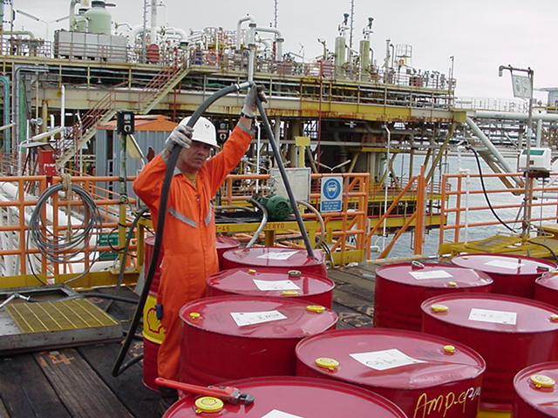
Risk
Likelihood that an agent will cause harm in the actual circumstances of exposure
Hazard
Exposure

Slide 8
HAZARD AND RISK
HAZARD
  - any source of potential damage, harm or adverse health effects on something or someone under certain conditions at work.
RISK
  - the chance or probability that a person will be harmed or experience an adverse health effect if exposed to a hazard.

Slide 9
Health Risk = Hazard x Exposure
Exposure
Hazard

Slide 10

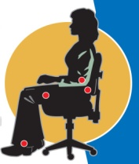


PHYSICAL HAZARD
ERGONOMIC HAZARD
CHEMICAL HAZARD
BIOLOGICAL HAZARD

Slide 11
HAZARDS AT WORKPLACE
Physical
Chemical
Biological
Psychosocial
Ergonomics
Mechanical

Slide 12


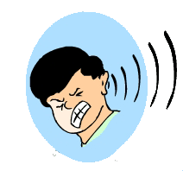


Classes of Hazards
Health hazard
The potential to cause harm to health
Chemical
Psychological
Physical
Ergonomic
Biological
Notes:
These are the five categories of hazards that are addressed in the HRA process. Can the group give an example from their own work environment for each of them?

Slide 13

Occupational Hazards
Bacteria
Fungi
Insects
Viruses
Manual handling
Repetitive movement
Restrictive working area
Noise
Vibration
Radiation
Lighting
Heat
Cold
Fibres
Dusts
BIOLOGICAL
ERGONOMICAL
PHYSICAL
CHEMICAL
PSYCHOLOGICAL
Fumes
Gases
Aerosols
Mists
Liquids
Vapours
Job stress
Job monotony
Unsociable hours
Job organization

Slide 14
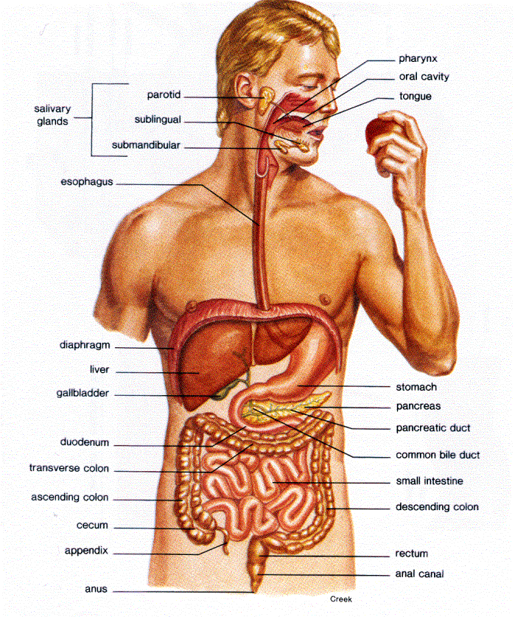
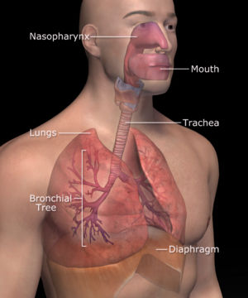
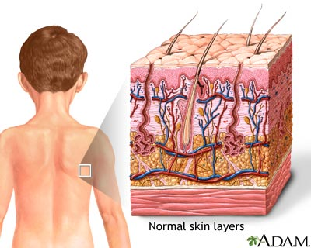
1. Chemical Hazards
Routes of entry into the body
Inhalation
Skin Contact
Ingestion

Slide 15
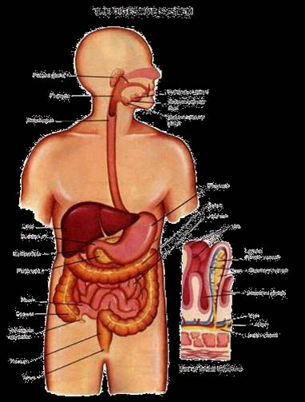
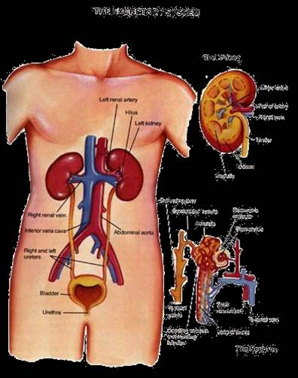
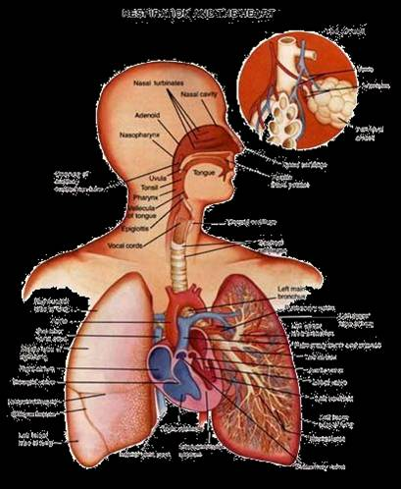
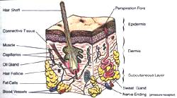
Chemical Hazards
Routes of excretion
Gastro-intestinal (feces)
Renal (urine)
Respiratory (exhalation)
Skin (sweat, hair, nails)

Slide 16
CHEMICAL HAZARDS
Solvents
Dusts (sand, asbestos, cotton)
Paints
Pharmaceuticals
Pesticides
Metal fumes
Acids & Alkali
which may be present in the working environment as gases, vapours, mists/aerosols, fumes, dusts, liquids or solids.

Slide 17
2. PHYSICAL HAZARDS

Slide 18
Physical Hazards
Noise
Vibration
Extreme Temperature
Illumination
Radiation

Slide 19


Physical hazards

Slide 20
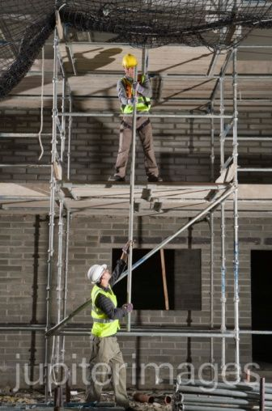
Physical hazards
Fall from heights e.g. scaffolding, high building
Slips and trips
Objects falling from cranes
Dangerous heavy machinery
Electrocution
Confined spaces

Slide 21


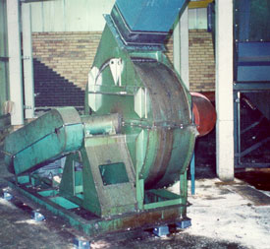

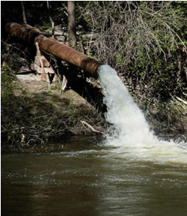
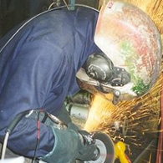
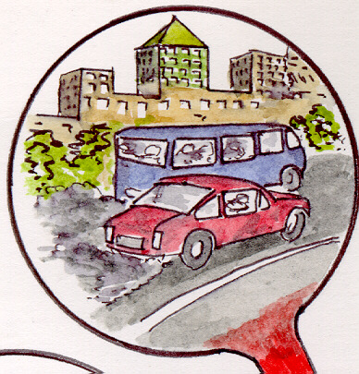
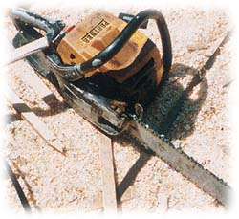
NOISE

Slide 22

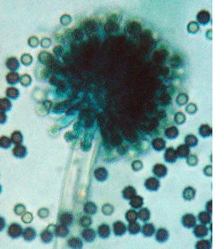
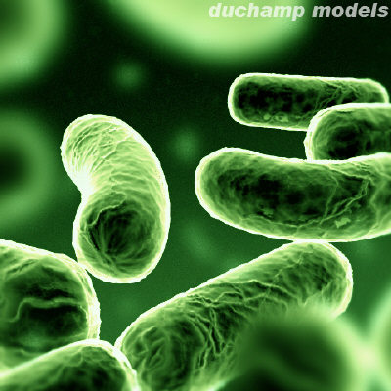

3. Biological hazards

Slide 23

BIOLOGICAL HAZARDS
Bacteria
Fungi – mold
Virus – Bird Flu, Influenza, SARS
Blood-borne pathogen - HIV, AIDS, Hepatitis
Tuberculosis
e.g. farmers, health care workers, animal handlers

Slide 24


4. Psychosocial hazards

Slide 25
Psychosocial hazards
Work-related stress – excessive working time, overwork, burnout
Bullying – emotional, verbal
Sexual harassment
Violence at work
Body odour
Health effects:
  Occupational Stress, Anxiety, Depression
  Cardiovascular Disorders, GI Disorders
  Drug abuse, smoking

Slide 26
5. ERGONOMIC FACTORS
Working postures / chairs
Space per work shift
Working surface height
Reach / machine feeding
Space between machines
Stress physical load

Slide 27
ERGONOMIC FACTORS
Lifting heavy loads/frequent bending/repetitive & monotonous work
Design of tools
Displays and instructions
Mental overload / visibilty

Slide 28
Hazard and Risk in Hospital
Refer to The National Institute for Occupational Safety and Health
completed a survey of 3687 hospitals to identify the types and frequencies of injuries and illnesses among hospital employees.
This study found that among all the exposures typified, the most common types of injury were strains and sprains.
These injuries are usually caused by improperly lifting objects, including patients, and slipping and falling on slippery floors, stairs, or ladders.

Slide 29
RISK
      Risk= How often x How bad
      Risk=Frequency x Consequences
      Risk= Frequency x Severity
      Risk= Likelihood x Consequences
      Risk= Probability x Consequences

Slide 32
Special attention should be given to hazardous occupational exposures :
1. for women of childbearing age,
2. to employees exposed to ionizing or
non-ionizing radiation,
3. and to operating room personnel exposed
to anaesthetic gases.

Slide 36
Hospital Occupational Health and Safety
1. Pre-placement medical examinations should be given to all new employees. These examinations should include a medical history, a thorough physical examination, laboratory tests (blood, urine, chest X-ray, etc.), and special consultations as indicated by the history , physical findings, or special job requirements.

Slide 37
2. Periodic health maintenance procedures should be instituted that include a general examination, as in item 1 above, an assessment of continued job compatibility, and special appraisals necessitated by extensive illness or job changes

Slide 38
7. Environmental control and surveillance services should be provided to detect, avoid, or limit harmful occupational exposures. Special attention should be given to hazardous occupational exposures for women of childbearing age, to employees exposed to ionizing or non-ionizing radiation, and to operating room personnel exposed to anaesthetic gases.
8. Employee health and safety records should be maintained in the health unit. These must include examinations, injury or illness reports, radiation records, and other environmental exposure reports or records.

Slide 39
Hospital Acquired Infection
Nosocomial infection
Infection occurring during hospitalization is considered the major problem.
‘cross infection’

Slide 40
Agents: staph aureus, hemolytic strep, ecoli, klebsiella, pseudomones and viruses.
Sources: patients: staff working in the hospital and environment

