Slide 1

An Integrated Surveillance System

Slide 2
What to learn?
Occupational Injury & Disease
Statistics
Hazard & Risk
The Epidemiological Triad
The Epidemiological Triad
(Workplace)
WHY Integrated?
Surveillance
Integrated Surveillance

Slide 3
Occupational Injury & Disease
INJURY
Acute exposure to physical agents or sudden lack of essential agents
WORK RELATED DISEASE
“A disease contracted as a result of an exposure over a period of time to risk factors arising from work activity”
(ILO, 2007)

Slide 4
“Injury” versus “Disease”
EXPOSURE
INTERVAL
APPEARANCE OF INJURY
“The shorter the time from exposure to its effects, the more likely we call it an injury rather than a disease” (CDC, 2005)

Slide 5
Compare!
A construction worker is diagnosed as having tendonitis of the elbow from the chronic vibrations of the jackhammer
Another worker fractures his toe while using a jackhammer

Slide 6
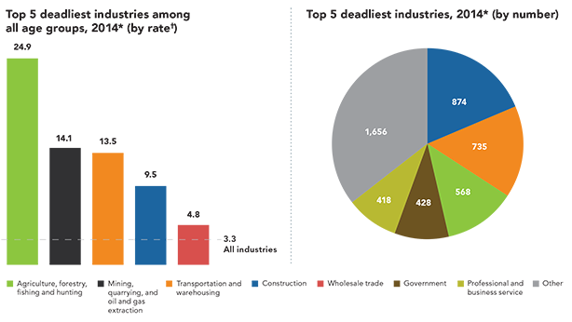
Statistics
Bureau of Labour Statistics, 2014

Slide 7
Workplaces
“Workplace is an important setting for health protection, health promotion and disease prevention programs” (CDC, 2016)
Potential place of Injuries & Disease
Right place to start preventions

Slide 8
Occupational Hazard & Risk
HAZARD
Something that has the potential to cause harm to people, property, or the environment
RISK
The chance or probability of that hazard causing harm or damage to people, property, or environment
Physical
Biological
Chemical
Ergonomic
psychosocial

Slide 9
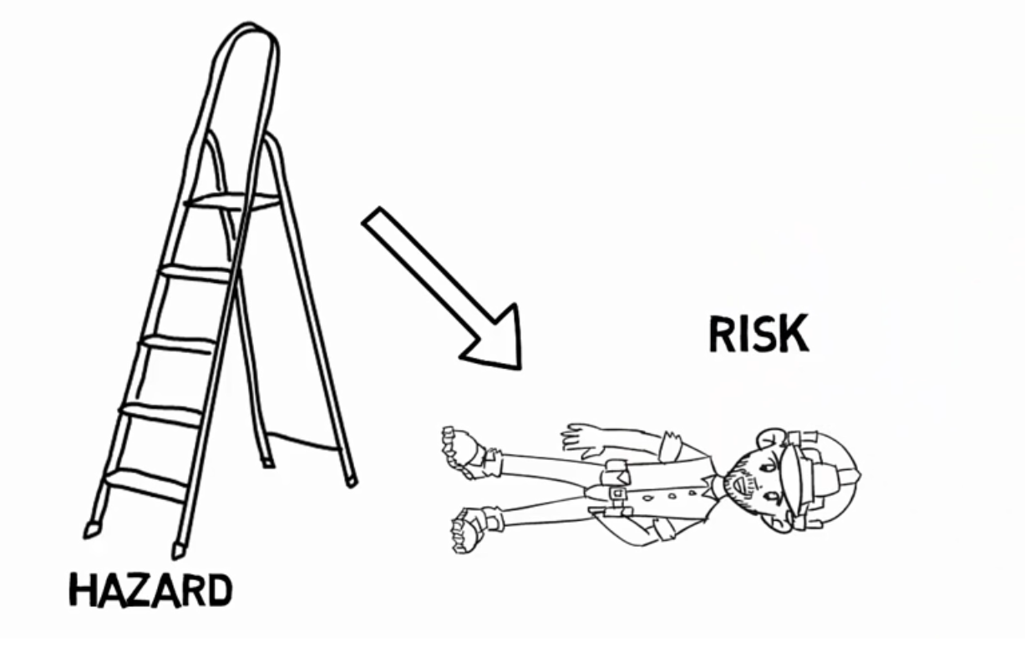
Example

Slide 10
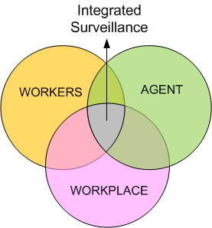

Slide 11
Case Example
A worker at plantation area often deals with pesticide (hazard). When the hazard (pesticide) is inhaled by the worker and he feels dizzy and falls down, then it’s an injury. But when it happens daily and the environment (high temperature) makes the pores bigger and the amount of pesticide entering the body higher, then it may result in a disease.

Slide 12
Integrated? Why is it a concern?
Workplaces are potential places for both injury and disease potential.
The existing surveillance mostly focuses only on injury surveillance or only on disease surveillance.
Prevent injuries and diseases at the same time

Slide 13
Surveillance
The regular, systematic collection, analysis and interpretation of health related data with timely dissemination for planning, implementation, and evaluation of public health practice. (WHO, 2015)

Slide 14
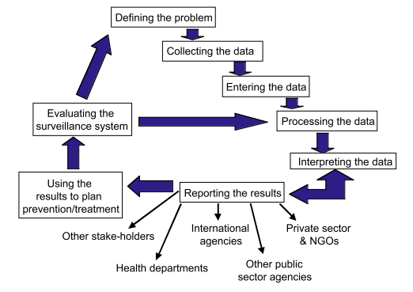
Steps
(WHO, 2001)

Slide 15
Surveillance
DATA
Collection/collation
Analysis/interpretation
Reporting/dissemination
CHARACTERISTICS
Regular
Systematic
Timely
Linked to action

Slide 16
Types
CASE
POPULATION
POPULATION BASED
INTITUTION
BASED
OR
ACTIVE
PASSIVE
VOLUNTARY
MANDATORY
(Hancock, W., Singh, N., Clothier, H., 2016)

Slide 17
How’s an integrated surveillance different?
DATA COLLECTION
Covers Injuries, diseases
DATA ANALYSIS
Analyze how hazards, risks, environment, injuries, and diseases are connected

