Slide 1


Exercise for obese people
Physical activity recommendation
Raden Argarini
Medical Physiology and Biochemistry Department
Cardiovascular and Exercise/Sport Research Group
Faculty of Medicine – UNIVERSITAS AIRLANGGA

Slide 2
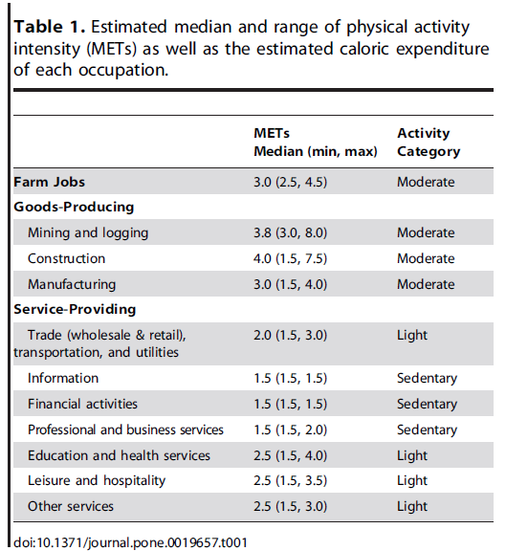
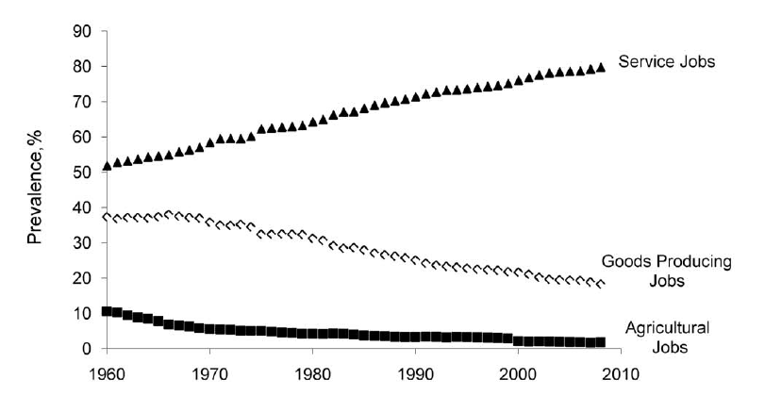
Trend of PA according to the occupation in US
Church et al 2011
Good producing and agricultural ↓, service jobs ↑

Slide 3
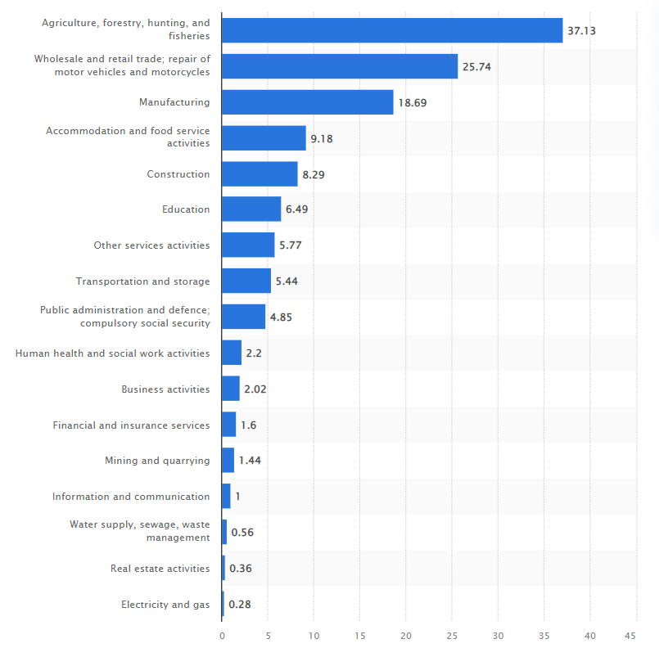
Trend of occupations in Indonesia
(aged 15 years and above in Indonesia in 2021, by industry)
Information technology – based professionals (artificial intelligent specialist, dev-ops engineer, data scientist) – based on linkedin report in 2021
Architecture and construction
Healthcare
https://www.statista.com/statistics/994498/employment-numbers-by-industry-indonesia/

Slide 4
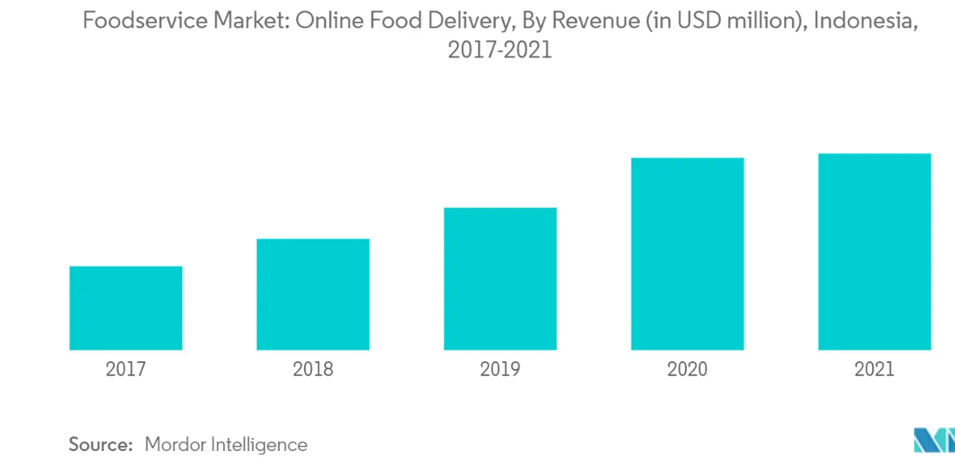
Trend of online food delivery in Indonesia

Slide 5
Does “Physically active” is similar with doing “Exercise”?
Physical activity
Exercise
“Any movement that is carried out by the muscles that require energy. In other words, it is any movement a person does”
“planned, structured, repetitive and intentional movement. Exercise is also intended to improve or maintain physical fitness.”

Slide 6



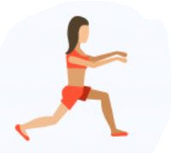
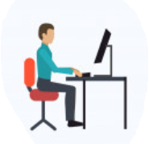




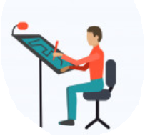
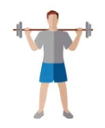
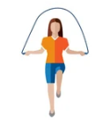
Does “Physically active” is similar with doing “Exercise”?
Physical activity
Exercise

Slide 7
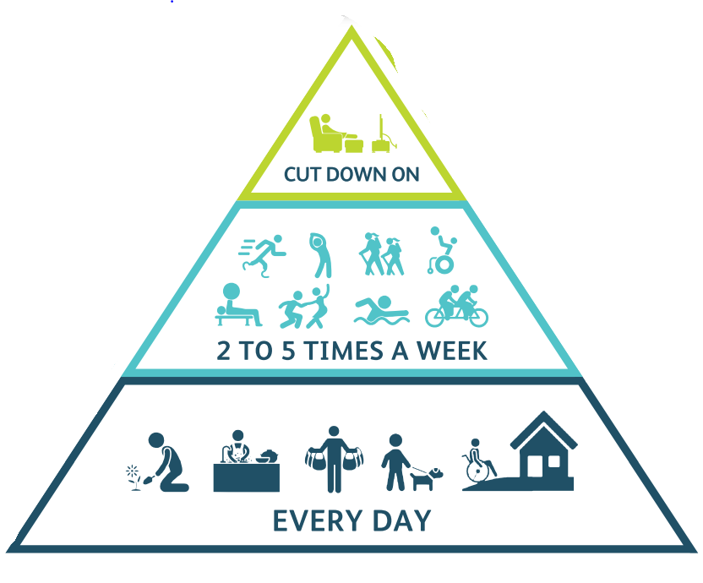
Does “Physically active” is similar with doing “Exercise”?
Physical activity
Exercise
Being sedentary during leisure time
EXERCISE
Being ACTIVE during normal routine

Slide 8
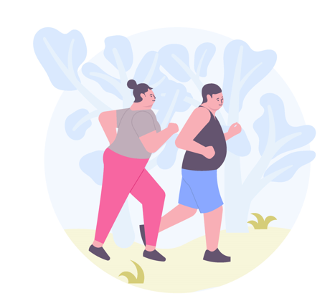
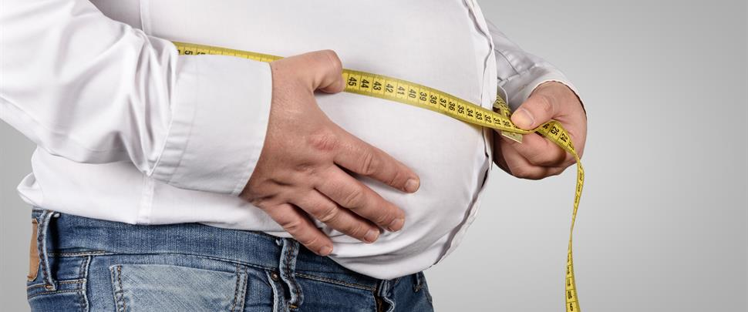
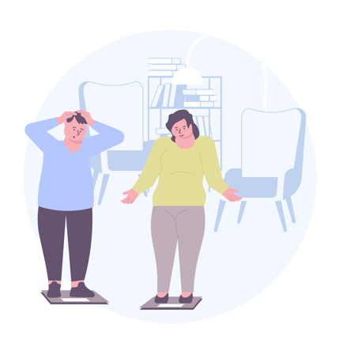
The benefit of keep “Physically active” for obese people
PA increases total energy expenditure, which can help to stay in energy balance or even lose weight, as long as they don’t eat more to compensate for the extra calories they burn.
PA decreases fat around the waist and total body fat, slowing the development of abdominal obesity
PA reduces depression and anxiety and this mood boost may motivate people to stick with their exercise regimens over time.

Slide 9
Determine personal goal for PA
Using pedometer:
Count your baseline steps
Add 400-600 steps/ 1-2 week
For example your daily steps count in average /week is 2000 steps ➔ next week increased by 500 to 3500

Slide 10
Challenge yourself!!!
3500 steps
Continue……..
Step by step, reasonable increase
No back pain, no spasm, no injury after 2 weeks ➔ increase the dose
3000 steps
2500 steps
Step it up!!!
2000 steps

Slide 11
Exercise for obese people
Exercise recommendation
Raden Argarini
Medical Physiology and Biochemistry Department
Cardiovascular and Exercise/Sport Research Group
Faculty of Medicine – UNIVERSITAS AIRLANGGA

Slide 12
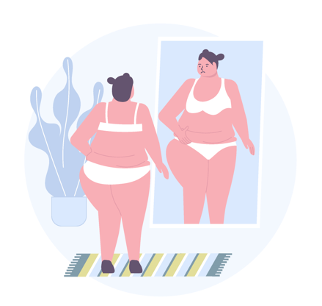
Does exercise makes you loss weights?
In fact, exercise has, on average, a moderate to small effect on weight loss (Seiler 2000, Miller et al 1993, Miller 1999)
however
Other health-related parameters are significantly improved (Seiler 2000).
“Exercise makes you FIT not only SHAPE”

Slide 13
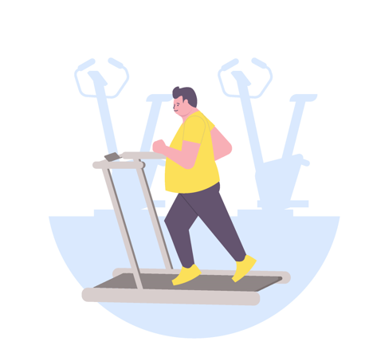
The benefit of EXERCISE for obese people
↑ muscular fitness
↑cardiorespiratory
fitness
Improved body composition (fat↓
↓risk for metabolic diseases : diabetes mellitus, heart diseases

Slide 14
The benefit of EXERCISE for obese people
Watts et al, 2004
19 obese subject, adolescent, 8 wks consists of 1 hour circuit training, 3x/week: ergocycle (65-85% HRM) and resistance training (55-70% pre-training max. strength)
  Fat (abdominal, trunk)↓
  Cardiorespiratory Fitness ↑
  Muscle strength ↑
  Conduit vessels function ↑

Slide 15
The benefit of EXERCISE for obese people
Prevention and treatment of musculoskeletal pain ➔ the stronger you are, the less lower back and joint pain you will experience.
Muscle is a secretory tissue: it produces substances that positively affect your well-being.
Muscle is a secondary stabilizing system (with tendons and ligaments being the first) for movement.
The more muscle you have, the stronger you will be, and the better you will handle your extra body fat (Pderson & Febbraio 2012).
Normalized endothelial-dependent vascular function (Watts et al, 2004; Osama et al, 2003)

Slide 16
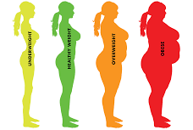
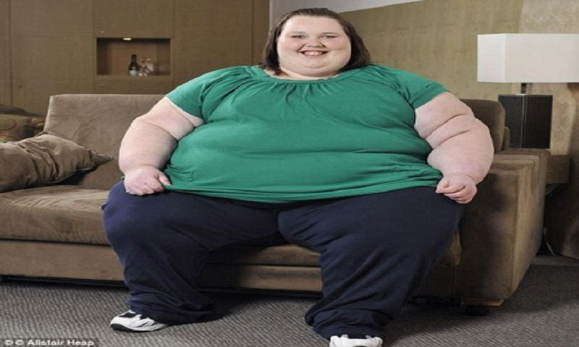
Exercise program for obese people: challenges
Source: https://www.daily-sun.com/post/204502/Severely-obese-people-more-likely-to-die-at-home

Slide 17
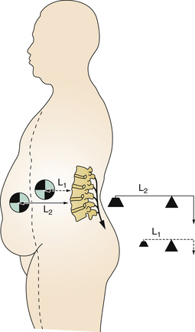
Physical barrier in obese people for doing exercise
Excess body weight ➔ displaced center of gravity. Abdominal obesity ➔ Com anterior to their base support ➔ adopting a stance and gait of exaggerated lumbar lordosis ➔ backache
Balance problem due to improper proprioceptive and kinaesthetic awareness system (Greve et al. 2007, Berrigan et al. 2006, Hue 2007, Ku 2012) ➔ greater risk for falls
https://clinicalgate.com/the-obese-patient/

Slide 18

More likely to have degenerative joint disease: osteoarthritis
Poor physical fitness
Poor strength
The burden over weight-bearing as well as non-weight-bearing joints
Existed comorbidities (diabetes, osteoarthritis, heart or lung disease)
Sorts of medication that affect their balance and alertness

