Slide 1

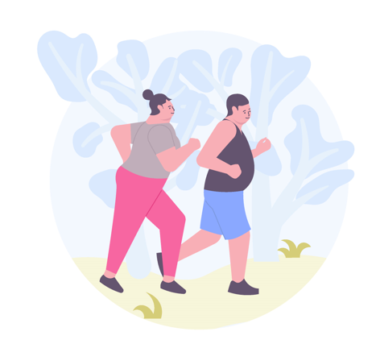
Exercise for obese people
Introduction
Raden Argarini
Medical Physiology and Biochemistry Department
Cardiovascular and Exercise/Sport Research Group
Faculty of Medicine – UNIVERSITAS AIRLANGGA

Slide 2

Outline
The global burden of obesity
  Epidemiology
  The importance of having weight loss for overweight/obese people – benefit of weight loss
  Contributing factors to obesity
  Strategy to fight against obesity
Physical activity recommendation for obese people
  Daily physical activity
  Adding exercise to your menu
Exercise recommendation for obese people
  General precaution for obese people before starting exercise
  Exercise recommendation and the challenge
  Balance and strength training
  Aerobic training
Combination of diet and exercise

Slide 3
Global Prevalence of obesity
In 2015, a total of 107.7 million (5.0%) children and 603.7 million (12%) adults were obese (The GBD 2015 Obesity Collaborators)
Since 1980, the prevalence of obesity has doubled in more than 70 countries
The rate of increase in childhood obesity in many countries >> adult obesity.
In 2015, China and India had the highest numbers of obese children, whereas the United States and China had the highest numbers of obese adults.

Slide 4
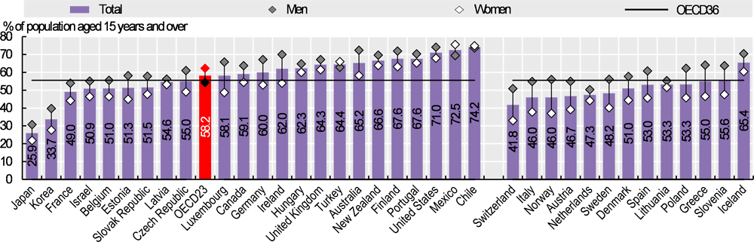
Global Prevalence of obesity
Note: Left- and right-hand side estimates utilise measured and self-reported data, respectively. OECD36 average includes both data types.
Source: OECD Health Statistic 2019

Slide 5
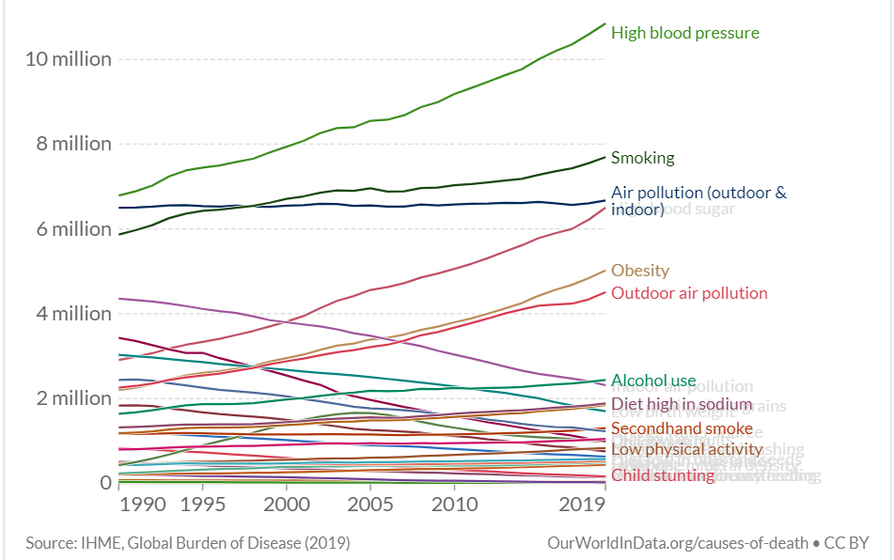
The burden of obesity
4.7 million
deaths
Notes:
High body mass index (BMI) has been estimated to cause 4.7 million deaths worldwide (Global Burden of Disease Collaborative Network, 2018)
More than two thirds of deaths (70%) related to high BMI were due to cardiovascular disease

Slide 6
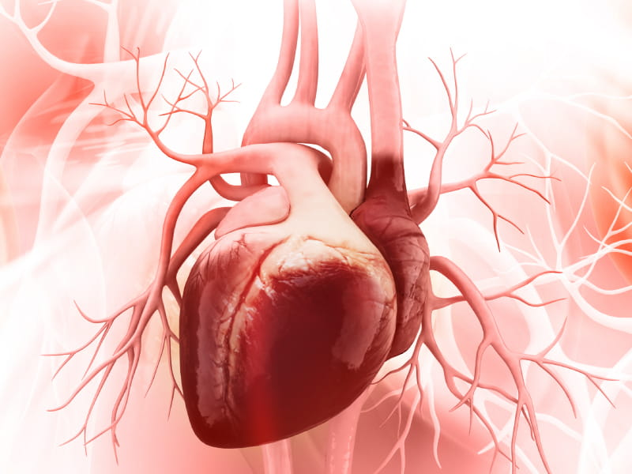
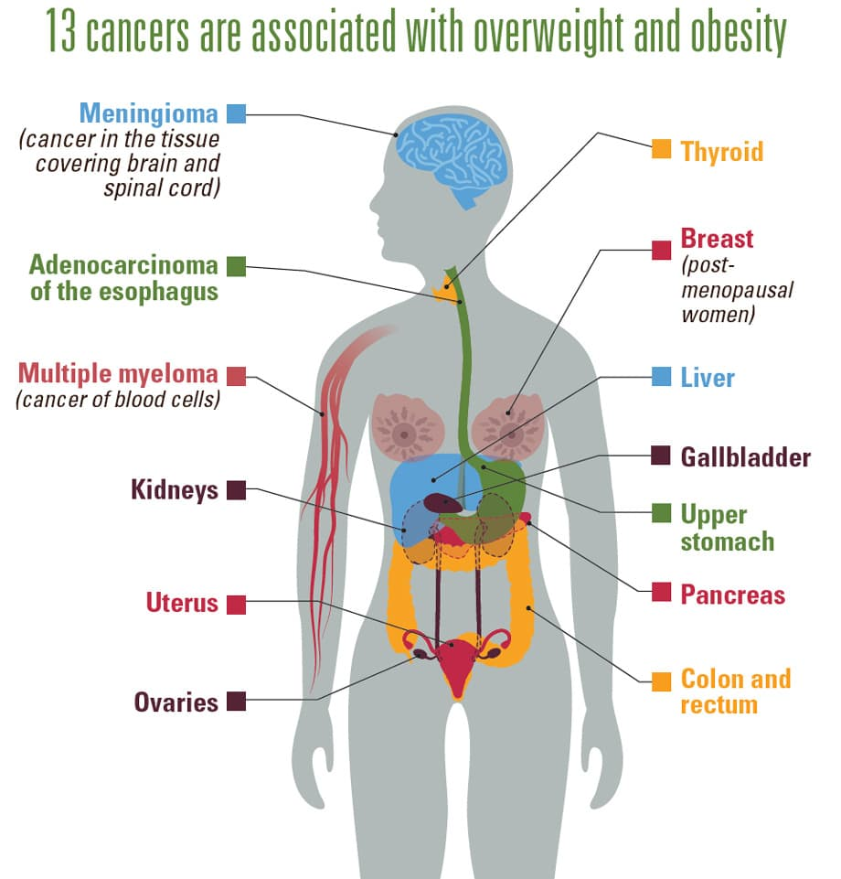

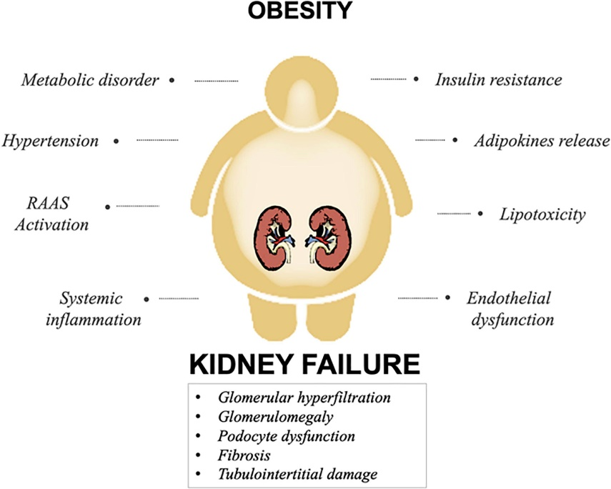
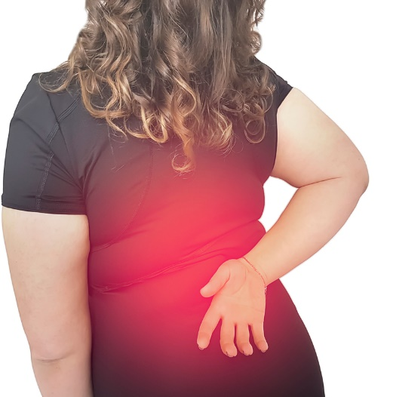
The burden of obesity: obese-related diseases
Cardiovascular diseases
Diabetes
  Musculoskeletal disorders
Notes:
major risk factor for various non-communicable diseases through the combination of high BP, high total serum cholesterol, and fasting plasma glucose:
cardiovascular diseases(ischemic heart disease, ischemic stroke, hemorrhagic stroke, hypertensive heart disease)
Diabetes
certain cancers (post-menopauseal breast cancer, esophagus, colon and rectum, liver, gallbladder and biliary tract, pancreas, breast, uterus, ovary, kidney, and thyroid, along with leukemia)
chronic kidney disease
musculoskeletal disorders
Increase people who live with disability

Slide 7
Contributing factors
Age: old > young.
  peak obesity: 60 and 64 years among women; 50 and 54 years among men.
Improper diet
  High consumption of calories-dense food
  Increased availability, accessibility, and affordability along with intense marketing)
increasingly sedentary lifestyles, reduce opportunities for doing PA
Gender (women > men)
Education
Socioeconomic status

Slide 8
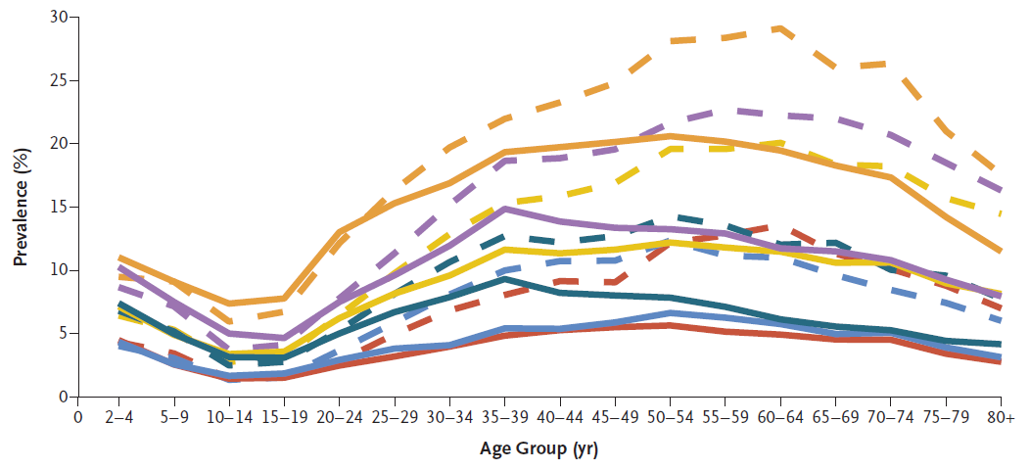
Obesity According to Age Group
(The GBD 2015 Obesity Collaborators)

Slide 9
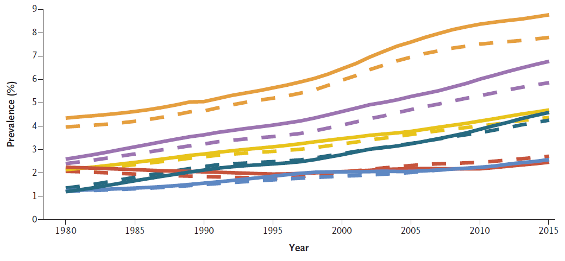
Obesity in Children According to Year
(The GBD 2015 Obesity Collaborators)

Slide 10
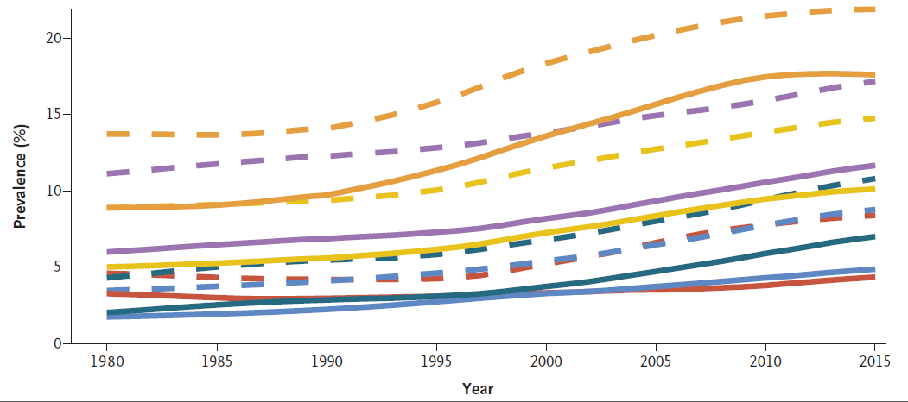
Obesity in Adult According to Year
(The GBD 2015 Obesity Collaborators)

Slide 11
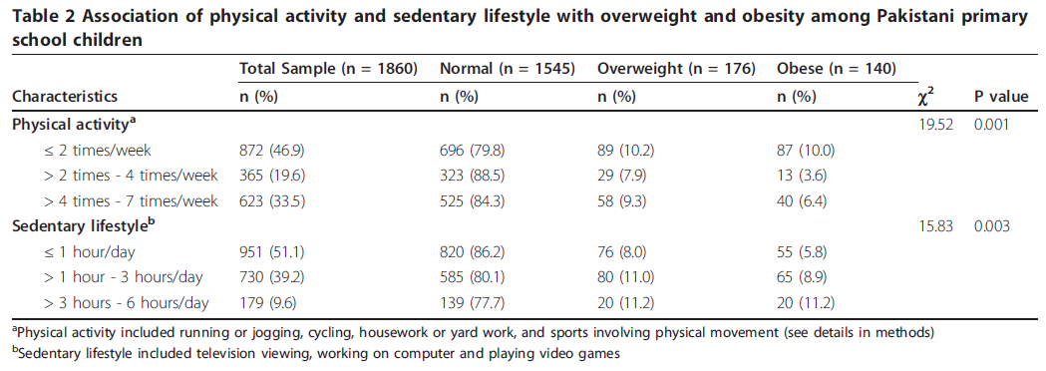
Contributing factors: PA↓ and sedentary lifestyle ↑
“Obesity and higher body weight are strongly associated with a sedentary lifestyle and lack of physical activity in the adult population of the European Union -Martínez-González, 1999
Mushtaq et al. International Journal of Behavioral Nutrition and Physical Activity 2011, 8:130

Slide 12

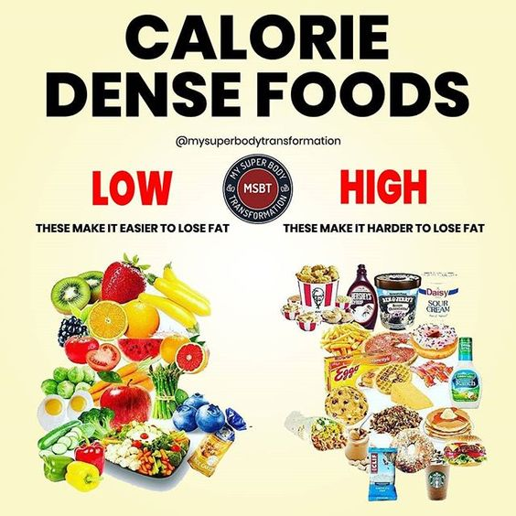
Contributing factors: Improper diet
➔Increased availability, accessibility, and affordability along with intense marketing)
Notes:
Skipping breakfast
High consumption of calories-dense food (fast-food, snacks)

Slide 13
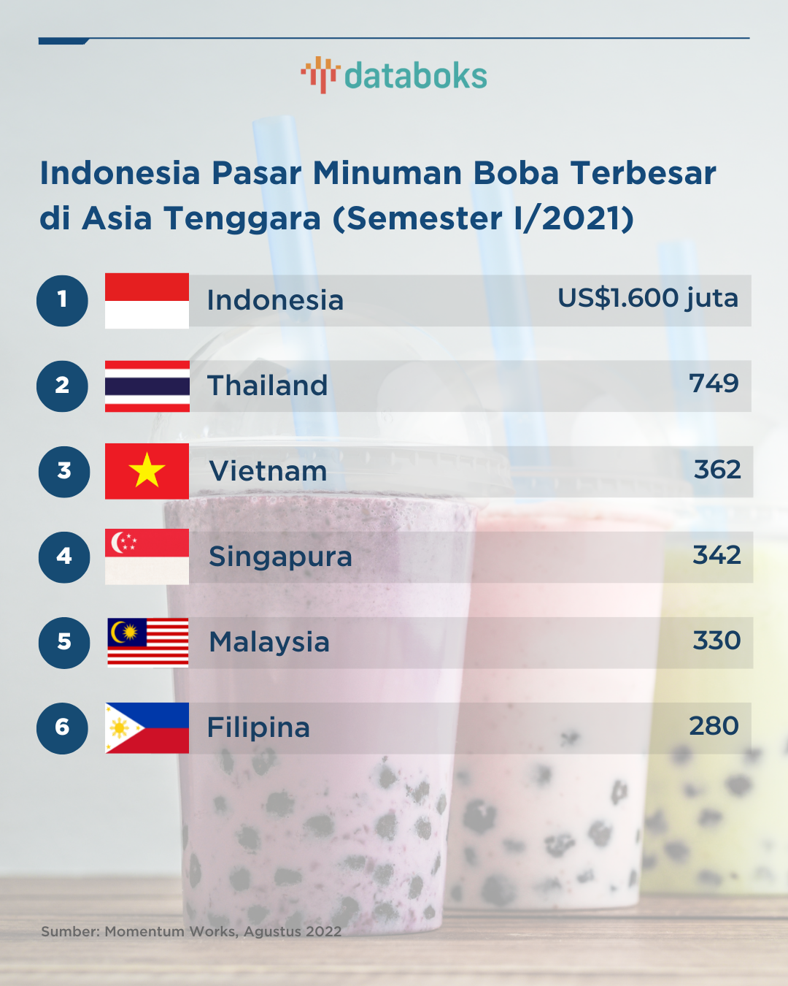
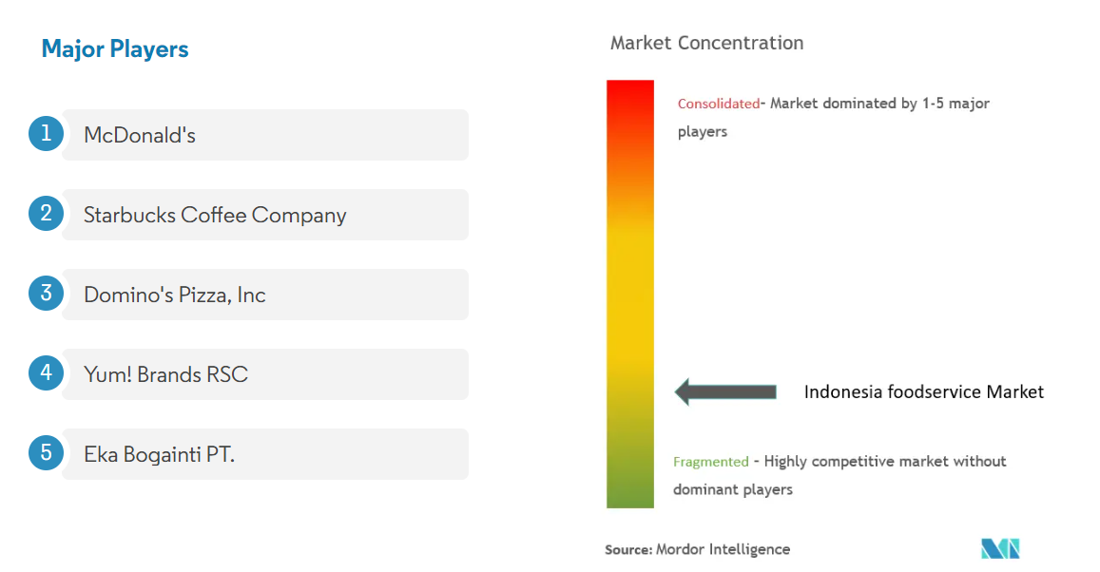
Contributing factors: Improper diet
➔Increased availability, accessibility, and affordability along with intense marketing)
Notes:
Skipping breakfast
High consumption of calories-dense food (fast-food, snacks)

Slide 14
Strategy to fight against obesity
Restricting the advertisement of unhealthy foods to children
Improving school meals
using taxation to reduce consumption of unhealthy foods
Providing subsidies to increase intake of healthy foods
supply-chain incentives to increase the production of healthy foods
Modest weight loss and moderate exercise intervention
Surgical interventions ➔ morbidly obese

