Slide 1





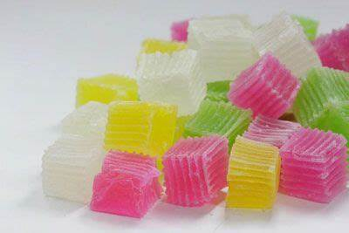
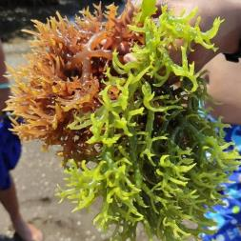
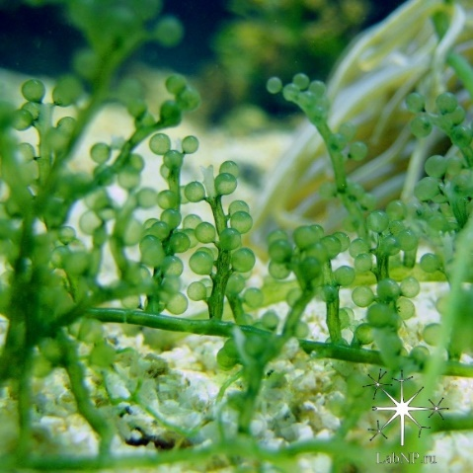
SIFAT DAN KARAKTERISTIK KOMODITAS RUMPUT LAUT
Dwi Yuli Pujiastuti, S.Pi., M.P., M.Sc
Program Study on Fisheries Product Technology
Department of Marine
Faculty of Fisheries and Marine
Universitas Airlangga
Notes:
Basically, my short presentation here has three aims; to present the needs of community services in universities, to propose one idea of establishing an association focusing on Community Development, and to invite all of the forum members to participate in the association at which all of us can talk further about the joint community service activities, their implementation, and the development in the future as one medium to strengthen the universities’ collaboration in ASEAN.
Therefore, for the next 15 minutes, my presentation will firstly address the system of Community Services in Universitas Airlangga. Secondly, I would like to highlight why we need to strengthen universities’ collaborations through community service. Thirdly I would like to talk about strategic orientation of for Community Development association which will be known as World University Association for Community Development. Finally, in the end of my presentation, I would like to address the first meeting on the World University Association for Community Service.

Slide 2
Capaian Pembelajaran
Capaian Pembelajaran Kursus Micro-credential sub topik Sifat dan Karakteristik Komoditas Rumput Laut ini adalah mahasiswa atau peserta kursus mampu menjelaskan sifat dan karakteristik rumput laut untuk nantinya dijadikan bahan baku produk olahan yang berkualitas
Notes:
Basically, my short presentation here has three aims; to present the needs of community services in universities, to propose one idea of establishing an association focusing on Community Development, and to invite all of the forum members to participate in the association at which all of us can talk further about the joint community service activities, their implementation, and the development in the future as one medium to strengthen the universities’ collaboration in ASEAN.
Therefore, for the next 15 minutes, my presentation will firstly address the system of Community Services in Universitas Airlangga. Secondly, I would like to highlight why we need to strengthen universities’ collaborations through community service. Thirdly I would like to talk about strategic orientation of for Community Development association which will be known as World University Association for Community Development. Finally, in the end of my presentation, I would like to address the first meeting on the World University Association for Community Service.

Slide 3
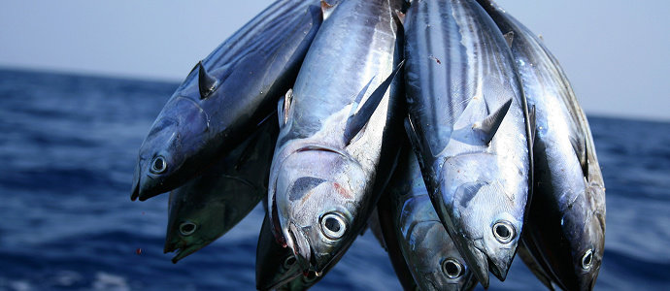
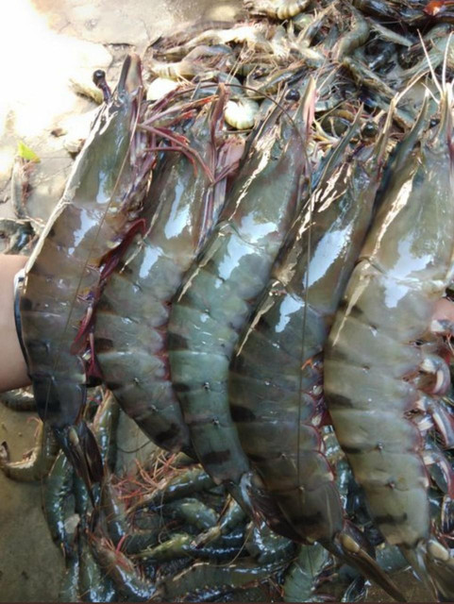
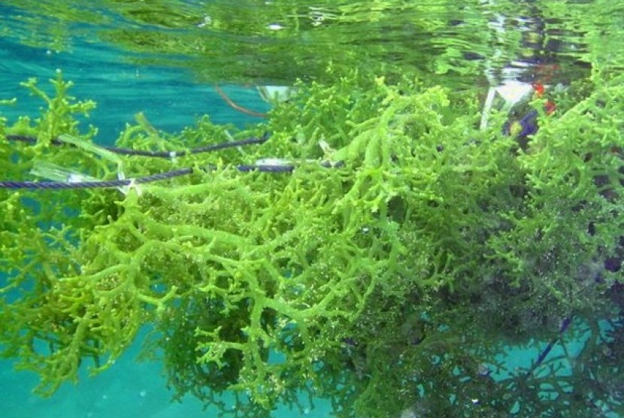
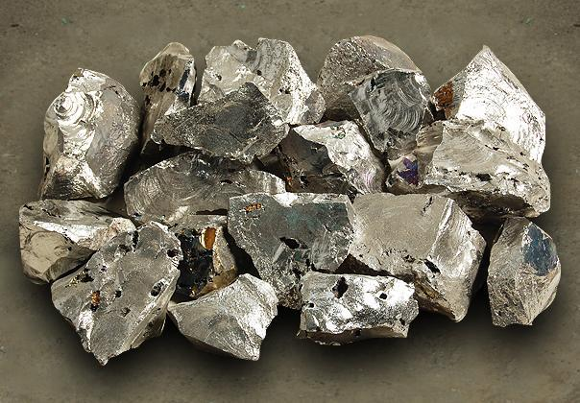
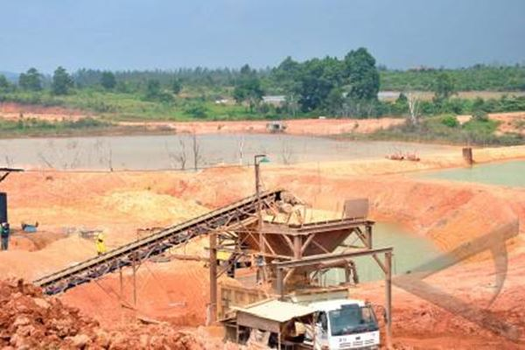


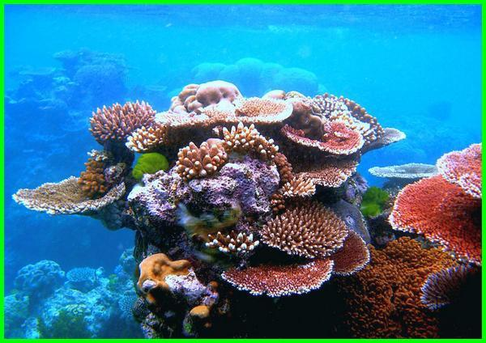
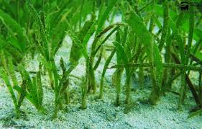
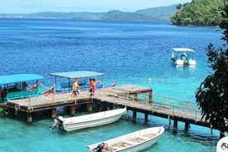
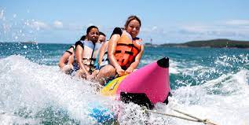
POTENCY
Indonesia memiliki kekayaan sumberdaya laut yang sangat melimpah dan dikenal sebagai negara maritim dengan berbagai diversitas keragaman sumberdayanya atau yang biasa dikenal dengan sebuatan mega biodiversity
Renewable Natural Resources
Non- Renewable Natural Resources
Marine tourism and transportation
The basic assets that must be managed optimally to improve the welfare and prosperity of the Indonesian people.
Notes:
Basically, my short presentation here has three aims; to present the needs of community services in universities, to propose one idea of establishing an association focusing on Community Development, and to invite all of the forum members to participate in the association at which all of us can talk further about the joint community service activities, their implementation, and the development in the future as one medium to strengthen the universities’ collaboration in ASEAN.
Therefore, for the next 15 minutes, my presentation will firstly address the system of Community Services in Universitas Airlangga. Secondly, I would like to highlight why we need to strengthen universities’ collaborations through community service. Thirdly I would like to talk about strategic orientation of for Community Development association which will be known as World University Association for Community Development. Finally, in the end of my presentation, I would like to address the first meeting on the World University Association for Community Service.

Slide 4
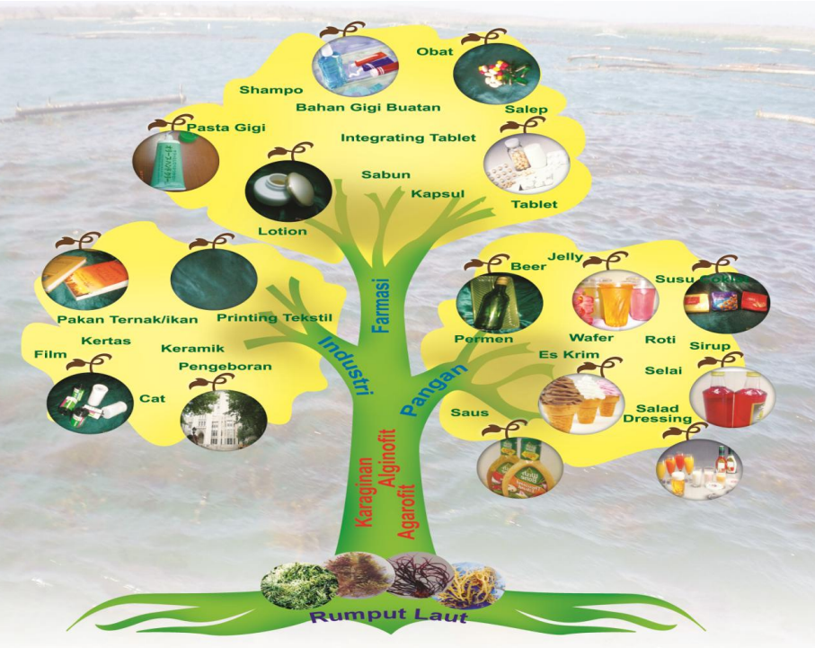
RUMPUT LAUT
Rumput laut merupakan makro algae yang termasuk dalam divisi Thallophyta, yaitu tumbuhan yang mempunyai struktur kerangka tubuh yang terdiri dari batang/thalus dan tidak memiliki daun serta akar.
Rumput laut Indonesia dikenal dengan kualitasnya yang baik dan banyak diminati oleh industri karena mengandung sumber keraginan, agar-agar dan alginate yang cukup tinggi dan cocok digunakan sebagai bahan baku industri makanan, pelembut rasa, pencegah kristalisasi es krim dan obat-obatan
Notes:
Basically, my short presentation here has three aims; to present the needs of community services in universities, to propose one idea of establishing an association focusing on Community Development, and to invite all of the forum members to participate in the association at which all of us can talk further about the joint community service activities, their implementation, and the development in the future as one medium to strengthen the universities’ collaboration in ASEAN.
Therefore, for the next 15 minutes, my presentation will firstly address the system of Community Services in Universitas Airlangga. Secondly, I would like to highlight why we need to strengthen universities’ collaborations through community service. Thirdly I would like to talk about strategic orientation of for Community Development association which will be known as World University Association for Community Development. Finally, in the end of my presentation, I would like to address the first meeting on the World University Association for Community Service.

Slide 5
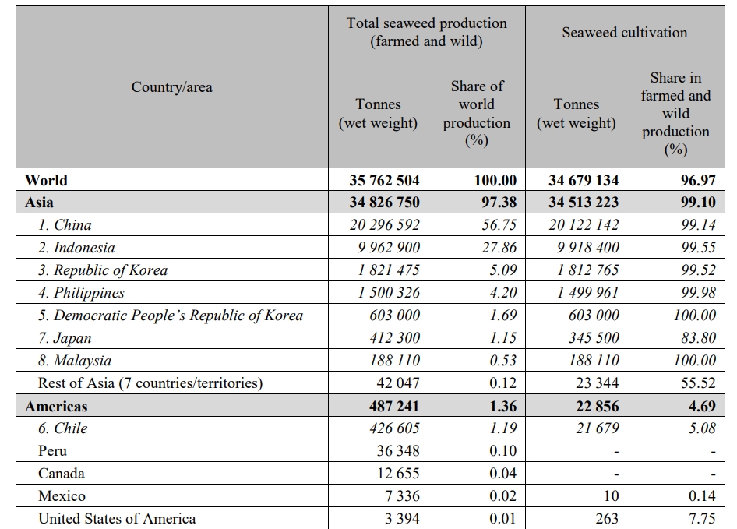
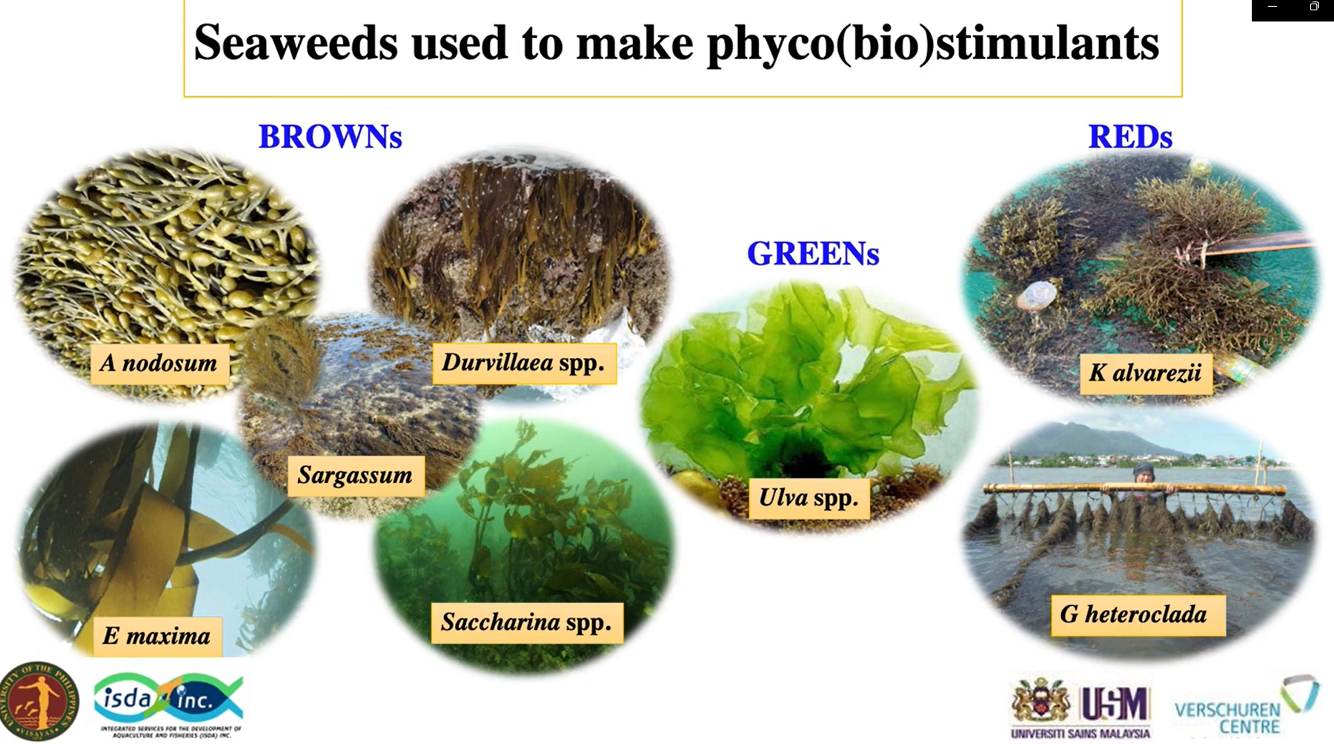
INDONESIAN SEAWEED DIVERSITY
Global Seaweed Production
Chlorophyta : 201 sp
Phaeophyta : 138 sp
Rodhophyta : 564 sp
Total : 903 sp
FAO, 2021
Notes:
Basically, my short presentation here has three aims; to present the needs of community services in universities, to propose one idea of establishing an association focusing on Community Development, and to invite all of the forum members to participate in the association at which all of us can talk further about the joint community service activities, their implementation, and the development in the future as one medium to strengthen the universities’ collaboration in ASEAN.
Therefore, for the next 15 minutes, my presentation will firstly address the system of Community Services in Universitas Airlangga. Secondly, I would like to highlight why we need to strengthen universities’ collaborations through community service. Thirdly I would like to talk about strategic orientation of for Community Development association which will be known as World University Association for Community Development. Finally, in the end of my presentation, I would like to address the first meeting on the World University Association for Community Service.

Slide 6
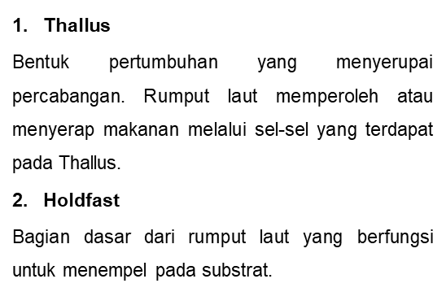
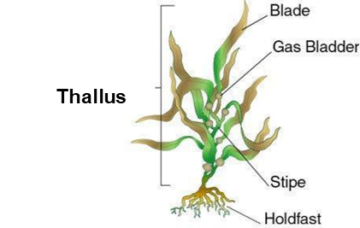
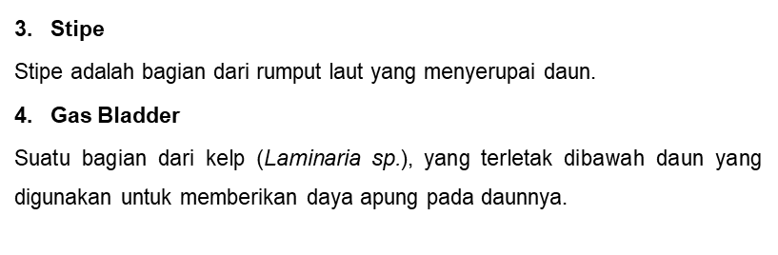
Rumput Laut

Slide 7
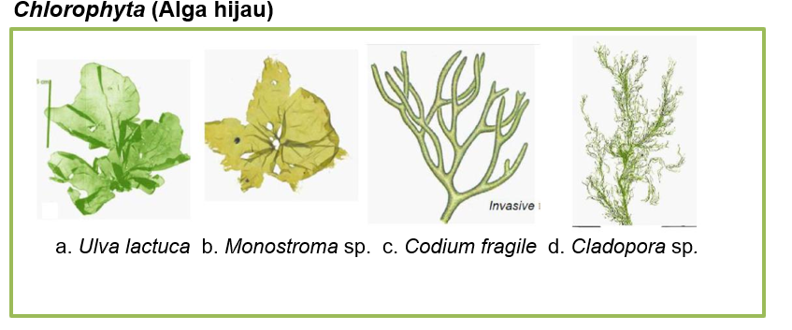
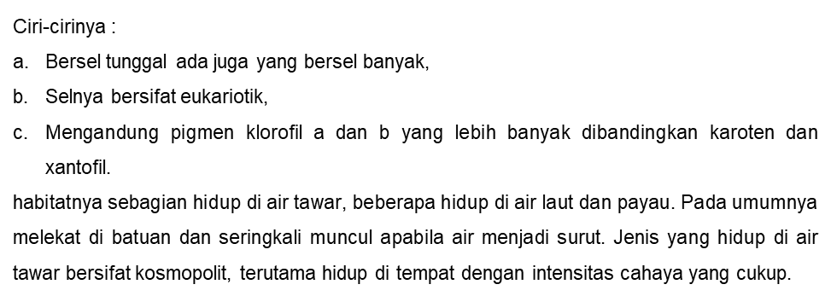

Slide 8
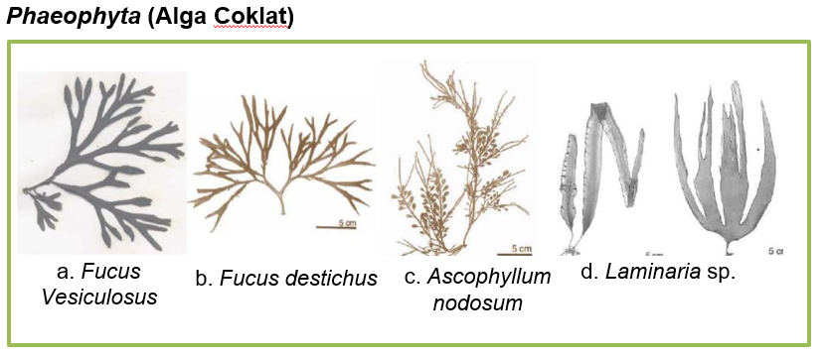
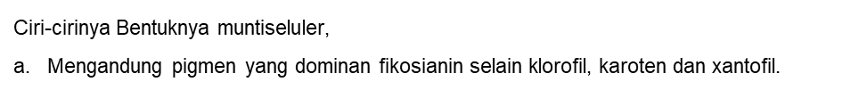


Slide 9
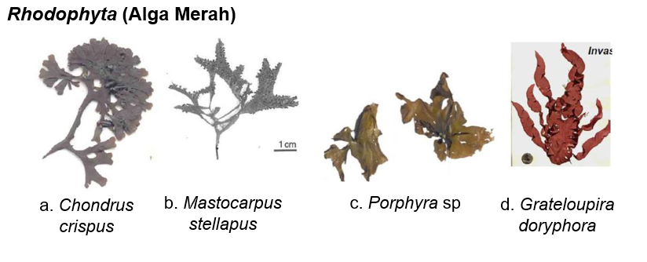
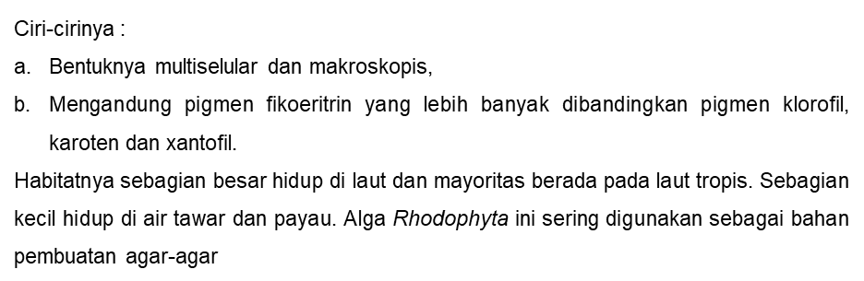

Slide 10
Komposisi Nutrient
Komposisi Nutrien
4-76% Polisakarida
5-20% Protein
56 jenis mineral
Vitamin A, B, C, D, E
1-5% kadar lemak
PUFA
Rumput laut kaya akan polisakarida, mineral esensial, vitamin, protein, rendah lemak
Komposisi gizi rumput laut sangat bervariasi, tergantung spesies, tempat tumbuh, dan musim.
Notes:
Basically, my short presentation here has three aims; to present the needs of community services in universities, to propose one idea of establishing an association focusing on Community Development, and to invite all of the forum members to participate in the association at which all of us can talk further about the joint community service activities, their implementation, and the development in the future as one medium to strengthen the universities’ collaboration in ASEAN.
Therefore, for the next 15 minutes, my presentation will firstly address the system of Community Services in Universitas Airlangga. Secondly, I would like to highlight why we need to strengthen universities’ collaborations through community service. Thirdly I would like to talk about strategic orientation of for Community Development association which will be known as World University Association for Community Development. Finally, in the end of my presentation, I would like to address the first meeting on the World University Association for Community Service.

Slide 11
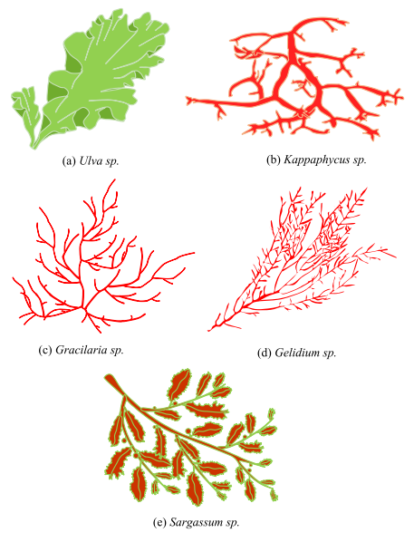
Phycocolloid
Salah satu sifat penting karaginan adalah mampu mengubah cairan menjadi padatan atau mengubah sol menjadi gel yang bersifat reversible. Kemampuan inilah yang menyebabkan tepung karaginan sangat luas penggunaannya, baik dalam bidang pangan maupun non pangan
Produk industri terpenting dari rumput laut adalah phycocolloid dari rumput laut merah dan rumput laut coklat. Phycocolloid dari kedua kelompok rumput laut tersebut sangat dibutuhkan industri sebagai larutan emulsi, gelling, stabilisator, suspensi dan bahan pembeku/perekat.
Istilah "phycocolloid" telah didefinisikan sebagai polisakarida yang kompleks dari rumput laut merah dan rumput laut coklat, yang membentuk sistem koloidal ketika dilarutkan dalam air
Polisakarida yang utama dan penting dari golongan rumput laut merah adalah agar dan karaginan. Kedua polisakarida ini banyak dimanfaatkan di berbagai bidang industri
Notes:
Basically, my short presentation here has three aims; to present the needs of community services in universities, to propose one idea of establishing an association focusing on Community Development, and to invite all of the forum members to participate in the association at which all of us can talk further about the joint community service activities, their implementation, and the development in the future as one medium to strengthen the universities’ collaboration in ASEAN.
Therefore, for the next 15 minutes, my presentation will firstly address the system of Community Services in Universitas Airlangga. Secondly, I would like to highlight why we need to strengthen universities’ collaborations through community service. Thirdly I would like to talk about strategic orientation of for Community Development association which will be known as World University Association for Community Development. Finally, in the end of my presentation, I would like to address the first meeting on the World University Association for Community Service.

Slide 12
Rumput Laut Potensial
Jenis Polisakarida
Agarofit
Karaginofit
Alginofit
Gracillaria
Gelidium
Gelidiela
Euchema cottoni
Kappaphycus alvarezii
Sargassum
Laminaria
Turbinaria
Karaginofit adalah rumput laut yang mengandung bahan utama polisakarida karagin
Agarofit adalah rumput laut yang mengandung bahan utama agar-agar
Alginofit adalah rumput laut coklat yang mengandung bahan utama polisakarida alginat
Notes:
Basically, my short presentation here has three aims; to present the needs of community services in universities, to propose one idea of establishing an association focusing on Community Development, and to invite all of the forum members to participate in the association at which all of us can talk further about the joint community service activities, their implementation, and the development in the future as one medium to strengthen the universities’ collaboration in ASEAN.
Therefore, for the next 15 minutes, my presentation will firstly address the system of Community Services in Universitas Airlangga. Secondly, I would like to highlight why we need to strengthen universities’ collaborations through community service. Thirdly I would like to talk about strategic orientation of for Community Development association which will be known as World University Association for Community Development. Finally, in the end of my presentation, I would like to address the first meeting on the World University Association for Community Service.

Slide 13
TIPE KARAGENAN
Kappa karagenan tersusun dari α(1,3)-D-galaktosa-4-sulfat dan β(1,4)- 3,6-anhidro-D-galaktosa
Galaktan yang mengandung sulfat
diklasifikasikan berdasarkan adanya 3,6-anhidrogalaktosa serta posisi dan jumlah golongan sulfat pada strukturnya
Kappa Karaginan mengandung D-galaktosa-6-sulfat ester dan 3,6 –anhidroD-galaktosa-2-sulfat ester
Iota karaginan berupa jeli lembut dan fleksibel atau lunak. Kappa karaginan berupa jeli bersifat kaku dan getas serta keras. Sedangkan lambda karaginan tidak dapat membentuk jeli, tetapi berbentuk cair yang viscous.
Kappa
Kadar Sulfat 25-30%
Iota mengandung 4-sulfat ester pada setiap residu D-glukosa dan gugusan 2-sulfat ester pada setiap gugusan 3,6-anhidro-D-galaktosa
Iota
Lambda
D-galaktosa-2-sulfat ester
tanpa unit 3,6-anhidro-D-galaktosa dan mengandung gugus sulfat yang tinggi.
Kadar Sulfat 23-35%
Kadar Sulfat 32-39%
Notes:
Basically, my short presentation here has three aims; to present the needs of community services in universities, to propose one idea of establishing an association focusing on Community Development, and to invite all of the forum members to participate in the association at which all of us can talk further about the joint community service activities, their implementation, and the development in the future as one medium to strengthen the universities’ collaboration in ASEAN.
Therefore, for the next 15 minutes, my presentation will firstly address the system of Community Services in Universitas Airlangga. Secondly, I would like to highlight why we need to strengthen universities’ collaborations through community service. Thirdly I would like to talk about strategic orientation of for Community Development association which will be known as World University Association for Community Development. Finally, in the end of my presentation, I would like to address the first meeting on the World University Association for Community Service.

Slide 14

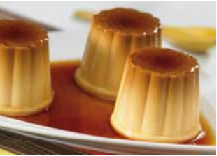
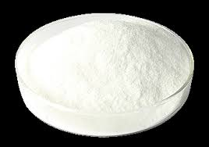
Aplikasi Karagenan
Karaginan sangat penting peranannya sebagai stabilizer (penstabil), thickener (pengental), pembentuk gel, pengemulsi, dan lain-lain.
Sifat ini banyak dimanfaatkan dalam industri makanan, obat-obatan, kosmetik, tekstil, cat, pasta gigi, dan industri lainnya.
Selain itu juga berfungsi sebagai pensuspensi, pengikat, protective (melindungi koloid), film former (mengikat suatu bahan), syneresis inhibitor (mencegah terjadinya pelepasan air), dan flocculating agent atau mengikat bahan-bahan
Penggunaan karaginan dalam bahan pengolah pangan dapat dibagi dalam dua kelompok, yaitu untuk produkproduk yang menggunakan bahan dasar air dan produkproduk yang menggunakan bahan dasar susu.

Slide 15
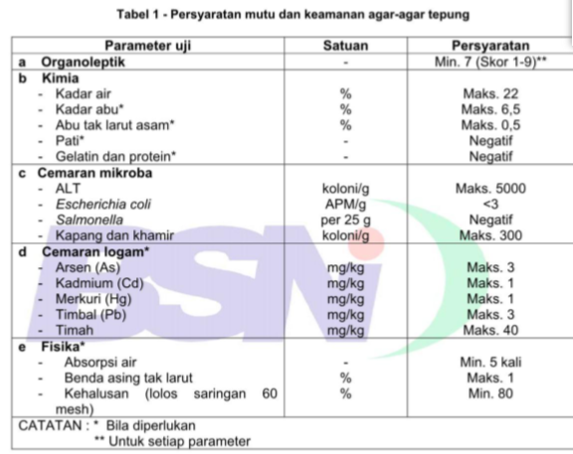
Aplikasi Agar
Fungsi utama agar-agar adalah sebagai bahan pemantap, penstabil, pengemulsi, pengisi, penjernih, pembuat gel, dan lain-lain.
Beberapa industri yang memanfaatkan kemampuan membentuk gel dari agar-agar adalah industri makanan, farmasi, kosmetik, kulit, fotografi dan sebagai media penumbuh mikroba.
Agar memiliki kemampuan membentuk lapisan gel atau film, sehingga banyak dimanfaatkan sebagai bahan pengemulsi (emulsifier), penstabil (stabilizer), pembentuk gel, pensuspensi, pelapis, dan inhibitor

Slide 16
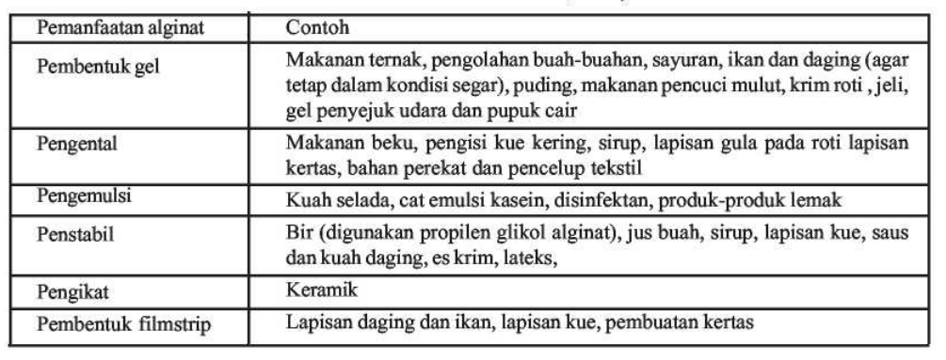
Aplikasi Alginat
Alginat yang biasa digunakan untuk kebutuhan industri (misalnya industri makanan, farmasi, kosmetik, tekstil, cat dan beberapa industri lainnya) meliputi natrium alginat, kalium alginat, amonium alginat, campuran kalsium-amonium alginat, campuran kalsium-natrium alginat yang merupakan garam-garam dari asam alginat dan propilen glikol alginat.

Slide 17
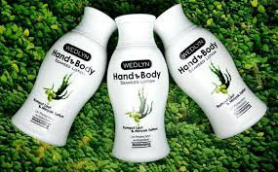
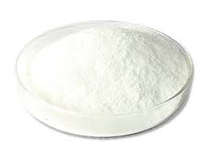
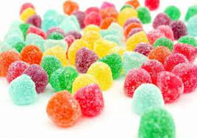
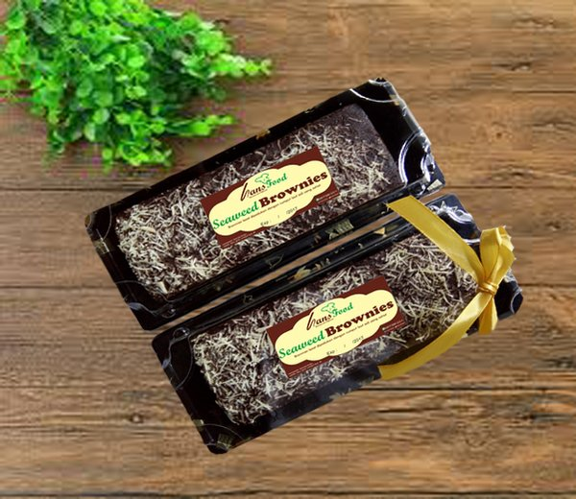
Commercial products
KESIMPULAN
Hasil rumput laut yang melimpah di Indonesia dan relatif mudah dibudidayakan
Pemanfaatan rumput laut di Indonesia masih bisa dikembangkan. Banyak sekali produk yang dihasilkan oleh rumput laut baik pangan ataupun non-pangan
Notes:
Basically, my short presentation here has three aims; to present the needs of community services in universities, to propose one idea of establishing an association focusing on Community Development, and to invite all of the forum members to participate in the association at which all of us can talk further about the joint community service activities, their implementation, and the development in the future as one medium to strengthen the universities’ collaboration in ASEAN.
Therefore, for the next 15 minutes, my presentation will firstly address the system of Community Services in Universitas Airlangga. Secondly, I would like to highlight why we need to strengthen universities’ collaborations through community service. Thirdly I would like to talk about strategic orientation of for Community Development association which will be known as World University Association for Community Development. Finally, in the end of my presentation, I would like to address the first meeting on the World University Association for Community Service.

Slide 18

Commercial products
Thank you
Notes:
Basically, my short presentation here has three aims; to present the needs of community services in universities, to propose one idea of establishing an association focusing on Community Development, and to invite all of the forum members to participate in the association at which all of us can talk further about the joint community service activities, their implementation, and the development in the future as one medium to strengthen the universities’ collaboration in ASEAN.
Therefore, for the next 15 minutes, my presentation will firstly address the system of Community Services in Universitas Airlangga. Secondly, I would like to highlight why we need to strengthen universities’ collaborations through community service. Thirdly I would like to talk about strategic orientation of for Community Development association which will be known as World University Association for Community Development. Finally, in the end of my presentation, I would like to address the first meeting on the World University Association for Community Service.

