Slide 1
Helmet Removel, Lifting Moving dan
Bebat Bidai

Slide 2
BIOMEKANIKA TRAUMA
Ilmu yang mempelajari kejadian cedera pada suatu jenis kekerasan atau kecelakaan tertentu
anamnesis atau melihat langsung tempat kejadian/kerusakan kendaraannya
menentukan cedera apa atau organ mana yang mengalami cedera
mencari dan membuktikan adanya kerusakan organ tertentu serta menentukan strategi penanggulangannya

Slide 3
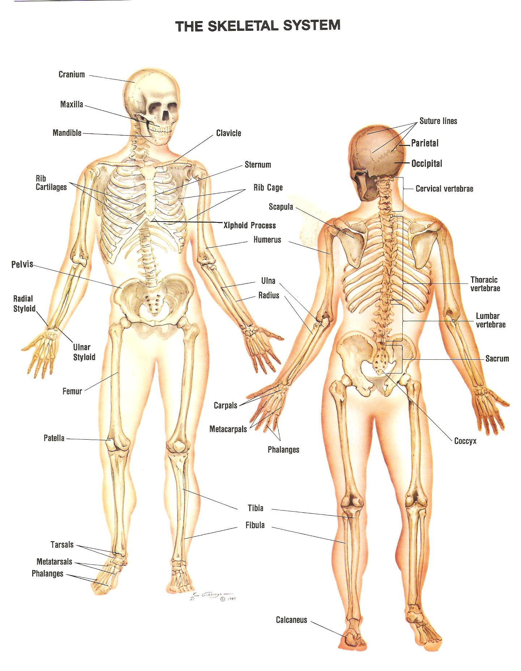
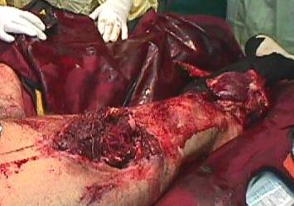
TRAUMA
MUSKULO SKELETAL

Slide 4
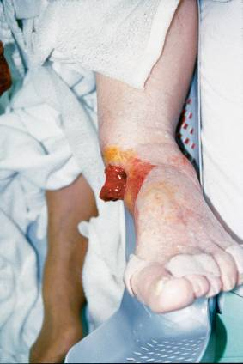
TRAUMA EKSTRIMITAS
  Fraktur
  Dislokasi
  Trauma Amputasi

Slide 5
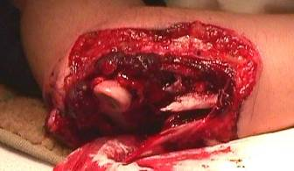
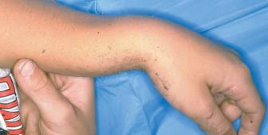
FRAKTUR
  Open (terbuka)
    Kontak dgn lingkungan luar
    Bahaya kontaminasi
    Menyebabkan perdarahan eksternal
  Closed (tertutup)
    Tidak ada kontak dgn lingkungan
    Bahaya terkontaminasi
    Menyebabkan perdarahan internal

Slide 6
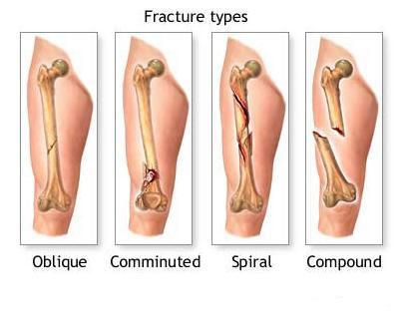
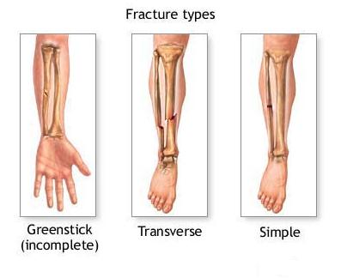
Tanda dan Gejala Fraktur
Nyeri dan kemerahan.
Pembengkakan.
Deformitas.
Krepitasi.
Keterbatasan gerak sendi.
Bone expose.
Perubahan posisi.

Slide 7
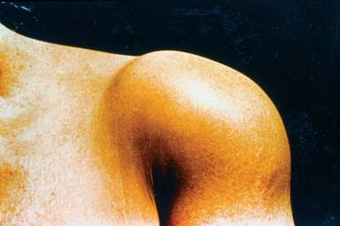
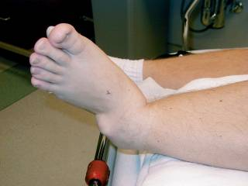
Dislocations
Terjadi perubahan anatomis
Px kesakitan
Immobilisasi dengan bidai
Jangan melakukan reposisi

Slide 8
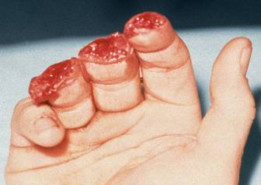
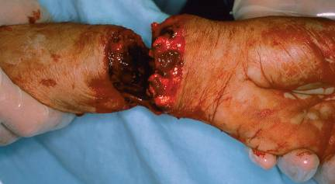
Amputations
    Dapat mengancam nyawa
    Potensial menyebabkan perdarahan massif
    Re-implantasi (6-8 jam) hanya bisa pada amputasi tertentu (bukan crushing)
    Dapat dilakukan tourniket → WASPADA

Slide 9
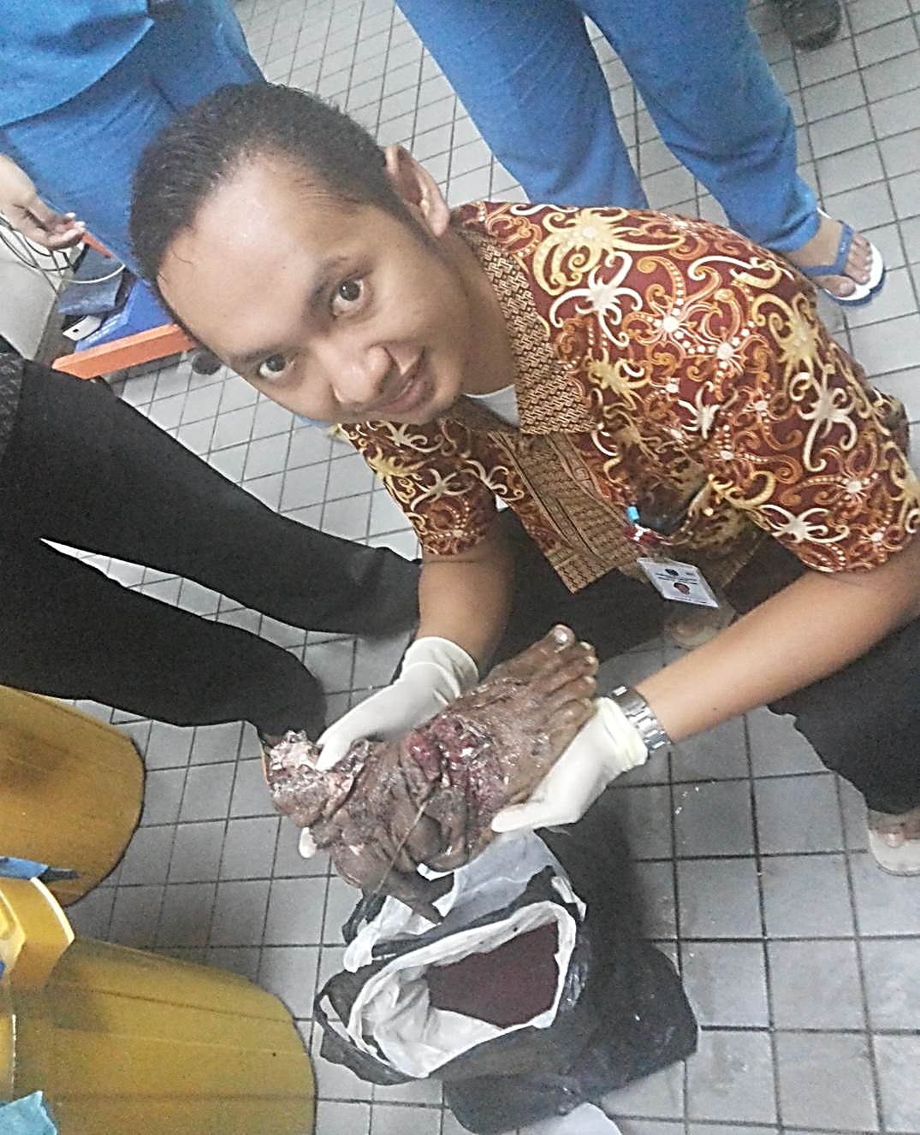
CARA MEMBAWA AMPUTAN
Bersihkan bagian yang terpotong dengan cairan isotonik
Bungkus dengan kasa steril
Masukkan kedalam kantong plastik
Kantong plastik tersebut masukkan ke dalam termos / kantong plastik yang lain yang berisis batu es
Bawa bersama pasien ke rumah sakit

Slide 10
Pembidaian
Pengertian
  Memasang alat untuk mempertahankan kedudukan tulang.
Indikasi
  Patah tulang terbuka / tertutup
Tujuan
  Mencegah pergerakan tulang yang patah
  Mengurangi nyeri
  Mencegah cedera lebih lanjut
  Mengistirahatkan daerah patah tulang
  Mengurangi perdarahan.

Slide 11
Aturan Umum Pemasangan Bidai
☞ Lepaskan pakaian yang menutup bagian yang fraktur
☞ Periksa pulsasi, motorik dan sensorik (PMS) bagian distal
☞ Lakukan traksi ringan
☞ Tutup daerah luka dan hentikan perdarahan
☞ Pasang bidai dengan melewati 2 sendi pd tulang yang patah
☞ Bila ada cedera lain yang lebih serius atasi lebih dulu

Slide 12
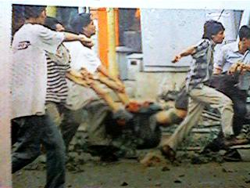
LIFTING
&
MOVING

Slide 13
Bagaimana mengangkatnya..?
Ergonomi Tubuh→ Penggunaan tubuh anda yang benar untuk membantu pengangkatan dan pemindahan
PERHATIKAN
Berapa berat objek?
Pasien Berat → Paramedik : Otak !!!
Bagaimana karakterisitik fisik kita?
Patner → sama tinggi??
Komunikasi 1, 2, 3 → Angkat / Awas,
Siap → Angkat ?

Slide 14
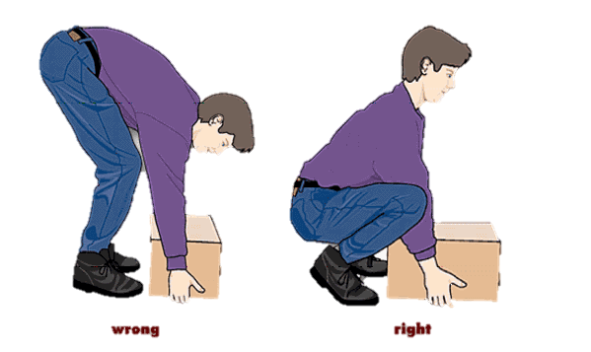
PANDUAN MENGANGKAT
Kenali kemampuan diri
Kedua kaki berjarak sebahu
Jangan membungkuk→ Gunakan kaki bukan pungung
Tangan menghadap kedepan
Tubuh sedekat mungkin dengan beban
Pada saat mengangkat tubuh Jangan memutar
Teknik Mengangkat

Slide 15
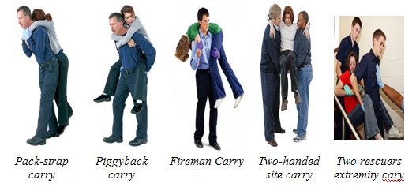
Jenis Pemindahan Penderita
Pemindahan Darurat
Kapan dilakukan ?
Tempat kejadian berbahaya
Perawatan kondisi yang mengancam hidup memerlukan resusitasi
Anda harus menolong penderita lain.

Slide 16
2. Pemindahan mendesak (URGENCY)
Kapan dilakukan ?
  A, B, C, D & E sudah stabil
  Cedera sudah di imobilisasi
  Perawatan kondisi penderita memerlukan pemindahan
  Faktor-faktor pada tempat kejadian menyebabkan kondisi penderita menurun

Slide 17
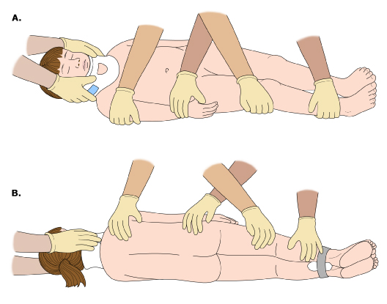
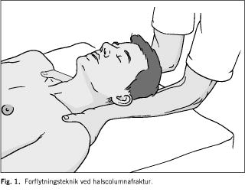
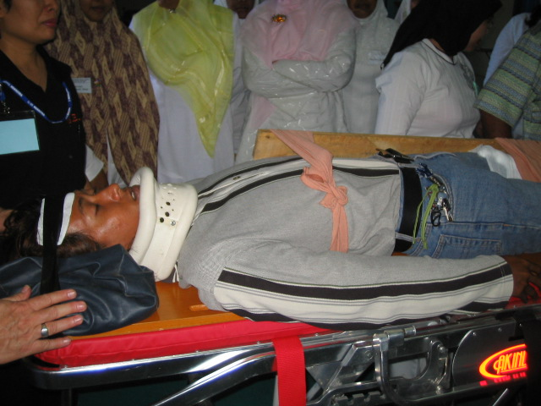
TEKHNIK “LOG ROLL”

Slide 18
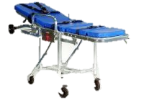
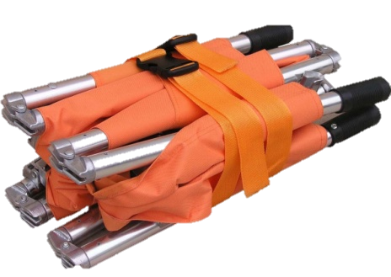
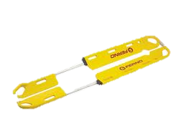
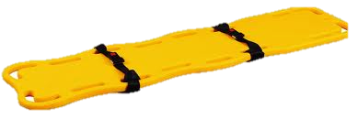
Peralatan Untuk Membawa Penderita
TANDU
WHEELED STRECHER
SCOOP
LSB

Slide 19
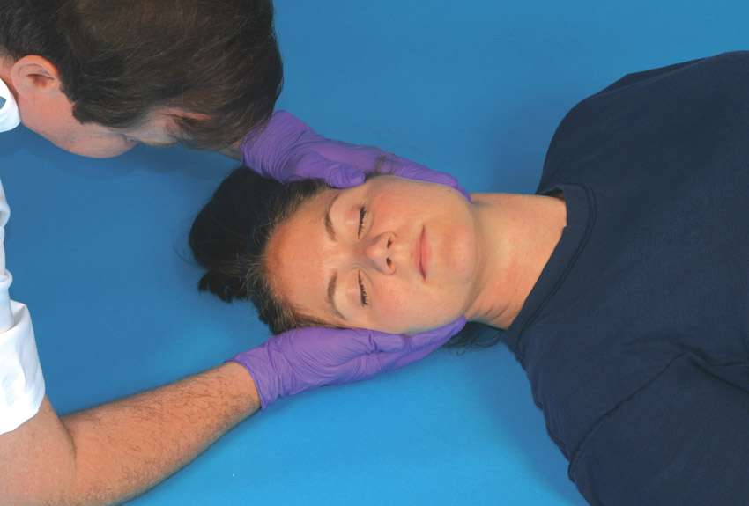
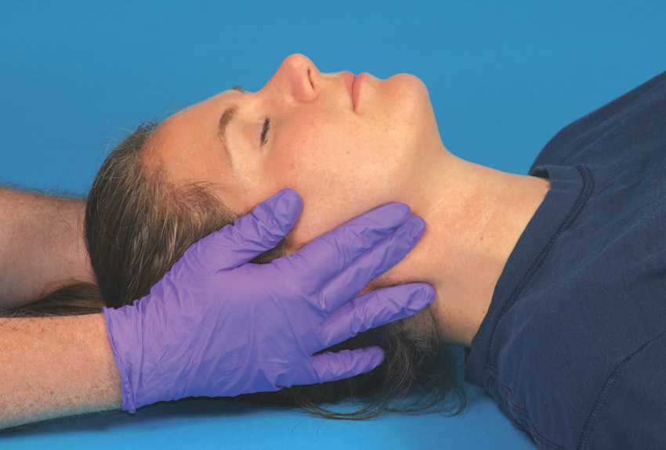
26-1: Performing Manual In-Line Stabilization 1
(1 of 2)
1.
2.
Kneel behind the patient and place your hands firmly around the base of the skull on either side.
Support the lower jaw with your index and long fingers, and the head with your palms. Gently lift the head into a neutral, eyes-forward position, aligned with the torso. Do not move the head or neck excessively, forcefully, or rapidly.

Slide 20
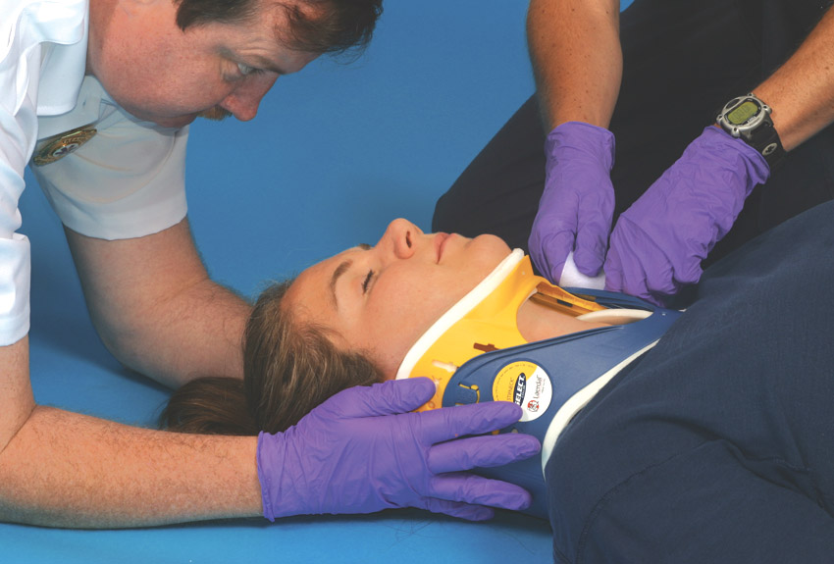
26-1: Performing Manual In-Line Stabilization)-1
(2 of 2)
3.
Continue to support the head manually while your partner places a rigid cervical collar around the neck. Maintain manual support until you have completely secured the patient to a backboard.

Slide 21
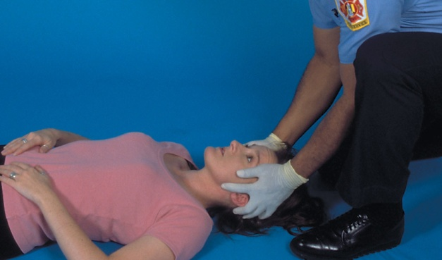
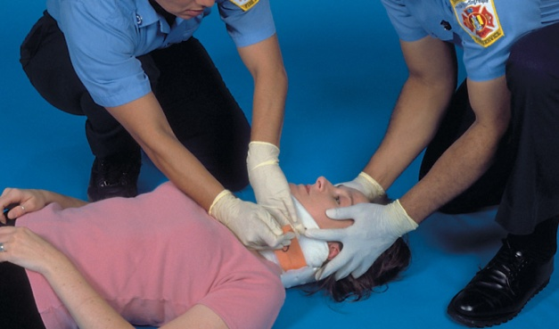
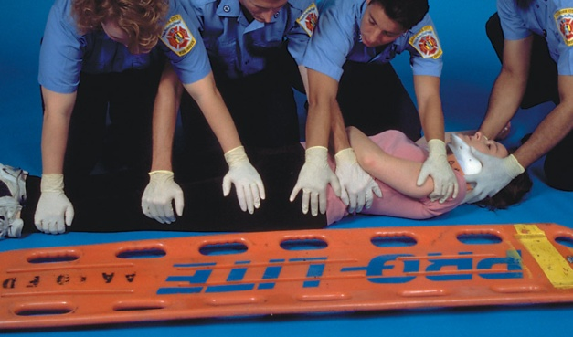
26-2: Immobilizing a Patient to a Long Backboard
(1 of 4)
1.
2.
3.
Apply and maintain cervical motion restriction. Assess distal functions in all extremities.
Apply a cervical collar.
Rescuers kneel on one side of the patient and place hands on the far side of the patient.

Slide 22
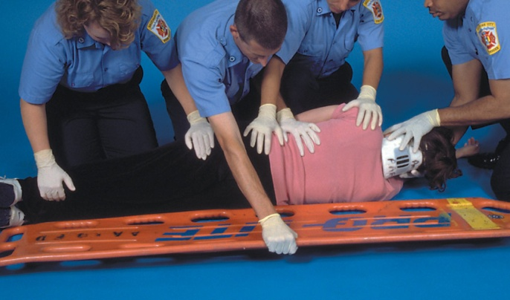
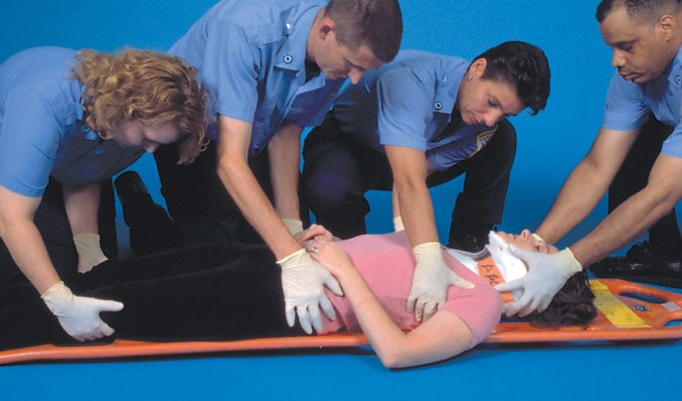
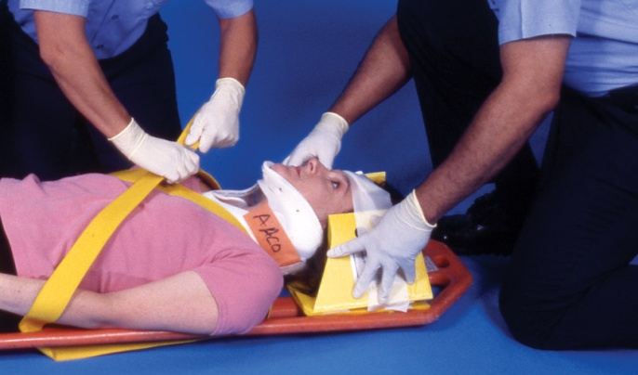
26-2: Immobilizing a Patient to a Long Backboard
(2 of 4)
4.
5.
6.
On command, rescuers roll the patient toward themselves, quickly examine the back, slide the backboard under the patient, and roll the patient on the board.
Center the patient on the board.
Secure the upper torso first.

Slide 23
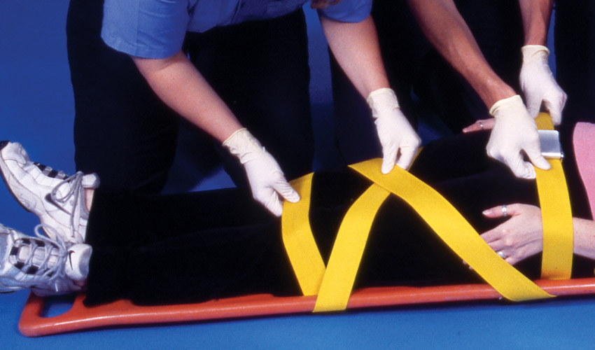
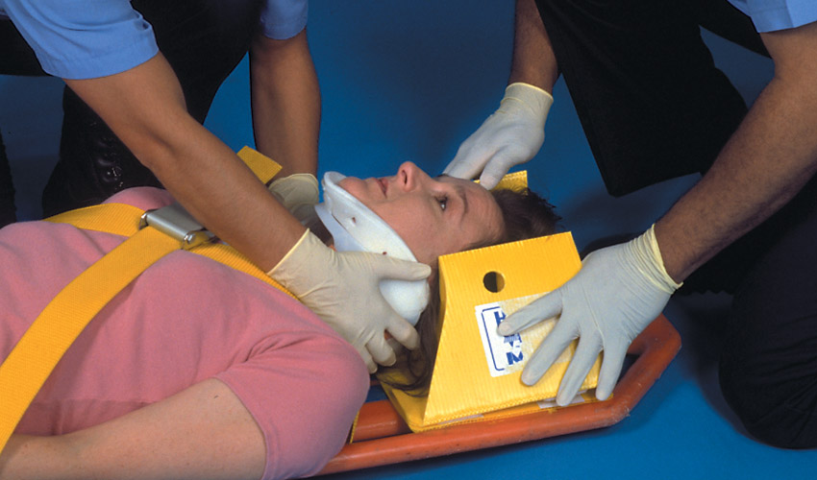
26-2: Immobilizing a Patient to a Long Backboard
(3 of 4)
7.
8.
Secure the pelvis and upper legs.
Begin to secure the patient’s head using a commercial immobilization device or rolled towels.

Slide 24
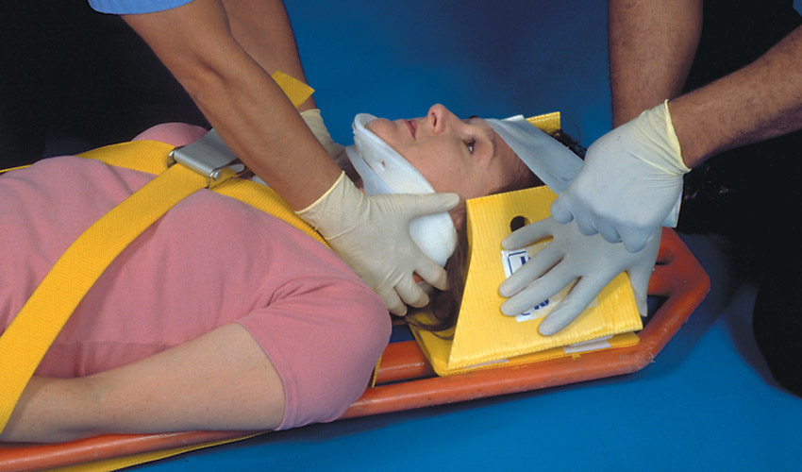
26-2: Immobilizing a Patient to a Long Backboard
(4 of 4)
9.
10.
Place tape across the patient’s forehead to secure the immobilization device.
Check all straps and readjust as needed. Reassess distal functions in all extremities.

Slide 25
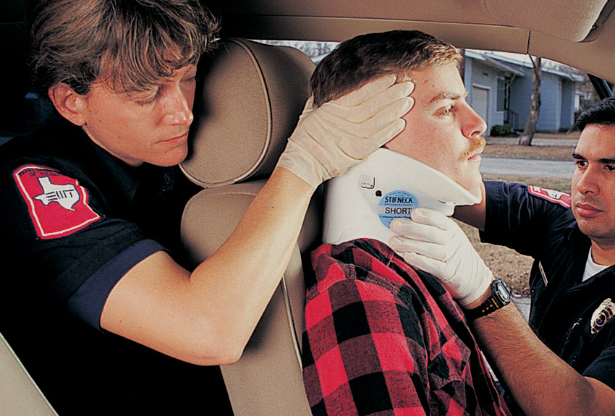
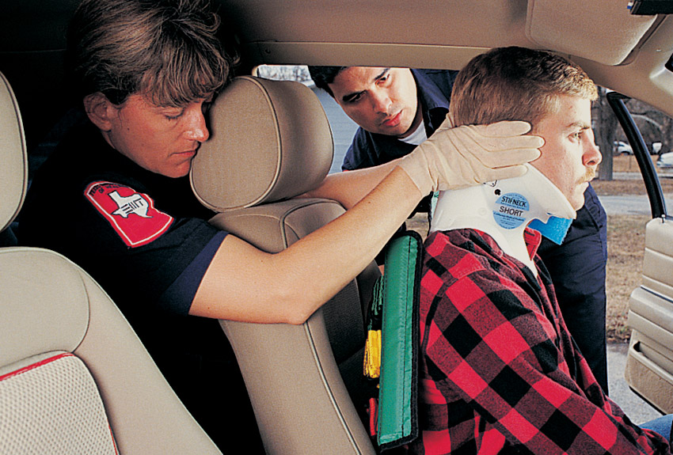
26-3: Immobilizing a Patient to a Long Backboard
(1 of 4)
1.
2.
Stabilize the head and neck in a neutral, in-line position. Assess pulse, motor, and sensory function in each extremity. Apply a cervical collar.
Insert a short spine immobilization device between the patient’s upper back and the seat.

Slide 26
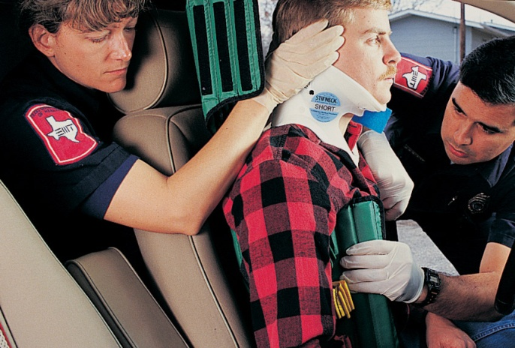
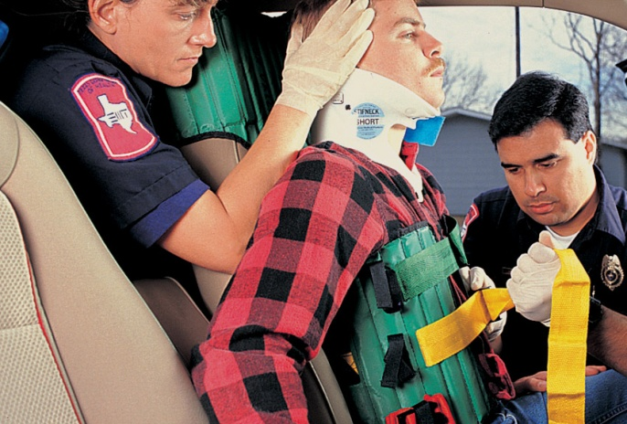
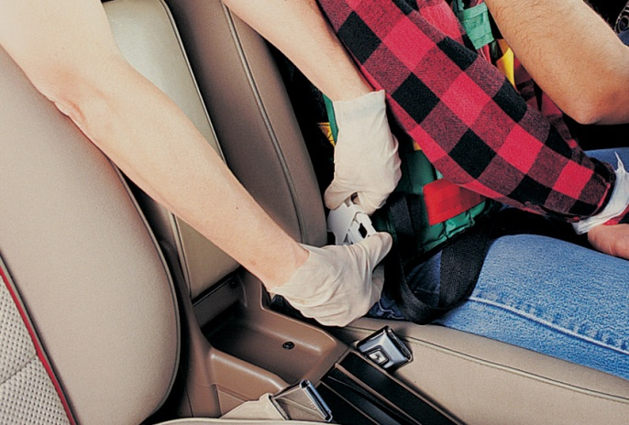
26-3: Immobilizing a Patient to a Long Backboard
(2 of 4)
3.
4.
5.
Open the side flaps, and position them around the patient’s torso, snug around the armpits.
Secure the upper torso flaps, then the midtorso flaps.
Secure the groin (leg) straps. Check and adjust the torso straps.

Slide 27
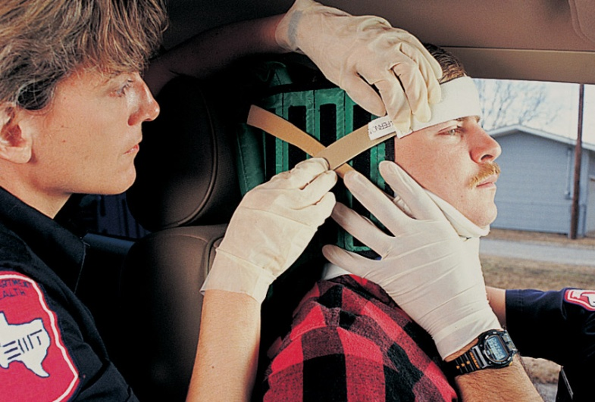
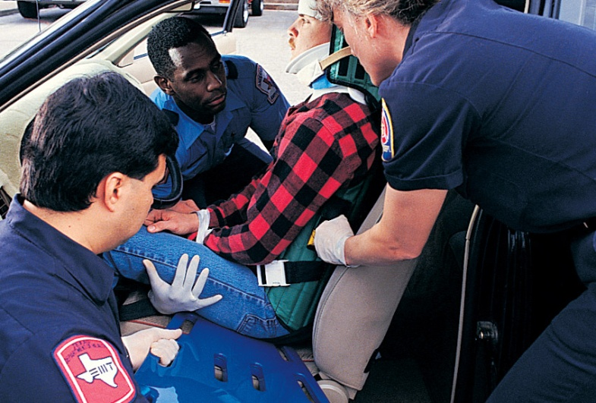
26-3: Immobilizing a Patient to a Long Backboard
(3 of 4)
6.
7.
Pad between the head and the device as needed. Secure the forehead strap and fasten the lower head strap around the cervical collar.
Place a long backboard next to the patient’s buttocks, perpendicular to the trunk.

Slide 28
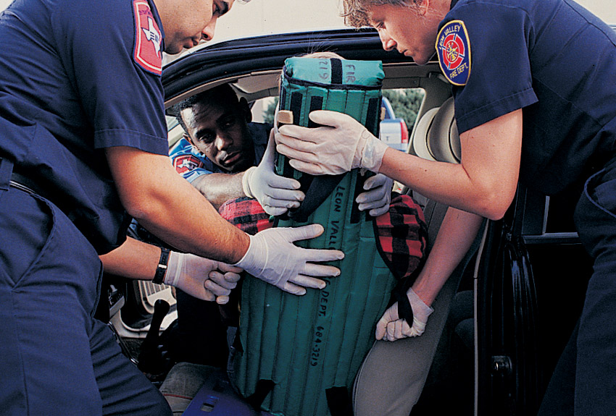
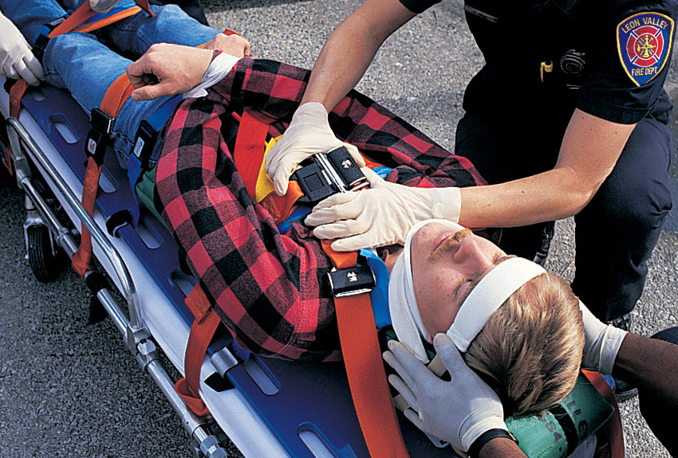
26-3: Immobilizing a Patient to a Long Backboard
(4 of 4)
8.
9.
Turn and lower the patient onto the long board. Lift the patient, and slip the long board under the short board.
Secure the immobilization devices to each other. Reassess pulse, motor, and sensory functions in each extremity.

Slide 29
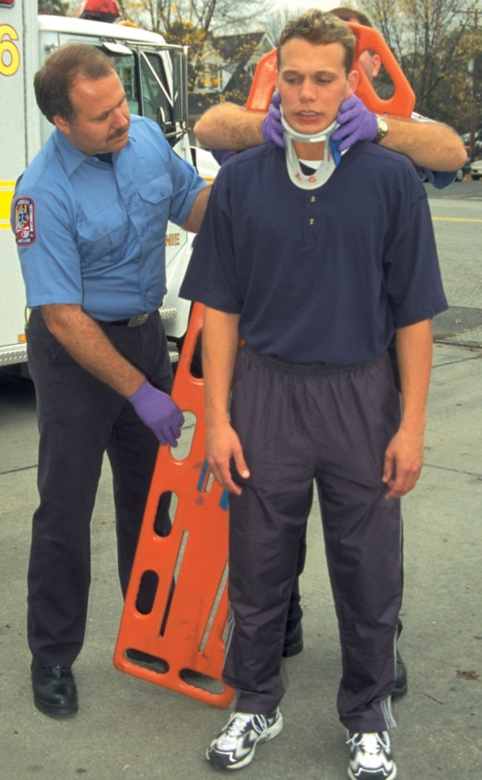
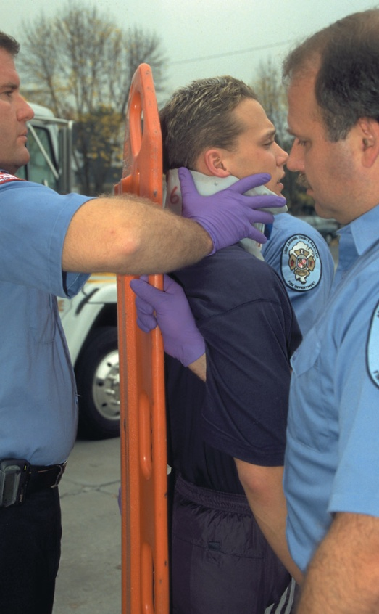
26-4: Immobilizing a Patient Found in a Standing Position
(1 of 2)
1.
2.
While manually stabilizing the head and neck, apply a cervical collar. Position the board behind the patient.
Position EMTs at sides and behind the patient. Side EMTs reach under the patient’s arms and grasp handholds at or slightly above shoulder level.

Slide 30
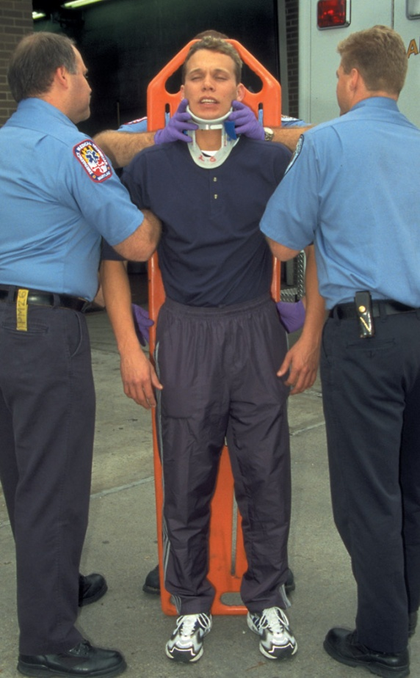
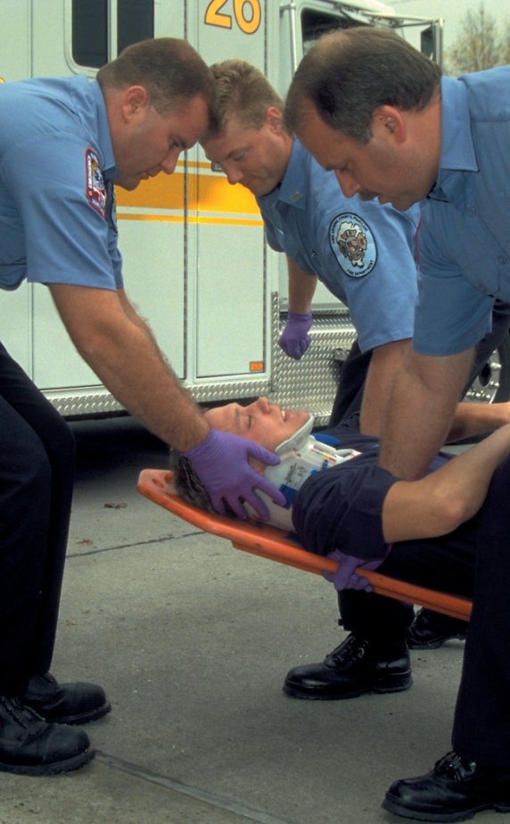
26-4: Immobilizing a Patient Found in a Standing Position
(2 of 2)
3.
4.
Prepare to lower the patient to the ground.
On command, lower the backboard to the ground as a unit under the direction of the EMT at the head.

Slide 31
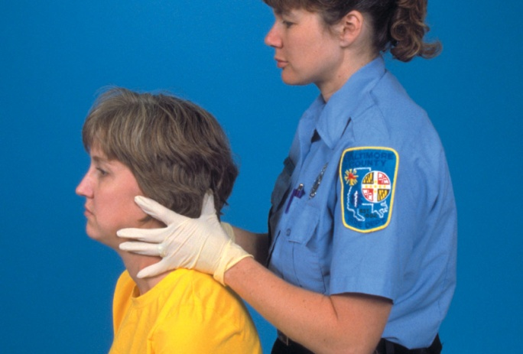
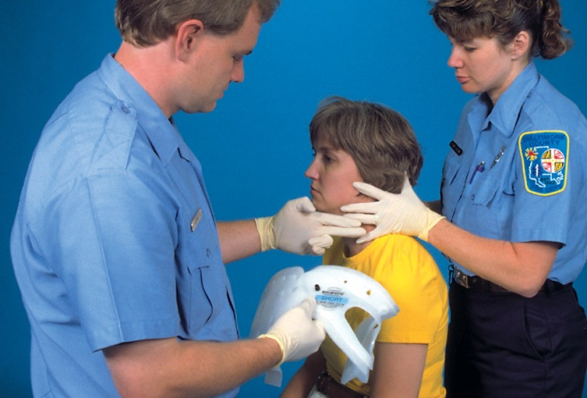
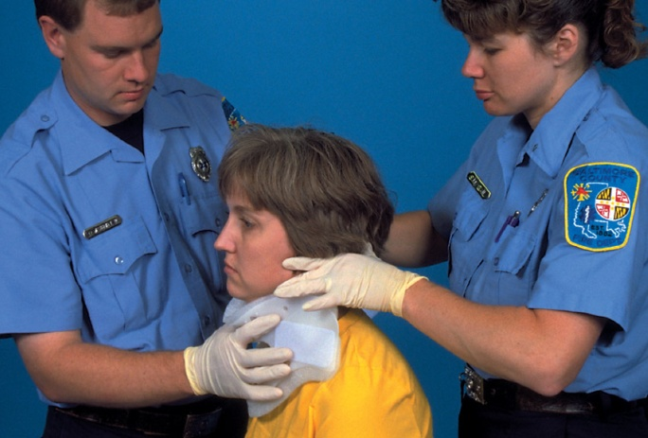
26-5: Application of a Cervical Collar
(1 of 2)
1.
2.
3.
Apply in-line motion restriction.
Measure the proper collar size.
Place the chin support first.

Slide 32


26-5: Immobilizing a Patient to a Long Backboard
(2 of 2)
4.
5.
Place the chin support first.
Ensure proper fit and maintain neutral, in-line motion restriction until the patient is secured to a backboard.

Slide 33


26-6: Removing a Helmet
(1 of 3)
1.
2.
Kneel at the patient’s head with your partner at one side. Open the face shield to assess airway and breathing. Remove eyeglasses if present.
Prevent head movement by placing your hands on either side of the helmet and fingers on the lower jaw. Have your partner loosen the strap.

Slide 34


26-6: Removing a Helmet
(2 of 3)
3.
4.
Have your partner place one hand at the angle of the lower jaw and the other at the occiput.
Gently slip the helmet about halfway off, then stop.

Slide 35

26-6: Removing a Helmet
(3 of 3)
5.
6.
Gently slip the helmet about halfway off, then stop.
Remove the helmet and stabilize the cervical spine. Apply a cervical collar and secure the patient to a long backboard. Pad as needed to prevent neck flexion or extension.

