Slide 1

Topik II
Cara membuat proposal riset studi lanjut di luar negeri dan strategi membuat motivation letter yang baik

Slide 2
“9 Hari Karantina Beasiswa: Siap Meraih Kesempatan Studi Lanjut di Luar Negeri”
Content Creator:
Andre Pupung Darmawan (041711433172), Departemen Ekonomi Syariah.
Dosen Pembimbing :
Angga Erlando., S.E., M.Ec.Dev, Departemen Ilmu Ekonom.
FAKULTAS EKONOMI DAN BISNIS
UNIVERSITAS AIRLANGGA

Slide 3
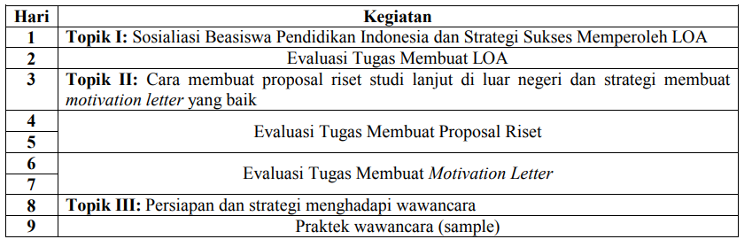
Skema Implementasi Kegiatan

Slide 4
Outline Inti Pelatihan
Topik I: Sosialiasi Beasiswa Pendidikan Indonesia dan Strategi Sukses Memperoleh LOA
Topik II: Cara membuat proposal riset studi lanjut di luar negeri dan strategi membuat motivation letter yang baik
Topik III: Persiapan dan strategi menghadapi wawancara

Slide 5
Topik II: Cara membuat proposal riset studi lanjut di luar negeri dan strategi membuat motivation letter yang baik
#2
Orientasi Materi dengan Desain 9 hari Karantina Berfokus Pada Konteks Memperolah Beasiswa S2 di Luar Negeri

Slide 6
#1 Tema/Topik

Slide 7
Strategi Membuat Proposal Research
Hal-hal yang perlu diperhatikan
Perlu memperhatikan terkait konten, format tulisan, aturan dan sejenisnya yang dibuat oleh pemberi beasiswa atau kampus tujuan
Tema/Topik
Outline/Konten Proposal
Teknis Penulisan
Bahasa Penulisan
Novelty dalam proposal
(tidak wajib)
Misalnya jika aturannya tertulis maksimal 10 halaman dengan daftar pustaka maka aturan itu tidak boleh di langgar

Slide 8
Strategi Membuat Proposal Research
Tema/Topik
Tema/Topil yang dipilih setidaknya memenuhi kriteria sebagai berikut:
Menarik dan Kekinian
Sesuai passion dan bidang kemampuan
Dapat menuntun saudara pada celah/gap research
Teori dengan Teori
Mendalami dan Memahami Literatur-literatur Sebelumnya
Teori dengan Lapangan
Lapangan dengan Lapangan

Slide 9
Strategi Membuat Proposal Research
Tema/Topik
Topik yang cukup menarik saat ini berkaitan dengan :
Perekonomian Global (Perdagangan Internasional atau Keuangan Internasional)
Keberlanjutan Lingkungan
Tenaga Kerja, Demografi (Bonus Demografi), Pengangguran
Kemiskinan, Ketimpangan, Keterbelakangan
yang Terbaru Kajian Mengenai→ Ekonomi Kemaritiman, Ekonomi Kriminologi, Ekonomi Energi, Ekonomi Kesehatan, dan lainnya
Pada pelatihan ini kita akan praktek/tutorial dengan
mengambil tema mengenai Ekonomi Korupsi

Slide 10
Strategi Membuat Proposal Research
Bagaimana Bila Tema/Topik yang ditawarkan
Calon Pemberi Beasiswa Tidak Sesuai Passion ?
“Menyesuaikan”
Tidak Terlalu Jauh Dengan Tema-Tema Ekonomi
Tulisan Dipersiapkan Dengan Matang
Berusaha Mencari dengan Jeli Gap Penelitian
Menambah Instensitas Untuk Membaca Topik Terkait
Harus Membangun Koneksi dengan Pakarnya
(Bisa Diskusi)
Tema/Topik

Slide 11
Strategi Membuat Proposal Research
Bagaimana Sebaiknya Paradigma Penelitian Yang Digunakan ?
Fokus dalam Sesi ini:
Tema/Topik
Kuantitatif
Kualitatif
Positivisme
Non-Positivisme
Objective:Base Theory
Subjective:Fenomena
Alat-Alat Ekonometrika
Wawancara, Dokumentasi, dan
Observasi, Coding, dan lainnya
Data Kuantitatif
Data Kualitatif

Slide 12
Strategi Membuat Proposal Research
Perlunya Spesifik dalam Mengambil Tema (Fokus)
Kemiskinan
Eko. Publik
Ekonomi
Kebijakan Pemerintah
Tenaga Kerja
Pembangunan
Mikro
Makro
Pertumbuhan Ekonomi
Pengangguran
Moneter
Stock Market
Ekonomi Internasional
Keuangan Internasional
Moneter Internasional
Impor
Pedagangan Internasional
Pasar Valas
Finansial Globalisasi
Gravity Model
Ekspor
Level Harga
Politik Perdagangan
Kecenderungan Perdagangan
Kebijakan Perdagangan Internasional
Tema/Topik
Mobilisasi TK Internasional
Integrasi Ekonomi Kawasan

Slide 13
Strategi Membuat Proposal Research
Perlunya Teknik dalam Membaca Literatur
dengan Cepat dan Tepat
Scaning Vs Skimming
Maping
Membaca
Abstrak
Metodologi Penelitian
Kesimpulan
Pembahasan
Tema/Topik

Slide 14
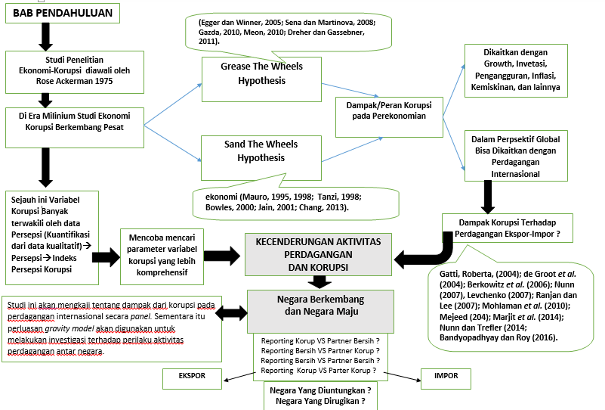


Strategi Membuat Proposal Research
Membuat Maping Memudahkan Proses Pembuatan Proposal Penelitian
Tema/Topik

Slide 15
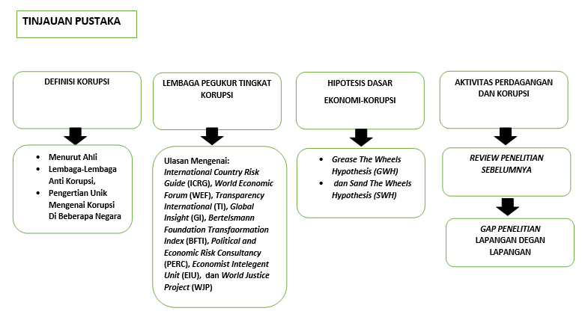
Strategi Membuat Proposal Research
Membuat Maping Memudahkan Proses Pembuatan Proposal Penelitian
Tema/Topik

Slide 16
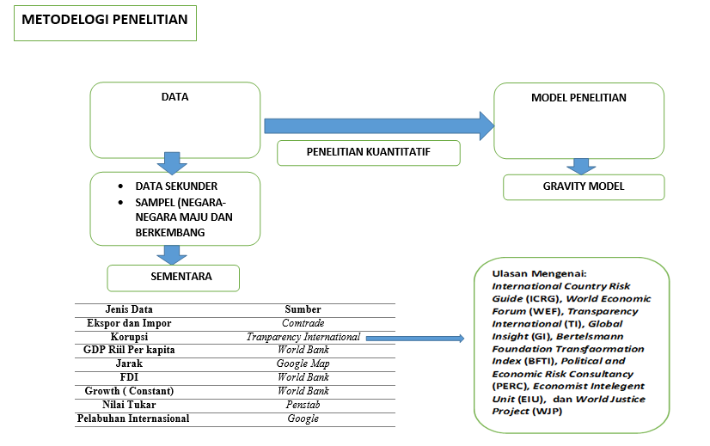
Strategi Membuat Proposal Research
Membuat Maping Memudahkan Proses Pembuatan Proposal Penelitian
Tema/Topik

Slide 17
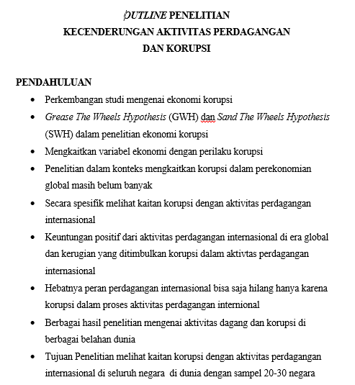
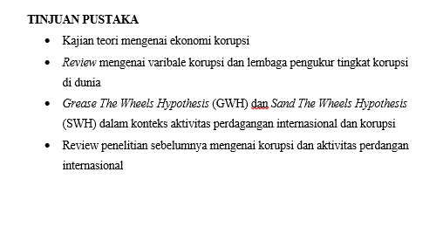
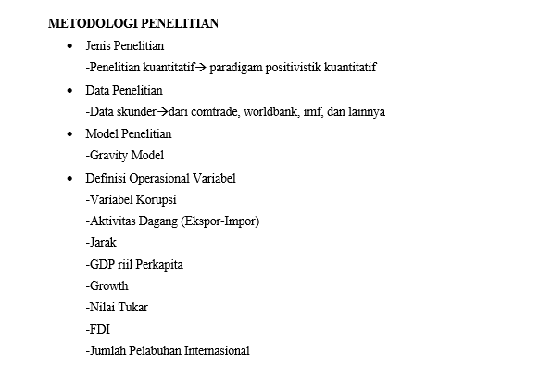
Strategi Membuat Proposal Research
Membuat Maping Memudahkan Proses Pembuatan Proposal Penelitian
Tema/Topik

Slide 18
Strategi Membuat Proposal Research
#2 Outline Proposal

Slide 19
Strategi Membuat Proposal Research
2. Outline Proposal
Pada umumnya outline proposal dibuat dalam format sebagai berikut
Latar Belakang (Background)
Tinjauan Literatur (Literature Review)
Metodologi Penelitian (Research Method)
Daftar Pustaka
(References)

Slide 20
Strategi Membuat Proposal Research
2. Outline Proposal
Latar Belakang (Background)
Judulnya:
DETERMINANTS OF ECONOMIC CORRUPTION: A CROSS-COUNTRY DATA ANALYSIS

Slide 21
Strategi Membuat Proposal Research
Latar Belakang (Background)
Corruption that can be generally defined as the use of public power for individual interest is a universal, complex and multifaceted concept (Aidt, 2003, p. 632). It can take many forms. Public office can be misused by bribery, embezzlement, extortion, fraud, nepotism, patronage, theft of state assets and insider trading. This phenomenon has been seen either as a structural problem of politics or economics, or as a cultural and individual moral problem (Andving, Fjeldstad, Amundsen, Sissener and Soreide, 2000, 9; Luo, 2004, p.121). Corruption is an extremely complex social behaviour. Because it has a feature that combines the various social science in a joint research center, there have been many notable scholary studies on the corruption (Collier, 2002, p.2). With this direction almost in every branch of social disciplines in terms of his own corruption issues discussed were receiwed and reviewed. Many methods could be employed in analysing corruption. Perspectives from political science, psychology, sociology, economic, law and anthropology all provide important insights for analysis (Tekgöz, 2002, p. 8).
2. Outline Proposal
Menjelaskan Korupsi Secara Umum
Bahasan Korupsi Menarik Jika Dikaitkan dengan Ilmu Ekonomi
Topik yang menarik

Slide 22
Strategi Membuat Proposal Research
Since the early 1990s, there has been a virtual explosion of academic writing on the economics of corruption. Because the construction of indicators of corruption that could be used in empirical studies (Abed and Gupta, 2002, p.3). Since 1990‟s, owing to a great deal of empirical work done on corruption and to the new developments in measurement technics, the literature about economic analysis of corruption has notabily been arisen. There is a multidimensional picture to illustrating economic causes of corruption (Adaman, Çarkoğlu and Şenalatar, 2001, p. 8).
First, economic development or growth is determined as the preliminary factors that are the economic causes of corruption. Second besides this basic factor, there are numerous economic factors affect corruption. In the literature, government regulations, government‟s role in economy, the size of the unregistered economy, public sector recruitment and wages, poverty and inequality in income distribution, trade openness, inflation, tax system, economy‟s competitiveness and economic freedom are extensively mentioned among others as the potential economic factors that affect corruption.
Latar Belakang (Background)
2. Outline Proposal
Menjelaskan Perkembangan Kajian Ekonomi dan Korupsi
Menjelaksan Bahwa banyak tendensi yang mengarah pada faktor ekonomi yang mengakibatkan korupsi
Topik yang menarik

Slide 23
Strategi Membuat Proposal Research
Latar Belakang (Background)
2. Outline Proposal
This study aims to identify the main causes of corruption particularly within economic factors. Hence, the method of this paper is to empirically test a model that links economic factors such as economic development and growth, inflation, economic freedom and income distribution to corruption in a cross-section data on 30 members of ASIAN Countries in the average of 2000-2017 years.
Maximum likehood method is used in estimating the coefficients of the regression model. As a priority for this aim, theoretical knowledge is explained on economic causes of corruption. Then, the hypothesis of a set of theoretical knowledge are created within the framework of this assumption and tested with econometric model. The study is based on theoretical framework of Paldam (2017). However it differs from Paldam‟s study on two aspects.
First, Paldam‟s crosscountry regressions covers only the year of 1995-2000 whereas this study covers the periods of 2000-2017. Second, this study covers ASIAN‟countries whereas Paldam‟s study just covers under developed countries.
Menjelaskan gambaran rencana penelitian (data yang digunakan dan sejenisnya)
Mengungkap gap penelitian
Contohnya

Slide 24
Strategi Membuat Proposal Research
2. Outline Proposal
Tinjauan Literatur (Literature Review)
“What are the factors leading to corruption?” is the fundamental question of studies on corruption. Studies trying to determine the causes of corruption, generally underline the socio-economic, political, judiciary and cultural aspects of a country. Therefore, corruption should be considered as a social deviation instead of defining it as an individualistic action. The assumption explaining that the human behaviour is caused by the sophisticated relations among social, political, economic and cultural structures supports this argument. Because of this assumption, it is convenient to say that corruptional behaviour of individuals depends on some circumstances that do not only include economic factors but also cover political, judiciary, social and cultural elements. In the literature, empirical research on the causes of corruption focuses on political institutions, government regulations, legal systems, GDP-levels, public sector wages, trade openness, gender, education, religion, ethno-linguistic diversity and other cultural dimension, poverty, as well as the role of colonialism (Andving et al., 2000, p.79)
Mengulas gambaran perkembangan kajian korupsi dan ekonomi
Menjelaksan bahwa topik ekonomi relevan untuk dihubungkan dengan seba terjadinya korupsi
Komprehensif dan padat

Slide 25
Strategi Membuat Proposal Research
2. Outline Proposal
Tinjauan Literatur (Literature Review)
By some authors, the causes of corruption are determined as follows: The impact of national wealth (Husted 1999, Mauro 1995, Paldam 1999-2002, Lambsdorff 1999, Montinola and Jackman 2002, Treisman 2002), the size of government (Elliot 1997, LaPalombara 1994, Montinola and Jackman 2002), income distribution and poverty (Gupta, Davoodi and Terme 1998, Husted 1999, Paldam 2002, You and Khagram 2004, Shen and Williamson 2005), public sector recruitmen and wages (Rijckeghem and Weder 1997, Treisman 2000, Rauch and Evans 2000, Tanzi 1998, La Porta et al. 1998), trade openness (Wei 2000, Broadman and Recanatini 2000, Laffont and N‟guessan 1999), inflation (Braun and Di Tella 2004, Paldam 2002, Al-Marhubi 2000, Getz and Volkema 2001), economic freedom (Paldam 2002, La Polambara 1994, Goel and Nelson, 2005), political stability (Leite and Weidman 1999, Treisman 2000, Persson and Tabellini 2000), economy’s competitiveness (Shlefer and Vishny 1993, Ades and Di Tella 1997).
Mengulas gambaran tulisan sebelumnya
Dapat dihubungkan dan dikaitkan antara tulisan satu dengan yang lain
Gunakan referensi yang terindeks scopus

Slide 26
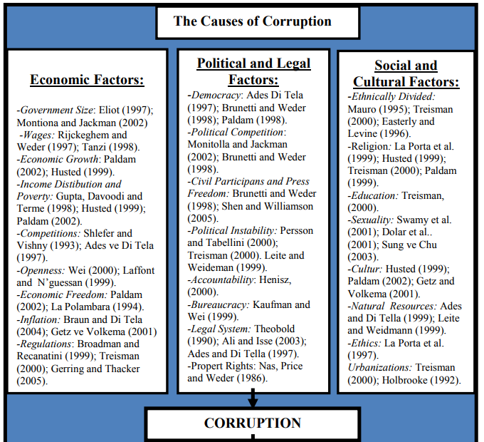
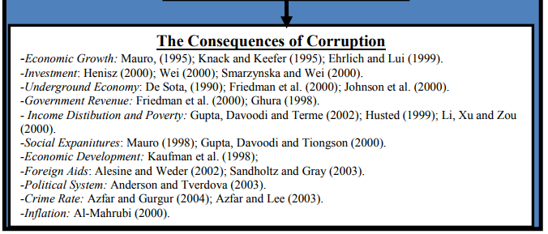
Tinjauan Literatur (Literature Review)
2. Outline Proposal
2. Outline Proposal
Untuk memudahkan alur tinjauan literatur bisa dibuat maping dahulu
Maping membantu dan memudahkan menulis literatur review
Gunakan sumber yang sesuai

Slide 27
Strategi Membuat Proposal Research
2. Outline Proposal
Untuk mendukung Tinjauan Literatur Bisa Juga Ditambahkan ...
Theoretical Framework
Misalnya:
The search for the roots of corruption has led theorists to consider a broad layout of economic, political, cultural and pyschological factors (Husted, 1999, p.339). The roots of corruption are as multiple and complex as its forms are varied (Mills, 2001, p.6). However in this prposal, only the role of economic growth and development, income inequality, inflation and economic freedom are discussed and analyzed.
Kemudian jelaskan dari setiap variabel tersebut dengan mengkaitkan pada tulisan sebelumnya
Pemilihan harus didukung oleh kajian atau penelitian sebelumnya
Jelaskan secara runut bahwa variabel tersebutmemang sesuai dan cocok dalam rencana proposal penelitian

Slide 28
Strategi Membuat Proposal Research
2. Outline Proposal
Metodologi Penelitian (Research Method)
This paper aims to answer to the question of what are the economic factors that may cause corruption. To answer the question, an empirical study is pursued by using a cross-section data including corruption, economic development, growth, inflation, economic freedom and income distribution on 30 members of ASIAN countries in the average of 2000-2017 years. Maximum likehood method is chosen in estimating coefficients of regression model. A list of 30 members of ASIAN countries is presented in appendix 1. In this study, the econometric model to be estimated is as follows:
Jelaskan metodologi penelitian
Jelaskan mengenai sampel dan hal-hal berkaitan dengan data penelitian
Harus jelas dan konsisten

Slide 29
Strategi Membuat Proposal Research
2. Outline Proposal
Metodologi Penelitian (Research Method)
In this study, the econometric model to be estimated is as follows:
CPI= c + α1 GDP + α2 G + α3 I + α4 EF + α5 GINI + ε............. (1)
where CPI is a corruption perception index; GDP stands for GDP per capita; G is the growth rate of gross domestic product; I is the inflation rate; EF is a economic freedom index; GINI is a Gini coefficient; c is a constant and ε is the error term. This study differs from others on some aspects. First, while the other studies have preferred to use the method of simple OLS estimation, in this study the Tobit model of censored regression models is employed to estimate the equation (1) using cross section data on the variables included in the model. Since the dependent variable, corruption index, has a certain points (from 0 to 10), OLS method is inconsistent and biased in estimating the regression models (Gujarati, 1999, p. 572; Kennedy, 2006, p. 309; Wooldridge, 2001, p. 517). Therefore, “Censored Regression Model” is used instead of OLS.
Jelaskan Model yang digunakan
Jelaskan alat dan referensi dari estimasi model
Model harus jelas dan tidak ambigu

Slide 30
Strategi Membuat Proposal Research
2. Outline Proposal
Metodologi Penelitian (Research Method)
The dependent variable of this study is Transparency International‟s (TI) annual index of “Corruption Perception Index (CPI)” for the average of 2000-2017. Another independent variables of this study are Gross Domestic Product (GDP) per capita in purchasing power standards, Growth Rate of Gross Domestic Product (G) is calculated as volume-percantage change on previous year, Inflation rate (I); annual average rate of change in harmonized induces of consumer prices. These indicators were extracted from the WORLD BANK. For economic freedom (EF) data are taken from the Fraser Institute‟s economic freedom indexs. To get inequality of income distribution in this study Gini coefficient (GINI) from World Bank Data file is used. All remaining variables are averaged over the period of 2000-2017 years.
Jelaskan Variabel yang digunakan
Jelaskan sumber data
Jelaskan dengan gamblang

Slide 31
Strategi Membuat Proposal Research
2. Outline Proposal
Daftar Pustaka
(References)
Harvard Style
Nwabuzor, Augustine. 2005. Corruption and Development: New Initiatives in Economic Openness and Strengthened Rule of Law. Journal of Business Ethics, Vol.59, No.1, June: 121-138.
Pellegrini, L. dan Gerlagh, R. 2008. Causes Of Corruption: A Survey Of Cross-Country Analyses And Extended Results. Economics of Governance, Vol. 9, No. 3, July: 245-263.
Pieroni, L. dan Agostino. 2012. Corruption And The Effects Of Economic Freedom. European Journal of Political Economy, Vol. 29, August: 54-72.
Nama Penulis (Nama Belakang). Tahun. Judul Joural. Publisher. Vol. 29, August: 54-72.

Slide 32
Strategi Membuat Proposal Research
3. Teknik Penulisan
4. Bahasa Penulisan
Perlu mencari referensi contoh proposal sebelumnya
Sesuai format yang ditentukan
Tidak bertele-tele dan lugas
Banyak konsultasi dengan yang lebih berpengalaman
Perhatikan pengutipan dan daftar pustaka
Usahakan tidak typo dan salah saat ditranslate ke bahasa inggris
Penempatan literatur/sumber referensi harus sesuai
Perlu dikonsultasikan dan dilakukan pengechekan bahasa kepada yang lebih ahli

Slide 33
Tips Dan Trick Membuat Motivation Letter

Slide 34
Tips Dan Trick Membuat Motivation Letter
Motivation Letter
Kepada Lembaga Pemberi Beasiswa
Kepada professor yang akan menjadi pembimbing
Mendapatkan Beasiswa
Mendapatkan LoA
Loa Conditional/Unconditional
Biasanya menjadi syarat

Slide 35
1. Tips Dan Trick Membuat Motivation Letter
Motivation Letter
Start Strong
Kepada professor yang akan menjadi pembimbing
Perhatikan Struktur
Pemilihan diksi/kata
(no grammar error)
Mendapatkan LoA
Jelaskan dengan detail
Conclusion yang jelas
Loa Conditional/Unconditional
Biasanya menjadi syarat

Slide 36
Tips Dan Trick Membuat Motivation Letter
Buatlah motivation yang tidak punya heading, hanya sekedar a bunch of words, “That could lead to fatality”.
Banyak bagian admission di universitas luar negeri berpendapat bahwa ‘We receive more than 1,500 applications. It’s like jungle warfare!‘. Jadi awalan harus menarik, sebagai bentuk persaingan dan nilai tawar kandidat
Start Strong
1
Paragraf 1
Economics is a rigorous discipline to which I find myself was intensely attracted. When elementary school, I used to sell my handicraft to my friends. Then in college, I made and sold my paint-shoes named “Soeketi”. And now I am building my business by making a clothing named “Shohih”, which has been exported to some other provinces. For me, it is not only an economic activity but also hobby, self-actualization and passion.

Slide 37
Tips Dan Trick Membuat Motivation Letter
Paragraf 2 sampai 3: kenapa ingin mengambil jurusan tersebut ?
Perhatikan Struktur
2
kenapa ingin mengambil jurusan tersebut secara spesific,
kompetensi dan kelinearan program s1 dengan jurusan yang diambil. (ingat bahwa motivation letter dibuat untuk menunjukkan ambisimu untuk diterima di program studi mereka.
Jelaskan dengan detail ‘what attracted you to this particular master program?) tunjukkan juga bahwa kamu fasih betul mengenai jurusan tujuan, dan kamu sangat tertarik dengan program tersebut.

Slide 38
Tips Dan Trick Membuat Motivation Letter
CONTOH
Paragraf 2 dan 3 : kenapa ingin mengambil jurusan tersebut ?
I appreciate this opportunity to introduce myself at your University and I perceive it as a perfect opportunity to support my application for the Master program in Welfare Economics offered by your University. With my educational background and working experience, I strongly believe that I am suitable candidate for the programme. I have chosen this University as my first choice because of valuable scholarly resources and well-known reputation of the highly qualified education of the University of XXX.
Since I was young I have always had a keen interest in Economics. I began to subscribe to the periodicals dealing with current events since middle school. At the university, I focused more on the economic welfare and took some elective courses in political economy and economic theory. Through the program, I not only made a systematic study of principle of economics, but also learnt the economical analytical methods to public policy, such as Game Theory, Principal-Agent theory and Taxation theory and principles. My minor thesis was in the field of poverty, parity and policy impacts on social welfare.

Slide 39
Tips Dan Trick Membuat Motivation Letter
Paragraf 4:
highligh notable academic activities, seperti pernah mengikuti research, kegiatan voluntary di bidang keilmuanmu, jelaskan academic achievement yang pernah kamu raih, atau bahkan kegiatan magang.
Have studied in Department of Economics Airlangga University, made me not only have economical knowledge but also strong statistical base. Therefore, I used to do research with statistical approach. I had researched about poverty in Karang Asem Regency, the poorest region in Bali in 2009 and also calculated the losses due to industrial pollution. My research results were accepted provisionally by the relevant department of municipal council and I was invited to contribute to the dialogue. Since then, I found my passion on welfare economics, and I set my profession goal being an economic adviser of welfare policy and contributing to improve the lives of ordinary people. Then, as a public college and have program full scholarship and allowances from BIDIKIMISI DIKTI (Ministry of Education in Indonsia) schoolarship, Airlangga University is definitely attractive for thousands of students moreover because the knowledge guarantee. Noted there were more than 20.000 eligible-applicants who competed to apply BIDIKMISI schoolarship for just 500 student seats in academic year 2010/2011.

Slide 40
Tips Dan Trick Membuat Motivation Letter
Paragraf 5:
jelaskan transferable skills yang pernah didapat melalui aktivitas pekerjaan keikutsertaan organisasi, kompetensi dalam kompetisi di luar akademik. Tunjukkan siapa kamu sebenarnya di dunia nyata. Seperti kamu punya soft skill memimpin dan komunikasi yang excellent, dimana kamu dipercaya menjadi ketua organisasi kampus…dan lainnya
Soon after graduated, I have been working in BAPPENAS (National Development Planning Agency), as staff of Production Economic Data Division. My main job is to provide economical datato be processed into economic indicators; Gross Domestic Product (GDP), Economic Growth, Human Development Index, etc. By these economic indicators I give policy analysis, advice and information to the government to evaluate, plan and make economic policy. Therefore, I have to make sure that these indicators are reliable, relevant and precision. Then, Inspired by Sri Mulyani, former Indonesian Finance Minister who is now director of The World Bank, which has saved Indonesia from the economic crisis in 2008 made me more determined to be an economist. The real economist who help and save the people out of poverty. For now, maybe I have not been able to do what she did but I can do the other things that I could. Therefore, since 2012 I have been actively participated as member of Research and Study Division in People’s Hopes Foundation that focuses on economic empowerment and social assistance. Besides that, since 2012 I was believed to be Head of Moslem Youth Research Institute.

Slide 41
Tips Dan Trick Membuat Motivation Letter
Paragraf 6. harapan untuk diterima di jurusan di universitas tersebut
Supported by universities that expert in this field, high qualified lecturers and curriculum, I definitely believe that XXX program/XXX University can help me to improve my economic knowledge and skill. So, I can improve the quality of economic indicator to make a better planning, evaluating and decision making to support The National Development Goals. Furthermore, I exactly have a related academic background from qualified college. As a government officer and philanthropist (sesuai keadaan), any knowledge and skill that I get will be widely useful for people. The last but not the least I have so huge passion in economics that every big struggle and challenge become small.

Slide 42
Tips Dan Trick Membuat Motivation Letter
Paragraf 7. Penutup dengan mengungkap mimpi di masa depan
After finishing my master study, I plan to further my study to PhD level. My journey for knowledge searching will never cease. Moreover, I plan to share my knowledge with other people, work together with economists around the world and implement what I have learnt. In the next five years, I view myself becoming a world class economist, researcher or university lecturer. I hope that what I get will be useful for many people because the best person is the most useful for others

Slide 43
Terimakasih
“9 Hari Karantina Beasiswa: Siap Meraih Kesempatan Studi Lanjut di Luar Negeri”
Content Creator:
Andre Pupung Darmawan (041711433172), Departemen Ekonomi Syariah.
Dosen Pembimbing :
Angga Erlando., S.E., M.Ec.Dev, Departemen Ilmu Ekonom.
FAKULTAS EKONOMI DAN BISNIS
UNIVERSITAS AIRLANGGA

