Slide 1


Dynamic Panel Data Regression:
GMM Method

Slide 2
Outline
Why dynamic panel?
Motivation and design of dynamic panel
Identify the features of dynamic panel models
Describe why the pooled model, fixed effect, and random effects models are biased in a dynamic panel data model
Explain the dynamic panel generalized method of moment (GMM) estimations
Estimate the dynamic panel data models using econometric software (Stata)
Interpret the estimation results of dynamic panel data models

Slide 3
Why GMM Estimator?
Control for a simultaneity bias caused by the possibility that some of the explanatory variables may be endogenous.
Control for country specific effects, which cannot be done using country-specific dummies due to the dynamic structure of the regression equation.

Slide 4
Dynamic Panel Motivation
Many banking and finance issues are dynamic by nature and use the panel data structure to understand adjustment
Allowing for dynamics in the underlying process may be crucial for recovering consistent estimates of other parameter
Example
  Demand (i.e. present demand depends on past demand)
  Dynamic wage equation
  Economic growth
  Investment of firm
  Capital structure

Slide 5
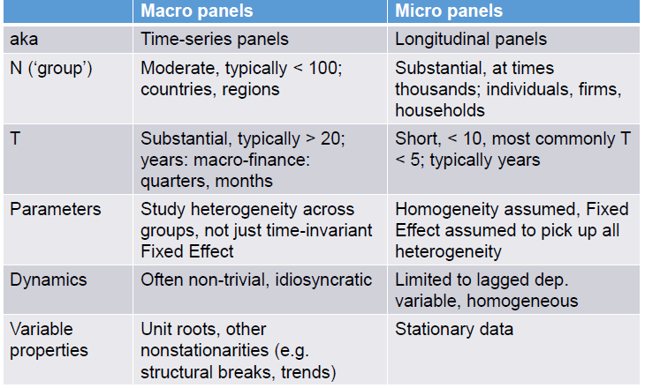
Micro (‘short T) and Macro (‘long T) Panels

Slide 6
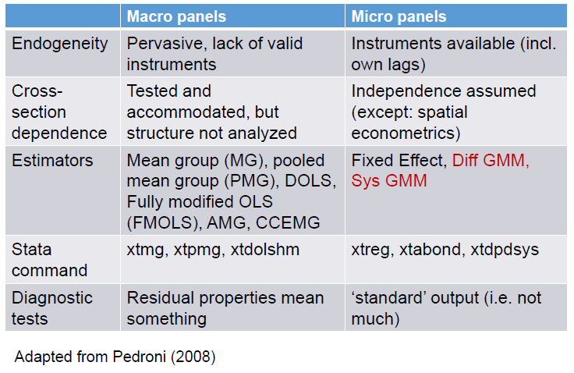
Micro (‘short T) and Macro (‘long T) Panels

Slide 7
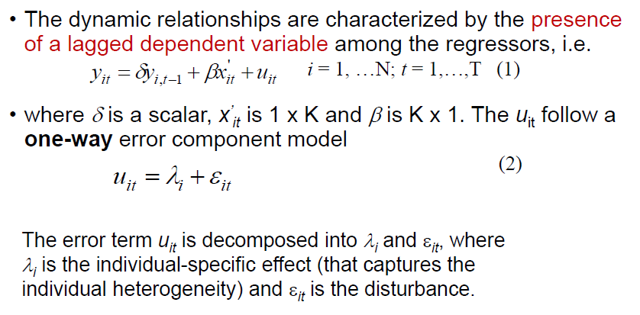
Dynamic Panels

Slide 8
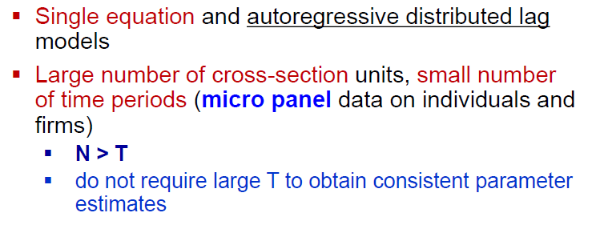
Focus on

Slide 9
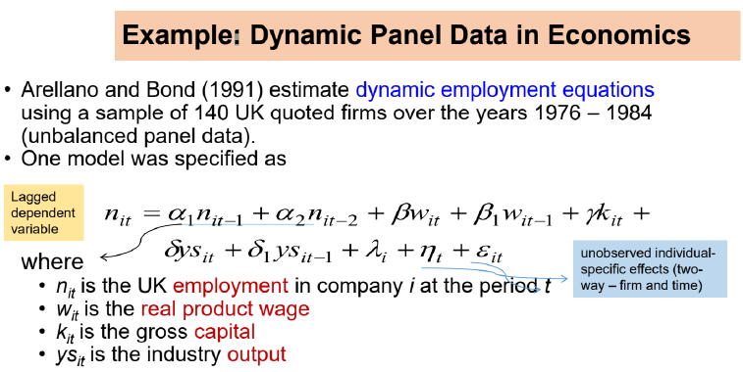

Slide 10
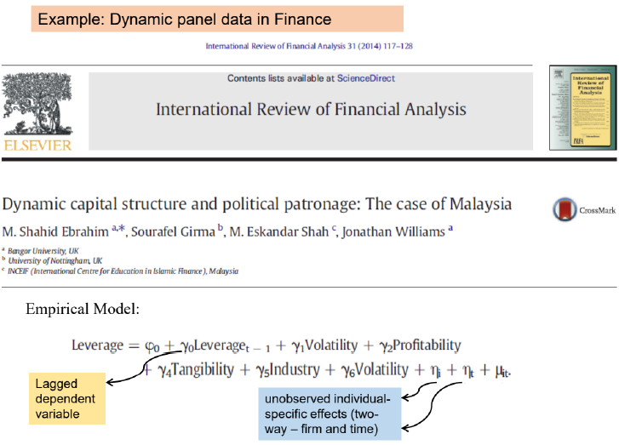

Slide 11
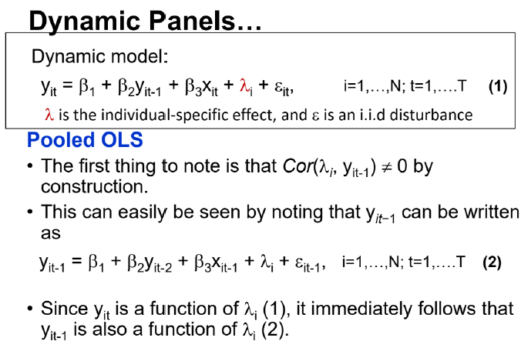

Slide 12
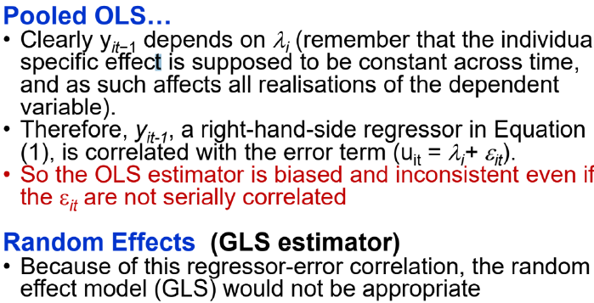
Dynamic Panel…

Slide 13
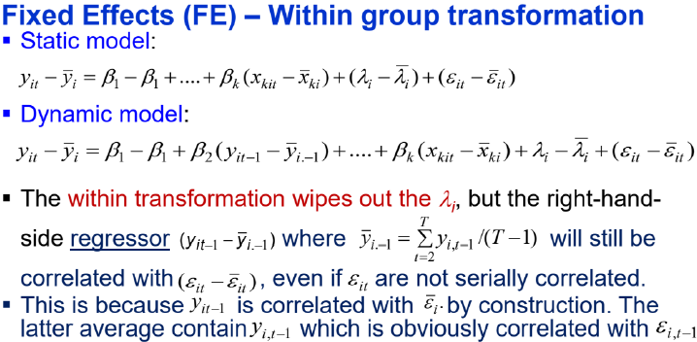
Dynamic Panel…

Slide 14
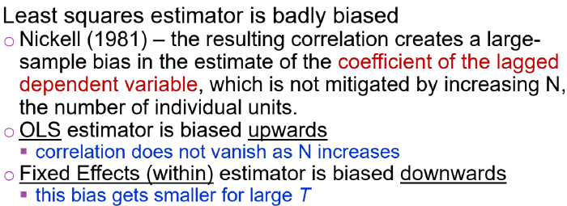
Dynamic Panel…

Slide 15
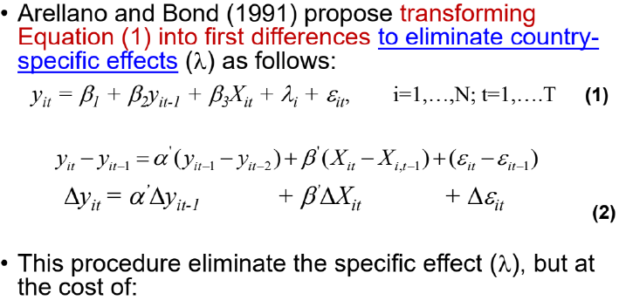
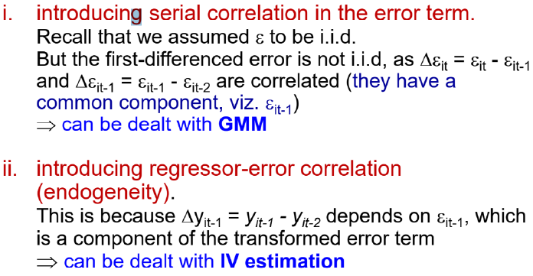
Arellano and Bond
(1991)

Slide 16
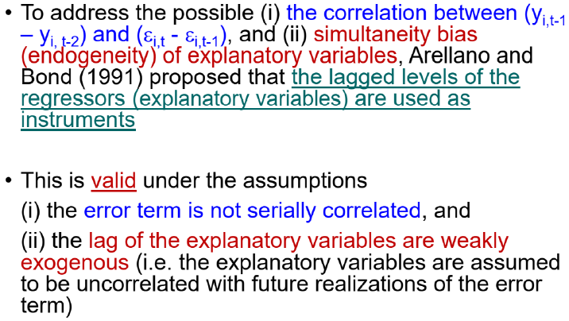
Arellano and Bond (1991)….

Slide 17
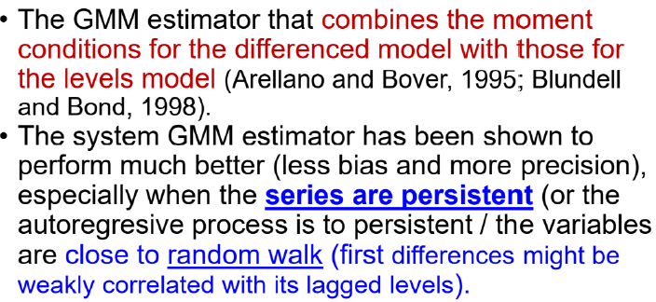
Blundel and Bond (1998)

Slide 18
The dynamic panel GMM….
There are two variants of GMM estimators, the one-and two-step estimator. Theoretically, the two-step estimator is more efficient than the one-step estimator because it uses optimal weighting matrices.
Asample with a small cross-section dimension, may lead to (i) based sitandard errors, (ii) biased estimated parameters (Windmeijer, 2005), and (iii) a weakened over-identification test (Bowsher, 2002).
•Roodman (2009) illustrates that the cause of these problems is instrument proliferations.
        Solution that reduces the dimensionality of the instrumental variable matrix.

Slide 19
The dynamic panel GMM….
The consistency of the GMM estimator depends on two specification tests / diagnostic
i. The Sargan test of over-identifying restrictions,
Failure to rejectthe null hypothesis would imply that the instruments are validand the model is correctly specified
ii. The serial correlation test in the disturbances (Arellano and Bond, 1991).
Should reject the null of the absence of the first order serial correlation (AR1), and
not reject the absence of the second order serial correlation (AR2).

Slide 20
Dynamic panel data models using Stata
Keterangan | Different | System
Comand | xtabond y x | xtdpdsys y x
 | xtabond y x, nocons
Sargan test | estat sargan | estat sargan
Autokorelasi | estat abond | estat abond
Two-step | xtabond y x, twostep | xtdpdsys y x, twostep
Robust standar error | xtabond y x, twostep vce (robust) | xtdpdsys y x, twostep vce (robust)
Limit maksimum lag | xtabond y x, maxldep(2) twostep | xtabond y x, maxldep(2) twostep

Slide 21
Dynamic panel data models using stata……
Keterangan | Different | System
One-step | xtabond2 y l.y x, gmm(l.y, collapse) iv(x) noleveleq nodiffsargan robust small | xtabond2 y l.y x, gmm(l.y, collapse) iv(x), (equation (level)) nodiffsargan robust orthogonal small
Choice instrument | noleveleq, nodiffsargan, robust, small | nodiffsargan, robust, orthogonal, small
Two-step | xtabond2 y l.y x, gmm(l.y, collapse) iv(x) noleveleq nodiffsargan twostep robust orthogonal small | xtabond2 y l.y x, gmm(l.y, collapse) iv(x), (equation (level)) nodiffsargan twostep robust orthogonal small
Choice instrument | noleveleq, nodiffsargan, twostep robust, orthogonal small | nodiffsargan, twostep robust, orthogonal, small

Slide 22
Dynamic panel data models using stata……
Keterangan | Different | System
One-step | xtabond2 y l.y x, gmm(l.y, lag(3 3)) iv(x) h(1) nolevel nodiffsargan robust small | xtabond2 y l.y x, gmm(l.y, lag(3 3)) iv(x), h(1) nodiffsargan robust orthogonal small
Choice instrument | noleveleq, nodiffsargan, robust, small | nodiffsargan, robust, orthogonal, small
Two-step | xtabond2 y l.y x, gmm(l.y, lag(3 3)) iv(x) nolevel two nodiffsargan robust orthogonal small | xtabond2 y l.y x, gmm(l.y, lag(3 3)) iv(x), h(1) two nodiffsargan robust orthogonal small
Choice instrument | nodiffsargan, robust, orthogonal small | nodiffsargan, robust, orthogonal, small

Slide 23
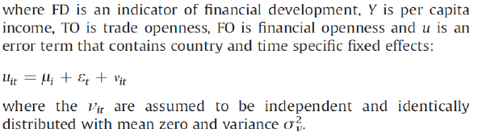
Estimate

Slide 24
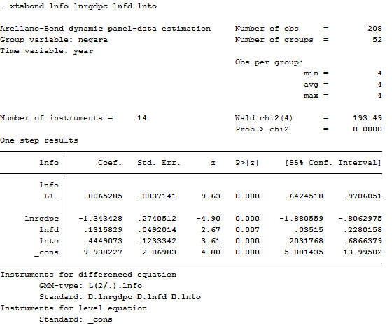
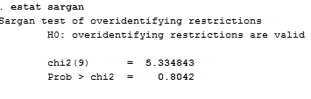
Using Stata – Different (1)

Slide 25
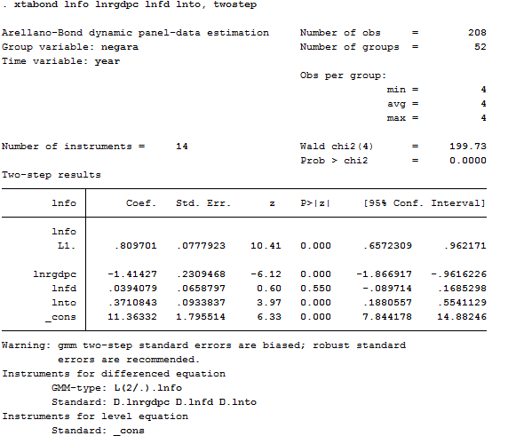
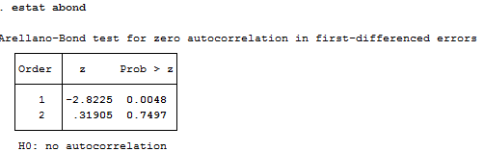
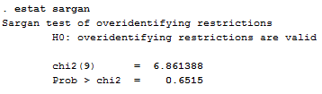
Using Stata – Different (1)……..

Slide 26
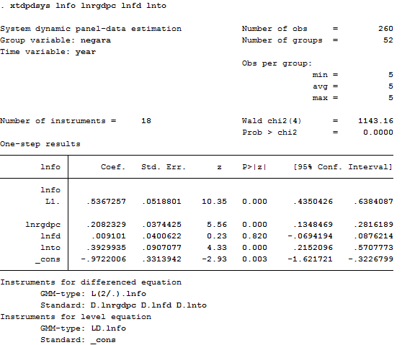
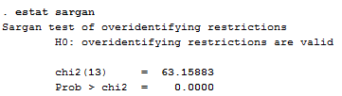
Using Stata – System (1)

Slide 27
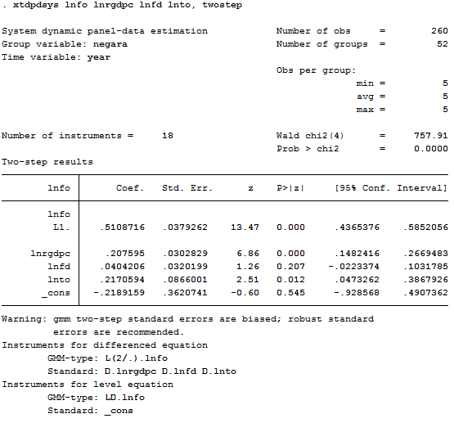
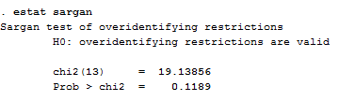
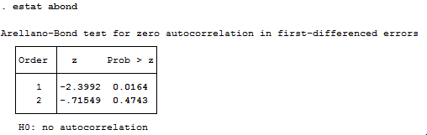
Using Stata – System (1)…..

Slide 28
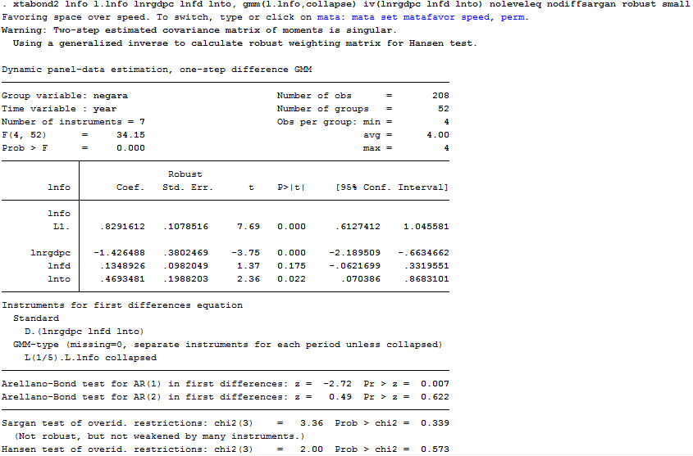
Using Stata – Different (2)

Slide 29
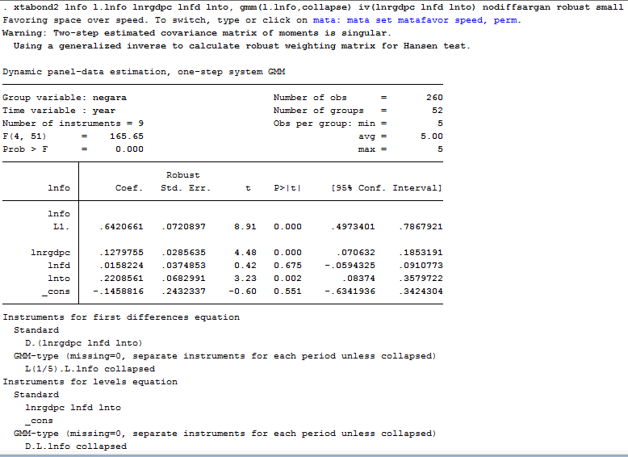
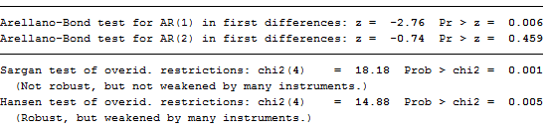
Using Stata – System (2)

Slide 30
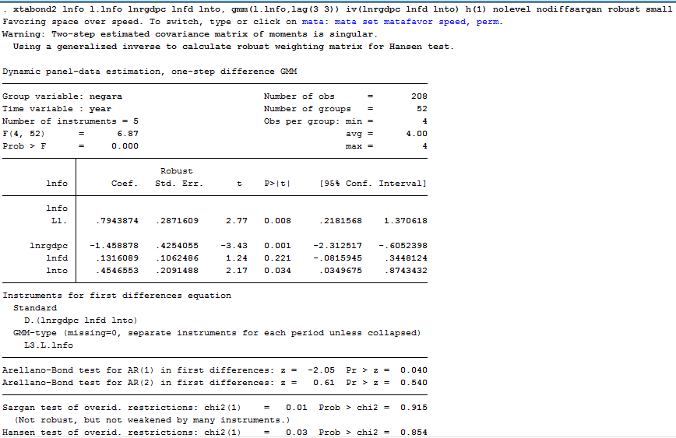
Using Stata – Different (2)

Slide 31
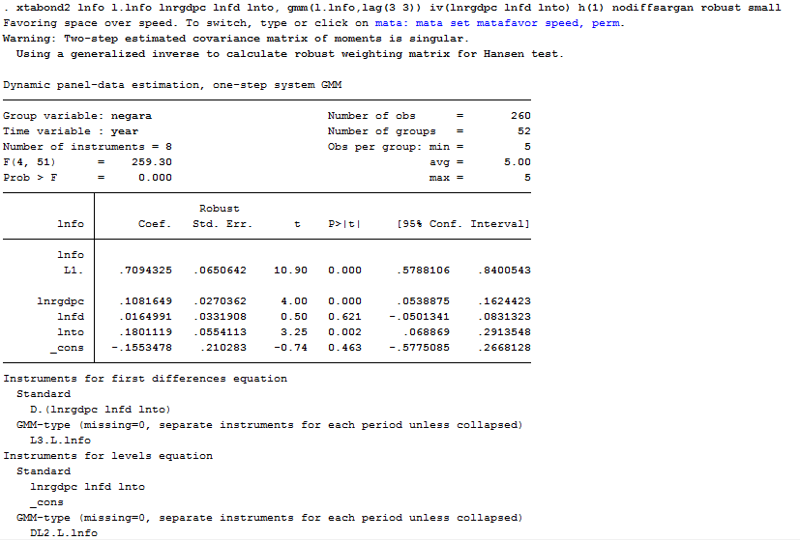
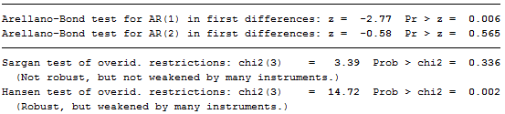
Using Stata – System (3)

