Slide 1

ARIMA

Slide 2
Outline
1
Forecasting in Economics
2
Approaches to Economic Forecasting
3
ARIMA
4
Hands on STATA

Slide 3
Concept of Forecasting
Forecasting is Process of predicting a future event.
GDP, inflation, exchange rates, stock prices, un-employment rate, and myriad other economics variable, how do we forecast them?
Before forecast the data, it’s better to analyze the time series component:
Recall statistics II:
Time Series Components:
Secular Trend
Cyclical Variation
Seasonal Variation
Irregular Variation

Slide 4
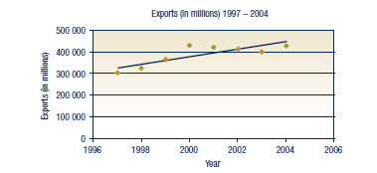
Secular Trend

Slide 5
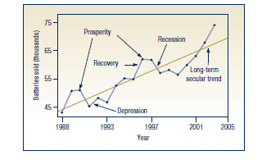
Cyclical Variation

Slide 6
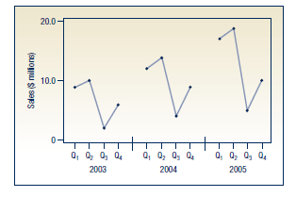
Seasonal Variation

Slide 7
Approaches to Time Series Forecasting
1
Exponential Smoothing Method
Fitting suitable curve to historical data of a given time series
2
Single-Equation regression models
3
Simultaneous-equation regression time series data
4
Autoregressive Integrated Moving Average (ARIMA)
Analyzing the probabilistic, or stochastic,, properties of economic time series on their own under the philosophy let the data speak for themselves. ARIMA sometimes called by atheoritic models.
5
Vector Autoregression Model (VAR)
Resembling simultaneous-equation model (endogenous variables). But each endo variables are explained by its lagged values.

Slide 8
AR (Autoregressive Process)
→ First order autoregressive process : AR(1) → AR (p)
→ Second order autoregressive process
Notice that in all the preceeding models only the current and previous Y values are involved, there are no other regressors. In this sense, we say that the “data speak for themselves”

Slide 9
A Moving Average (MA) Process
→ Y at time t is equal to a constant plus a moving average of the current and the past error term
A Moving Average Process is simply a linear combination of white noise error terms

Slide 10
An Autoregressive and Moving Average (ARMA) Process
→ Y has characteristic of both AR and MA, and its therefore ARMA (1,1) → ARMA (p,q)
Yt follows autoregressive and moving average component.

Slide 11
An Autoregressive Integrated Moving Average (ARIMA) Process
Briefly, the mean and variance for a stationery time series are non stationary. But, we know that many economic time series are non stationary, that is, they are integrated.
If a time series is integrated of order 1 (I(1)), its first differences are I(0), that s, stationary, and so on.
Therefore, if we have to difference time series d times to make it stationary and then apply the ARMA (p,q) model to it, we call this model as ARIMA (p,d,q) .
Example: ARIMA (2,1,2) → how to obtain this → Box-Jenkins Methodology

Slide 12
Box-Jenkins Methodology
Step 1. Identification
Find out the appropriate values of p, d, q by the using of correlogram and partial correlogram
Step 2. Estimation
Sometimes this calculation can be done by simple least squares but sometimes we use non linear model
Next step is to see whether the chosen model fits the data-reasonably well, for it is possible that another ARIMA Model might the job as well → Iterative Process
Step 3. Diagnostic Checking
Step 4. Forecasting
Are the estimated residuals white noise? Yes → Go to Step 4

Slide 13
Nature of Simultaneous-Equation Model
Identification problem
A Test for Simultaneity
A Test for Exogeneity
Step 1. Identification
Type of Model | Typical pattern of ACF | Typical Pattern of PACF
AR (p) | Decays exponentially or with damped sine wave pattern or both | Significant spikes through lags p
MA (q) | Significant spikes through lags p | Declines exponentially
ARMA (p,q) | Exponentially decay | Exponentially decay

Slide 14
Nature of Simultaneous-Equation Model
Identification problem
A Test for Simultaneity
A Test for Exogeneity
Step 1. Identification
ARIMA ( p, d, q)
Partial Autocorrelation Function (PACF)
Autocorrelation Function (ACF)
Unit Root Test (Dickey Fuller Test)

Slide 15
Nature of Simultaneous-Equation Model
Identification problem
A Test for Simultaneity
A Test for Exogeneity
Step 1. Identification (Examples)

Slide 16
Step 1. Identification (Examples)
ARIMA (p,1,q)

Slide 17
Step 1. Identification (Examples)
ARIMA (p,1,1)
ARIMA (p,1,2)
ARIMA (p,1,3)
ARIMA (p,1,4)
ARIMA (p,1,5)
ARIMA (p,1,6)

Slide 18
Nature of Simultaneous-Equation Model
Identification problem
A Test for Simultaneity
A Test for Exogeneity
Step 1. Identification (Examples)
ARIMA (4,1,1)
ARIMA (4,1,2)
ARIMA (4,1,3)
ARIMA (4,1,4)
ARIMA (4,1,5)
ARIMA (4,1,6)
ARIMA (1,1,1)
ARIMA (1,1,2)
ARIMA (1,1,3)
ARIMA (1,1,4)
ARIMA (1,1,5)
ARIMA (1,1,6)
ARIMA (2,1,1)
ARIMA (2,1,2)
ARIMA (2,1,3)
ARIMA (2,1,4)
ARIMA (2,1,5)
ARIMA (2,1,6)

Slide 19
Nature of Simultaneous-Equation Model
Identification problem
A Test for Simultaneity
A Test for Exogeneity
Step 2. Estimation
Arima (1,1,1)

Slide 20
Nature of Simultaneous-Equation Model
Identification problem
A Test for Simultaneity
A Test for Exogeneity
Arima (1,1,2)

Slide 21
Nature of Simultaneous-Equation Model
Identification problem
A Test for Simultaneity
A Test for Exogeneity
Step 3. Diagnostic
One simple test of the chosen model is to see if the residuals estimated from this model are white noise; if they are, we can accept the particular fit; if not, we must start over.
Ho: the variable is white noise process
H1: the variable in not white noise process

Slide 22
Nature of Simultaneous-Equation Model
Identification problem
A Test for Simultaneity
A Test for Exogeneity
Step 4. Forecasting
arima ln_wpi, arima(1,1,1)
predict ln_wpihat, y
predict ln_wpihatdy, dynamic(tq(1985q1)) y
tsline ln_wpi ln_wpihatdy ln_wpihat if tin(1985q1,)

