Slide 1

Academic Text
Yuni Sari Amalia, Ph.D.
Universitas Airlangga

Slide 2


About academic texts
Aim for academic purposes.
Written in relations to other research and are reviewed by other authors.
Based on experts’ assessment and evaluation before getting published.
The use of formal language and specific terms.
Provide factual, precise, impersonal, and objective information.
Include concepts and theories related to the specific discipline.
YUNI SARI AMALIA

Slide 3

Types of texts
YUNI SARI AMALIA

Slide 4

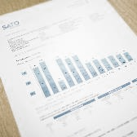




Types of Texts
Which one(s) are suitable for academic use?
Textbook
Official Report
Website
Newspaper
Magazine
Journal
article
E-Book
YUNI SARI AMALIA

Slide 5

Textbooks
Specifically designed to help the learner, for example, in starting to learn about a new topic and making summaries or reviews. Textbooks vary in style, tone and level depending on their audience.
YUNI SARI AMALIA

Slide 6
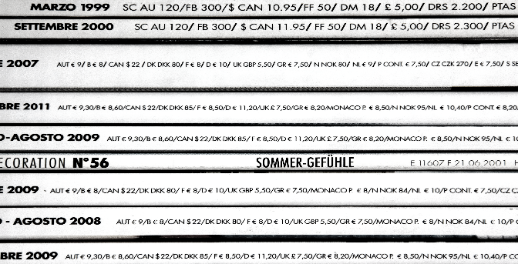
Journal Articles
Mainly written for a particular group of people such as academics, researchers and postgraduate students.
A Journal Article generally contains the following:
Introduction to the research
Literature review
Background to the research and methods
Results or main findings
Discussion, including authors' interpretation of the results
Recommendations: ideas for future research
Conclusion
Bibliography/References
Appendix (optional) to give information such as more complete tables of data from the research
YUNI SARI AMALIA

Slide 7

Official Reports
Aim to describe what happened (e.g. in a piece of research) and discuss as well as examine its significance. Reports are found in different disciplines, such as science, law and medicine.
Official Reports mostly include some or all of the following:
Context/Overview (Title, Contents etc.)
Introduction
Methodology/Description of the event (e.g. piece of research)
Findings/Main points
Discussion/Evaluation
Conclusion
YUNI SARI AMALIA

Slide 8







Other Examples of Academic Texts
Peer reviewed
articles
Reports
Essays
Literature reviews
Books
Conference papers
Research papers
Dissertation
and thesis
YUNI SARI AMALIA

Slide 9
Sustainable Transport for a Large Business: The Case of Leeds Metropolitan University
There were 2,287,540 students in UK higher education in 2004/2005. A high percentage live away from home, or come from abroad (some 318,395) and they are heavy consumers of transport. There were 109,625 full-time academic staff, and 51,030 part-time staff, plus many administrative and support staff. Higher education is a large foreign currency earner. It is big business. But some universities are massive, and equate with very large corporations both in their financial turnover, and in the environmental footprint generated by their transport activities.
Leeds Metropolitan University is a good example. It is one of the largest universities in the UK, with 52,000 students and 3,500 staff. Its turnover is about £135 million per annum. Of course, its economic impact is far larger than this, as the student body is not an insignificant proportion of the total population of the city, and they are all consumers and spenders. The university has three major campuses. One of the campuses is on the edge of the city, on a restricted site. A second campus is five miles north from the city centre, on an outstanding but inaccessible parkland site, while a third campus is fifteen miles away in Harrogate.
Source: Wetherly & Otter, 2008, p.221

Slide 10
Questions
What is the title of the text?
When was it published?
Who are the authors?
Who is the intended audience of the text?
What is the type of the text?
YUNI SARI AMALIA

Slide 11
1. Title
Sustainable Transport for a Large Business: The Case of Leeds Metropolitan University
There were 2,287,540 students in UK higher education in 2004/2005. A high percentage live away from home, or come from abroad (some 318,395) and they are heavy consumers of transport. There were 109,625 full-time academic staff, and 51,030 part-time staff, plus many administrative and support staff. Higher education is a large foreign currency earner. It is big business. But some universities are massive, and equate with very large corporations both in their financial turnover, and in the environmental footprint generated by their transport activities.
Leeds Metropolitan University is a good example. It is one of the largest universities in the UK, with 52,000 students and 3,500 staff. Its turnover is about £135 million per annum. Of course, its economic impact is far larger than this, as the student body is not an insignificant proportion of the total population of the city, and they are all consumers and spenders. The university has three major campuses. One of the campuses is on the edge of the city, on a restricted site. A second campus is five miles north from the city centre, on an outstanding but inaccessible parkland site, while a third campus is fifteen miles away in Harrogate.
Source: Wetherly & Otter, 2008, p.221
4. Audience:
-Students
-Researchers
-Government Officials
5. Type of Text: Official Reports
3. Authors
2. Date Published

Slide 12
Sources
Bailey, S. (2015). Academic writing: A handbook for international students.
https://flinders.libguides.com/c.php?g=492364&p=4501791

