Slide 1

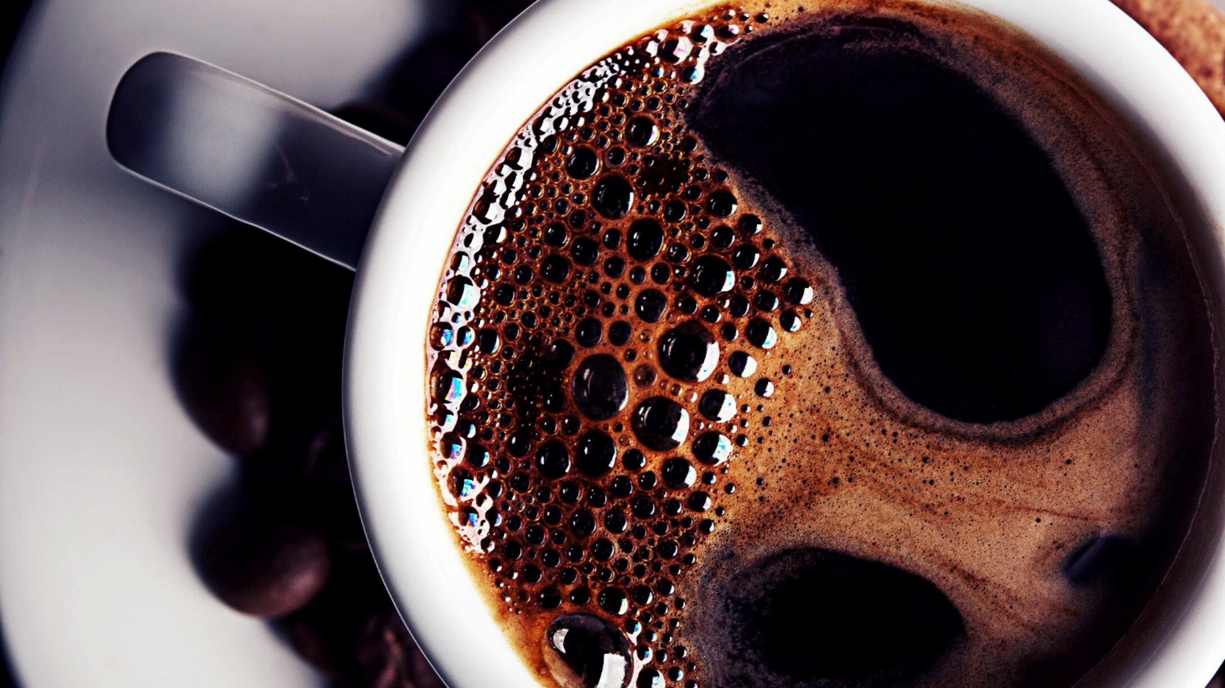
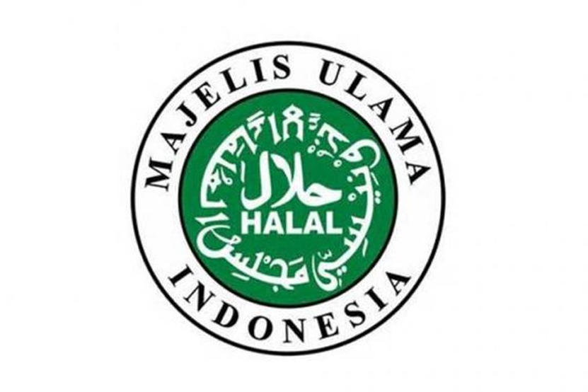
Halal, is not everything…
Dr. Gancar C. Premananto

Slide 2
Materi
Muslim consumers types
01
Halal clues
02
closing
03

Slide 3
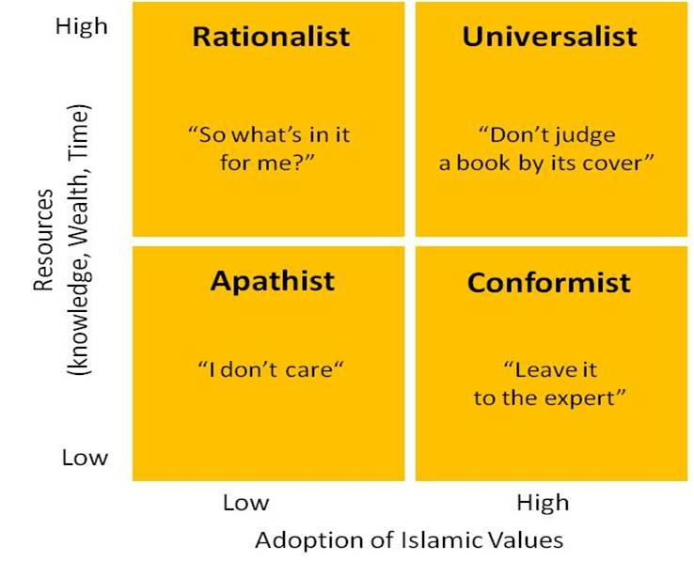
Segmentation of Muslim Consumers
Sumber: Yuswohadi (2014)

Slide 4
Halal Cues
For the Conformist, HALAL logo from MUI is a must. They have Halal app to check
For Universalist
- Is not just about HALAL logo from MUI, Sometimes other Halal logo is fine
Looking for Islamic Symbol such as, jilbab, kopiah haji, kaligrafi etc.
They give trust to others for halal cues
For Rationalist, as long it is not Pork and alcohol.
For Apathist, no problems at all

Slide 5
Type of Producers for Targeting Muslim
Best Producers: They have Good Intention to serve Muslim. They submit for Halal Logo MUI also
Seller: Just want to sell, doesn’t really care about marketing and logo
Opportunist: Serve where money go
Niche market: Serving small market

Slide 6
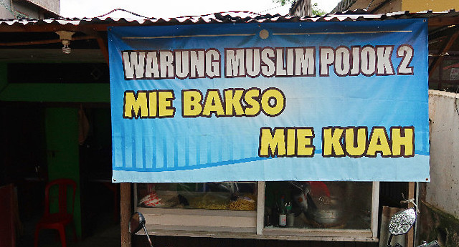


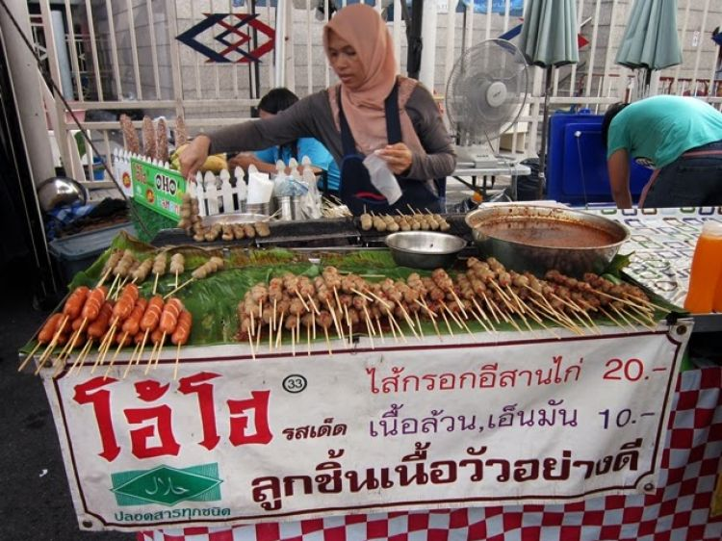
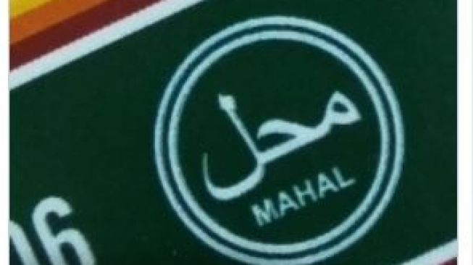
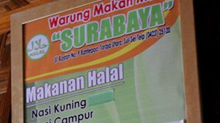
Different Marketing for different segmen

Slide 7
Closing
Heaven and Hell have leveling that give special place for specific man according to what they believe, think, feel and do, give us lessons about segmentation.

